Slide 1



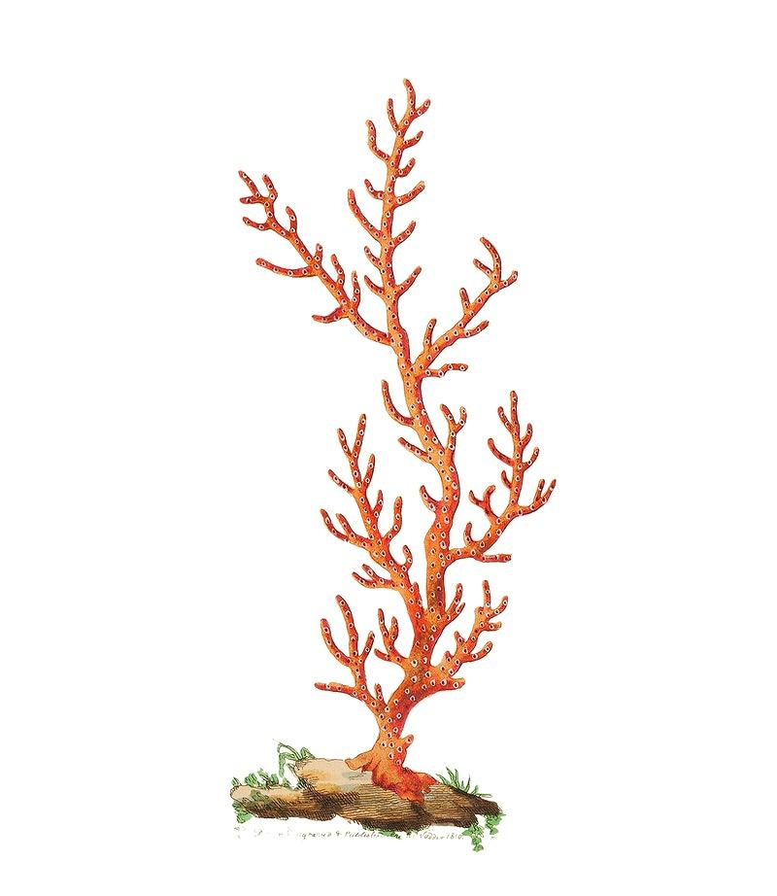
Zooxanthellae Resistance Using HSP70
Nadia Shah, Eva McKone, Abhay Yajurvedi, Jeffrey Conners
Andover High School, Andover, MA Mentor: Alberto Donayre
Introduction & Project Details
Experiments We Did &/or Planned
About Our Topic
Coral Bleaching
  Ejection of zooxanthellae
    Zooxanthellae supports coral health while coral provides a habitat for the zooxanthellae
      Symbiotic relationship
  Failed coral health
About Our Design
Transgenic microalgae
  Symbiodinium sp. algae
Temperature-induced promoter
Heat shock proteins (HSP’s)
Experiment details / plans
We would perform an experiment where we have a control group of coral and a treated group
After the experiment we would collect data on the portion of coral in each set that experienced bleaching
Then to see if our product produced statistically significant results we would perform a two-proportion Z-Interval

Slide 2
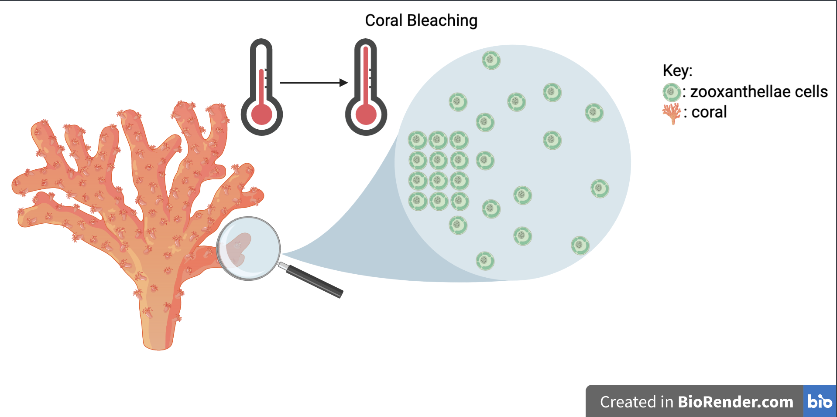
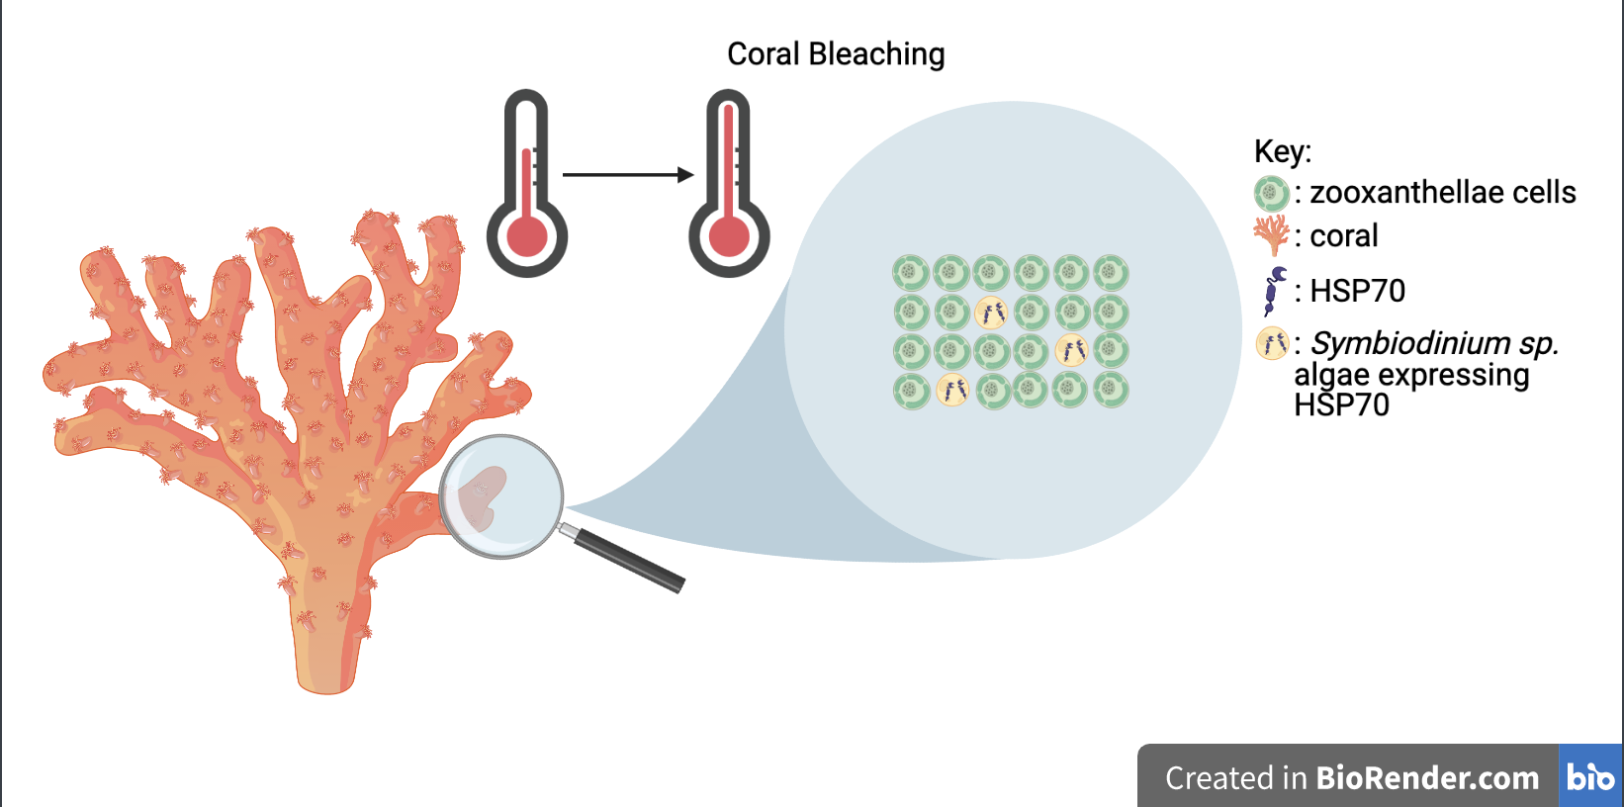
Zooxanthellae Resistance Using HSP70
Nadia Shah, Eva McKone, Abhay Yajurvedi, Jeffrey Conners
Andover High School, Andover, MA Mentor: Alberto Donayre
Challenge for Next Year’s Team
About This Year’s Team
Key things to consider:
  Creating a GMO to repair existing coral
  Apply construct to other problems that involve temperature change
  Conduct the actual experiment instead of theoretically doing it
Hello! We are a returning team from Andover High School
We are a motivated group with a passion for learning
References & Acknowledgements
We thank our mentor, Dr. Alberto Donayre, for assisting us in our research and our advisor, Lindsay L’Ecuyer for guiding us along our biological journey. In addition, we would like to extend our gratitude to BioBuilders for the opportunity to share our research. Finally, we would like to thank Dr. Khalid Shah for providing us a platform to create images.

