Slide 1


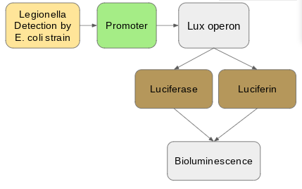
Bioluminescent Legionella Detector
Anya Mittal, Grace Xu, Hannah Tandang, Henry Tshabalala, Rohit Kommuru,
Samuel Dillon, Aashi Agarwal, Amanda Zhang, Apurva Joshi, Shirley Jin, Song Leav
Acton-Boxborough Regional High School, Acton, MA
Introduction & Project Details
Experiments We Did &/or Planned
Legionella is a common water-borne bacteria that contaminates drinking water, causing a deadly type of pneumonia called Legionnaires disease. To combat this problem, we are designing a system that can detect legionella in water, using bioluminescence to indicate whether the water is contaminated. Specifically, our system employs the use of the lux operon that will be turned on when it detects legionella in the water. Once the promoter of the operon is turned on, it will allow the production of luciferin and luciferase, both of which will react and create bioluminescent light.
We were not able to test this system this year, but our plan would be to mix our transformed e-coli with a solution containing water and legionella, and observing whether light is produced.

Slide 2
Bioluminescent Legionella Detector
Anya Mittal, Grace Xu, Hannah Tandang, Henry Tshabalala, Rohit Kommuru,
Samuel Dillon, Aashi Agarwal, Amanda Zhang, Apurva Joshi, Shirley Jin, Song Leav
Acton-Boxborough Regional High School, Acton, MA
Challenge for Next Year’s Team
About This Year’s Team
Needs for advancing the project:
  Specifics of legionella detection
  Parts of promoters/operons
Future experimentation (for other teams):
  Finish design by identifying specific parts from registry or found in the wild.
  Test and compare potential aspects of the system for specificity, sensitivity etc.
  Test the system at different concentrations of legionella to find out the sensitivity (we may need partner with a university lab for lab safety purposes).
Leaders: Apurva Joshi, Samuel Dillon, Rohit Kommuru
Returning Members: Anya Mittal, Hannah Tandang, Song Leav, Amanda Zhang, Grace Xu
New Members: Henry Tshabalala, Shirley Jin, Aashi Agarwal
References & Acknowledgements
Acknowledgements:
Will Beeson (Mentor)
Aaron Mathieu (Teacher/Advisor)
References:
“Bioluminescent and Fluorescent Reporters in Circadian Rhythm Studies.” Reporter Review, ccb.ucsd.edu/the-bioclock-studio/education-resources/reporter-review/.
Brodl, Eveline, et al. “Molecular Mechanisms of Bacterial Bioluminescence.” Computational and Structural Biotechnology Journal, Research Network of Computational and Structural Biotechnology, 15 Nov. 2018, www.ncbi.nlm.nih.gov/pmc/articles/PMC6279958/.
Kuhnert P;Heyberger-Meyer B;Burnens AP;Nicolet J;Frey J; “Detection of RTX Toxin Genes in Gram-Negative Bacteria with a Set of Specific Probes.” Applied and Environmental Microbiology, U.S. National Library of Medicine, pubmed.ncbi.nlm.nih.gov/9172345/.
Ripp, S., et al. “Bioluminescent Bioreporter Integrated Circuit (BBIC) Sensors: Semantic Scholar.” Undefined, 1 Jan. 1970, www.semanticscholar.org/paper/Bioluminescent-bioreporter-integrated-circuit-Ripp-Moser/c54df4d5a563dee02dc89121524740c2d851db3f.
Weber, Stefan S., et al. “Identification of Protective B Cell Antigens of Legionella Pneumophila.” The Journal of Immunology, American Association of Immunologists, 15 July 2012, www.jimmunol.org/content/189/2/841.

