Slide 1
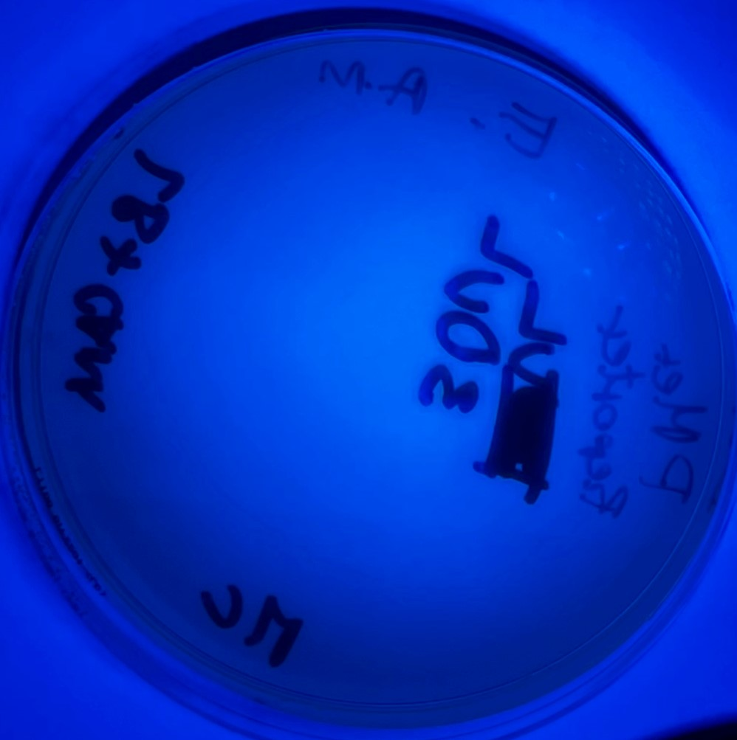
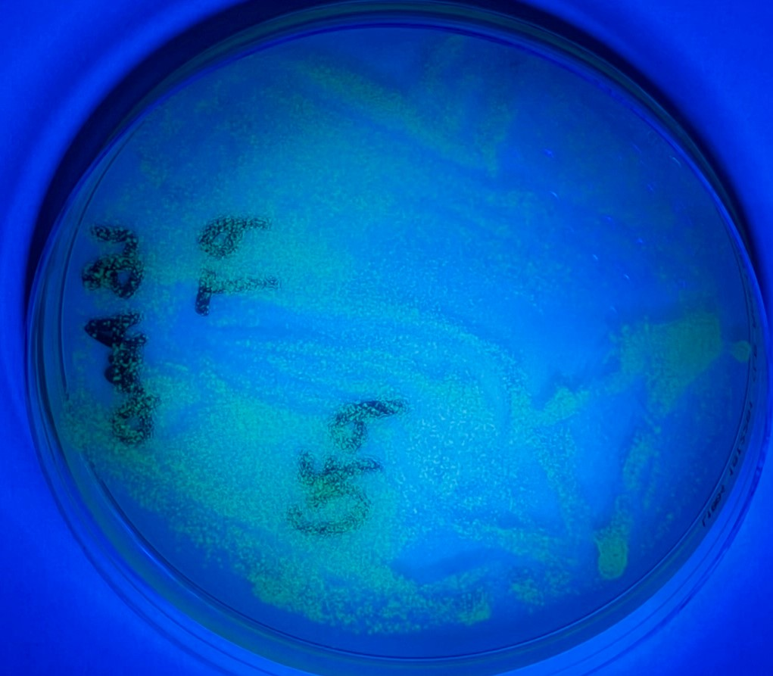
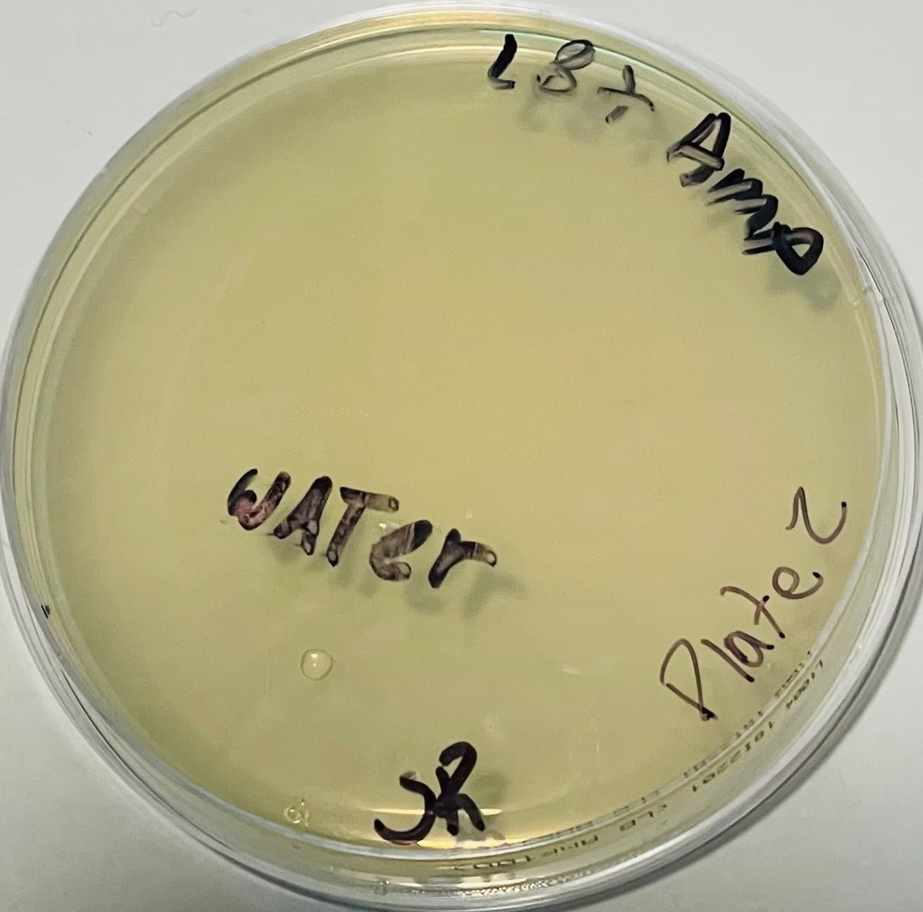
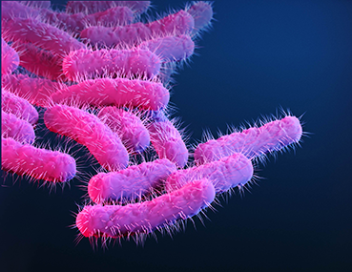
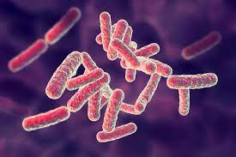

Developing a Whole-cell Biosensor and Bioreporter to Monitor Mercury from the Environment
Students: Sergio Avila, Mangal Maibam, Ricardo Rengifo, El Momar Cound0ul , Valeria Hidalgo,Thte Htar Swe Zin, Rosa Toledo and Angel Molina
Team leader: Alfred Lwin Mentor: Racquel Kim Sherwood PhD
School: Manhattan Comprehensive Night and Day High School, New York, NY
Project Rationale: Mercury, a toxic heavy metal, can be a contaminant in drinking water worldwide. Current methods utilized to detect and eliminate mercury contamination are not practical for detecting and removing it from large bodies of water and are costly. However, biosensors, bioreporters, and bioremediation would be ideal for identifying mercury contamination and removing it inexpensively. With that in mind, our team wants to contribute to the first step in this process, developing a cost-effective mercury biosensor and bioreporter.
Our Research Goal: We will use synthetic biology approaches to engineer a mercury-responsive biosensor capable of producing a GFP signal when it detects mercury contamination in water.
Techniques: Our literature reviews showed the Pseudomonas strain K-62 to be 100 times more resistant to mercury than E.coli. Therefore, we used a bioreporter construct (Bba_175843) encoding genes from the Mer R operon from Pseudomonas spp. The sensor module constitutively expresses the MerR sensor protein. And in the presence of mercury, this sensor protein promotes the expression of the mercury-responsive promoter, pMer (Bba_K346002), upstream of GFP, in the output/reporter module. See below.
Bba_175843 from the iGEM registry of parts was transformed into DH5⍺ competent E.coli cells and plated under chloramphenicol selection at the BioBuilder Lab. Transformants we incubated at room temperature for 48 hours and visualized using a blacklight.
Transformation Results: We observed many small, non-fluorescent biosensor/bioreporter colonies growing in the absence of mercury. Our positive control plate yielded many small GFP fluorescent colonies (they received a plasmid construct that constitutively expresses GFP.) Our negative control competent cells were transformed with water and did not yield any colonies when grown on selective media. See below.
Theoretical Test and Anticipated Results: We could not test our bioreporter function due to mercury toxicity. However, if we could have, we would plate patches of transformants on LB + Chloramphenicol plates top-spread with different concentrations of Mercury nitrate solution and compared it to cells patched on regular LB + Chloramphenicol plates. If our bioreporter worked, we would anticipate that those patches would glow green in the presence of mercury and would not fluoresce on media lacking mercury. See theoretical results on the right.
Technical Need and Limitation: Our most significant technical limitation was due to the toxicity of mercury. As a result, there was no way to obtain mercury solution and safely test it. As a result, we have provided theoretical testing data.
Theoretical Results
GFP
(+ Control)
Hg Biosensor
- Hg
Biosensor + Reporter
Positive Control
Negative Control
INSERT PICTURE HERE
+ Hg
Results
We successfully transformed our chassis E.coli with a mercury biosensor and bioreporter, and a constitutively expressed GFP plasmid, as a positive control. Due to the toxicity of mercury, we could not test the function of our system. However, we hypothesize that our bioreporter patches would turn green when incubated in the presence of mercury. Whereas our GFP control would fluoresce regardless of the presence or absence of mercury.
BBa_K1758343
p70a-deGFP
BBa_K1758343
Sensor Module
Pc = Constitutively expressed promoter.
MerR = Mercury sensor, bind Hg ions.
Output/Reporter Module
pMer = Mercury responsive promoter.
GFP = Green Fluorescent Protein.

