Slide 1


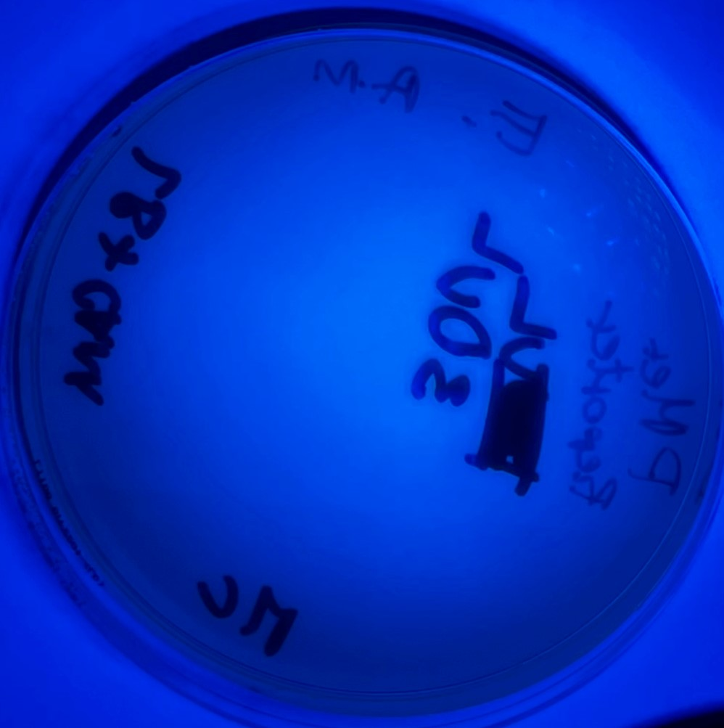
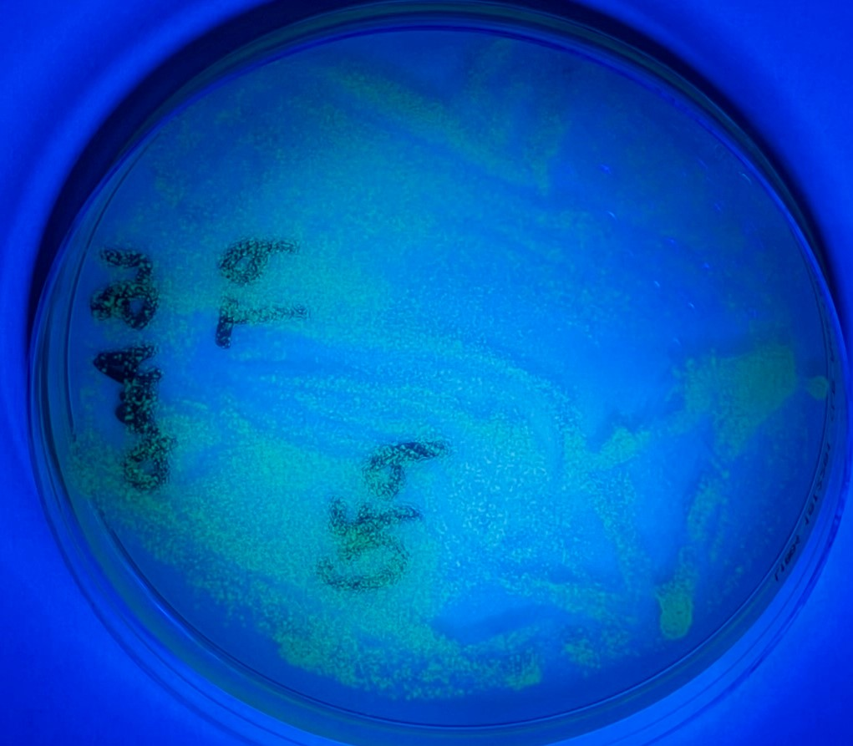
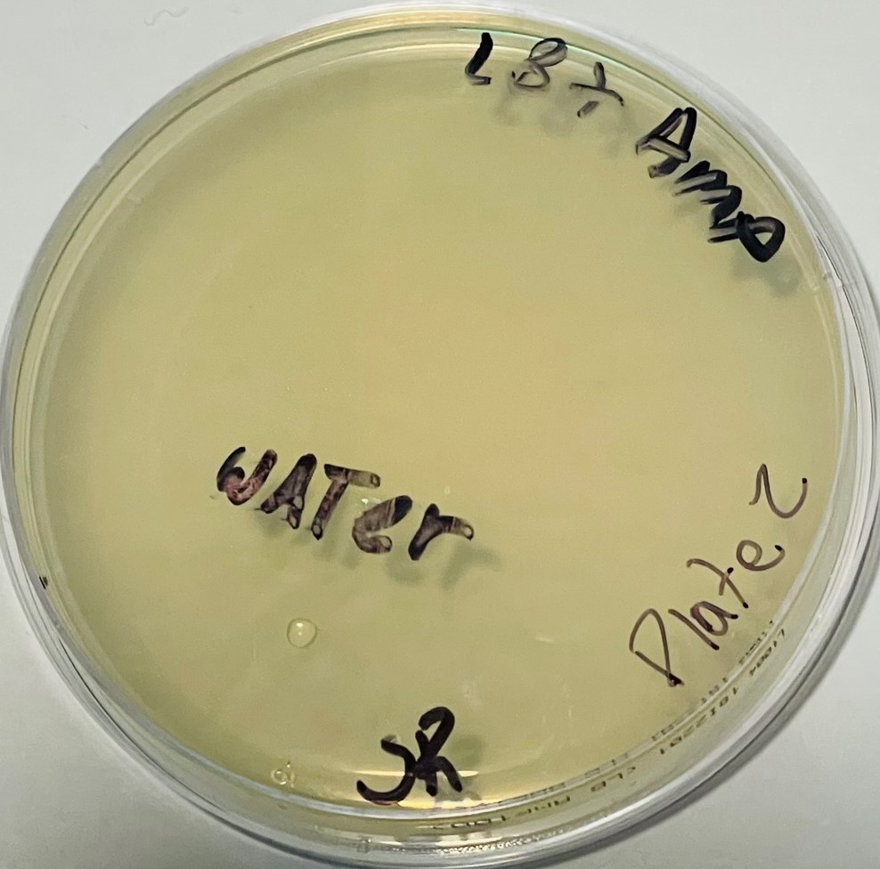
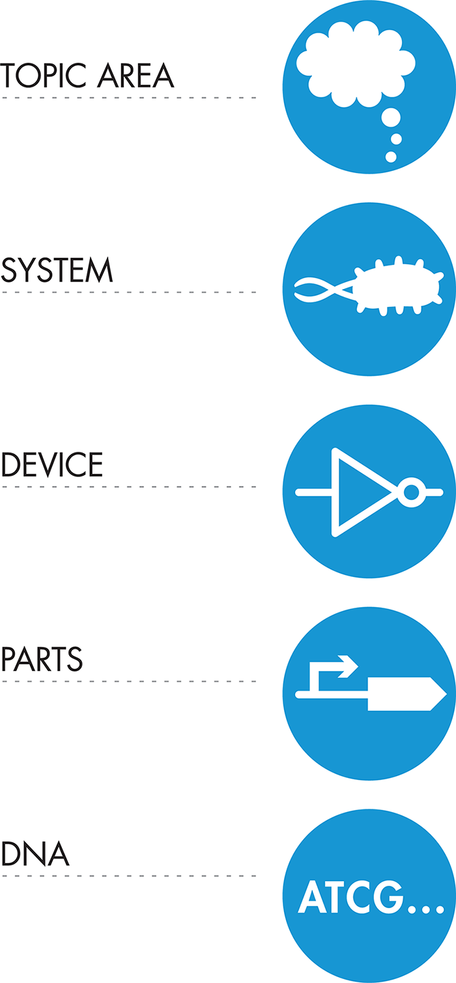
Developing a Whole-cell Biosensor and Bioreporter to Monitor Mercury from the Environment
Students: Sergio Avila, Mangal Maibam, Ricardo Rengifo, El Momar Coundoul , Valeria Hidalgo,Thte Htar Swe Zin, Rosa Toledo and Angel Molina
Team leader: Alfred Lwin, Mentor: Racquel Kim Sherwood
School Name: Manhattan Comprehensive Night and Day High School, New York, NY
Abstract
Mercury is one of the most toxic and highly bioaccumulative contaminants in the environment. This heavy metal poses a greater risk to the marine environment and human health. Mercury is a naturally occurring metal, but human activities result in mercury pollution in the environment, especially in developing countries. Research shows that currently available technologies to remove mercury from the environment are expensive and produce a large amount of waste. However, synthetic biology techniques can provide a solution to detecting and removing mercury from the environment through bioremediation. These methods will be less expensive and an environmentally safe option to detect, monitor and ultimately remove mercury pollutants. Therefore, our MCNDHS team engineered the first step in this process and developed a whole-cell biosensor and bioreporter capable of detecting environmental mercury contaminants. Our literature review showed that the Pseudomonas strain K-62 is 100 times more mercury-resistant than E.coli. Therefore, we used a bioreporter construct (Bba_K1758343 – See below) encoding genes from the Mer R operon from Pseudomonas spp. The sensor module consists of constitutively expressing the MerR sensor protein. And in the presence of mercury, this sensor protein activates the expression of the mercury-responsive promoter, pMer (Bba_K346002)—this promoter is upstream of GFP, in the output/bioreporter module. Bba_K1758343 was obtained from the iGEM registry of parts and transformed into a DH5⍺ competent E.coli cell chassis and plated under chloramphenicol selection at the BioBuilder Lab. Transformants were incubated at room temperature for 48 hours and visualized using a blacklight. Due to mercury toxicity, we have provided theoretical results demonstrating that we anticipate GFP expression when our biosensor and bioreporter are incubated in the presence of mercury.
Building a Biosensor and Bioreporter
Transformation: Materials and Methods
1) Collect competent cell and plasmid DNA and incubate them on ice for 30 mins.
2) Gently aspirate 2µl of plasmid (Experimental - Bba_K1758343 / Positive control -
p70a-deGFP / Negative control - Water), add to competent cells and flick to mix.
4) Incubate cell + Plasmid mix on ice for 30 minutes. Do not mix.
5) Heat shock at exactly 42°C for exactly 30 seconds. Do not mix.
6) Place on ice for 5 minutes.
7) Add 950 µl of room temperature LB medium to the transformation tube.
8) Place in a shaking incubator at 37°C for 60 minutes.
9) Using a spreader to distribute transformed cells onto a selection plate.
10) Incubate at room temperature for 24-36 hours. Store plates in the refrigerator.
11) Photo document transformation plates illuminated by a blacklight.
Transformation Results
We observed many small, non-fluorescent biosensor/bioreporter colonies growing on selective plates. Our positive control plate yielded many small GFP fluorescent colonies (they received a plasmid construct that constitutively expresses GFP.) Our negative control competent cells were transformed with water and did not yield any colonies when grown on selective media. See below.
Biosensor + Reporter
Positive Control
Negative Control
BBa_K1758343
Chassis
E. coli
BBa_K1758343
p70a-deGFP
Transformation Plates
- Control = Water
+ Control= GFP producer
Bioreporter

Slide 2
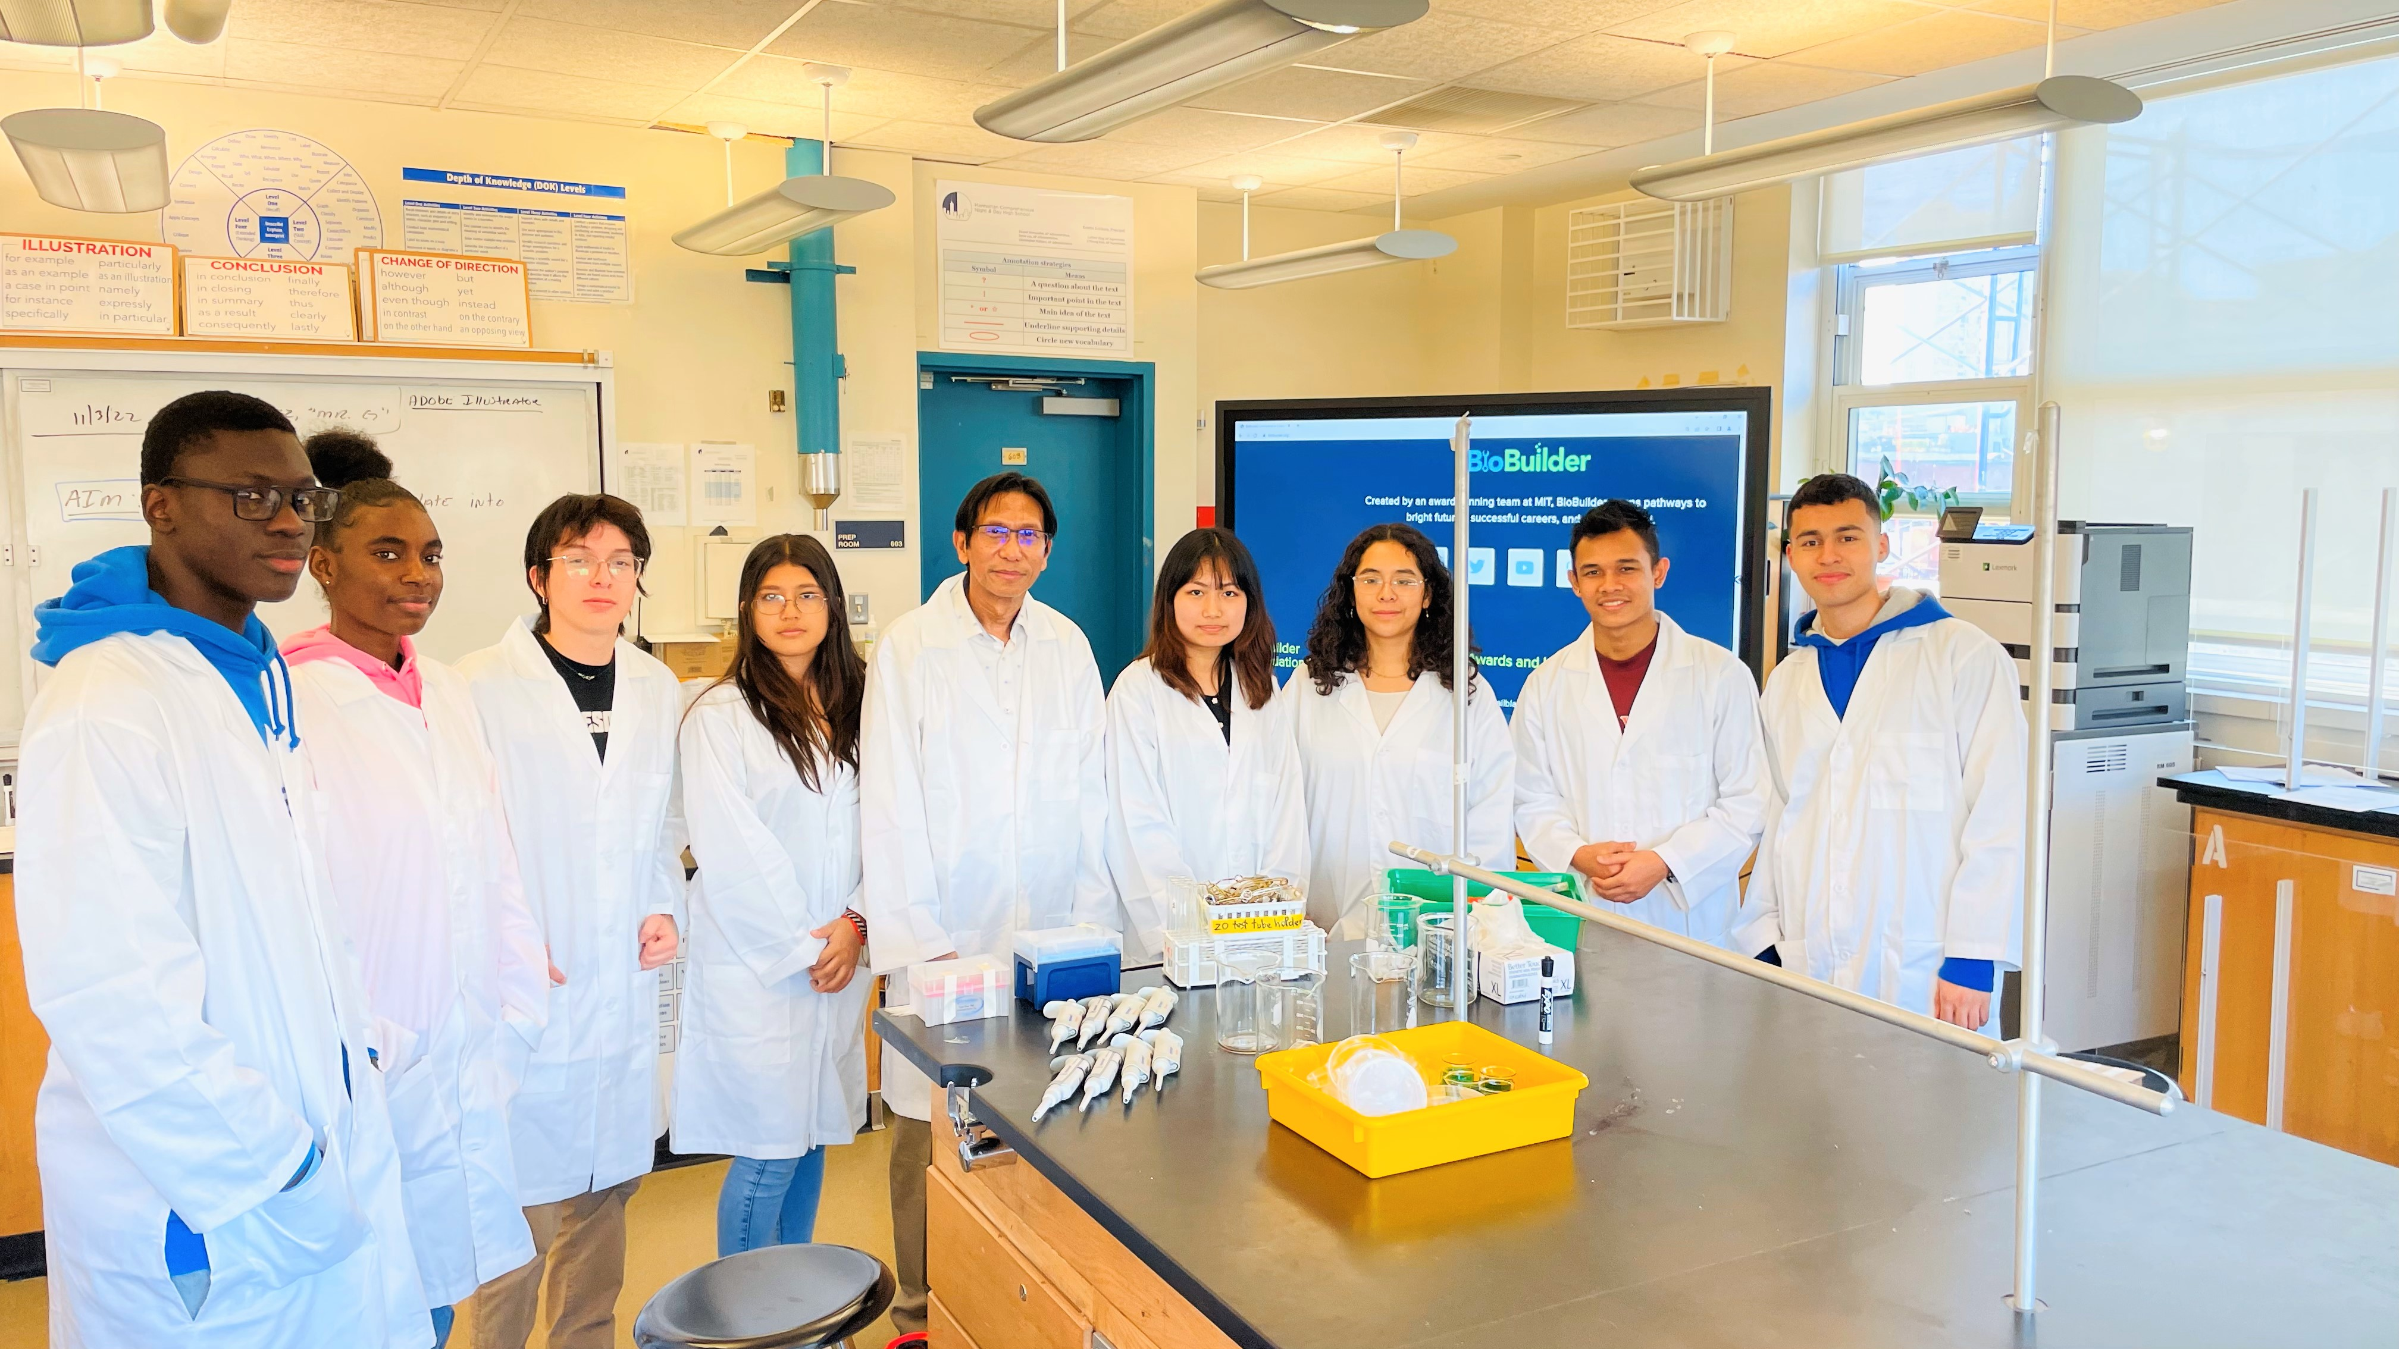
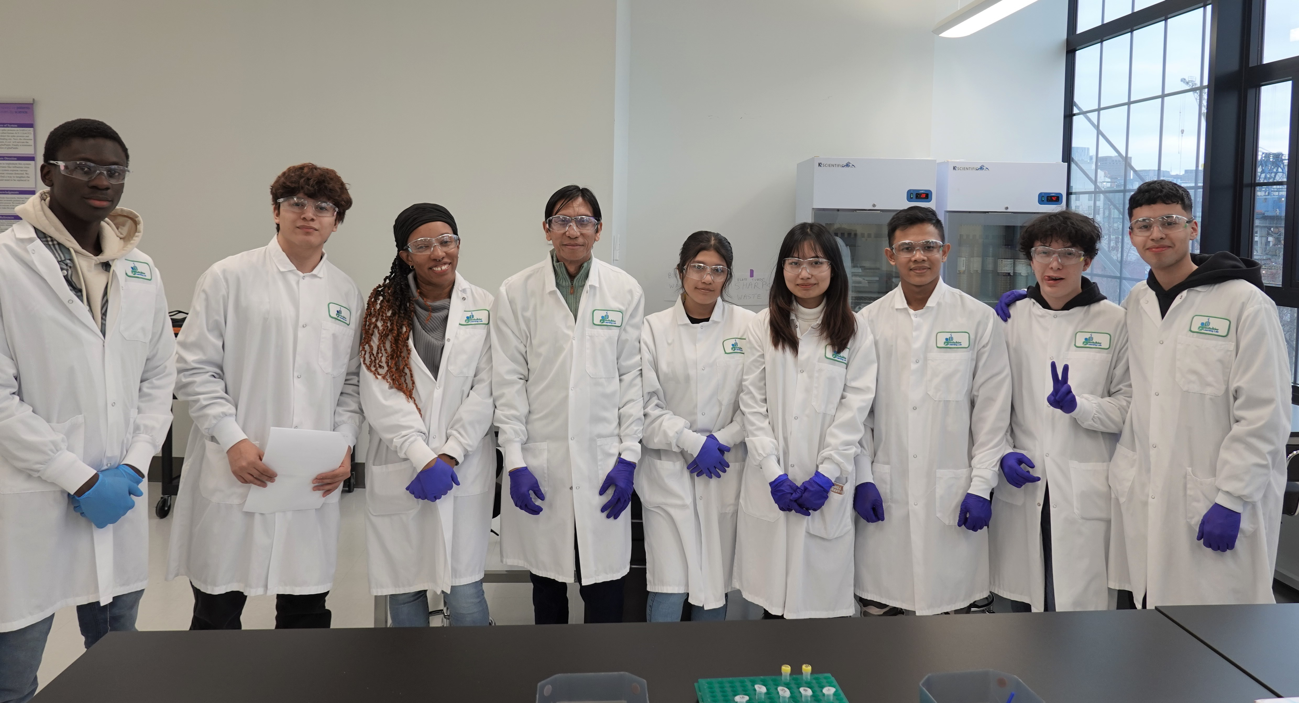
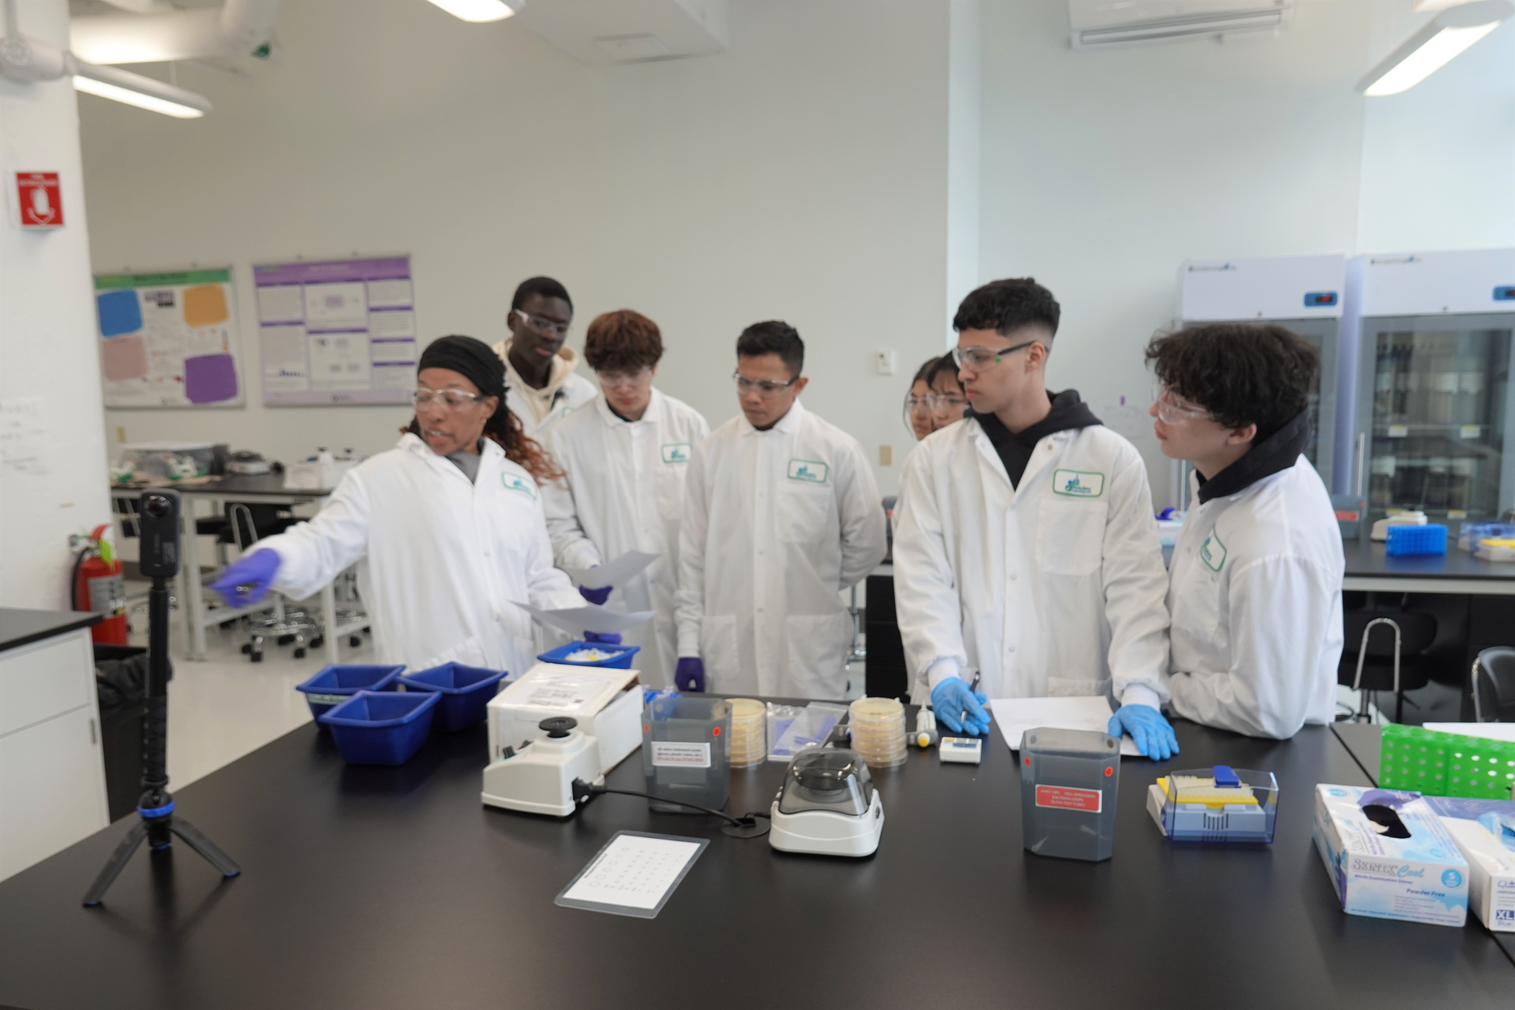
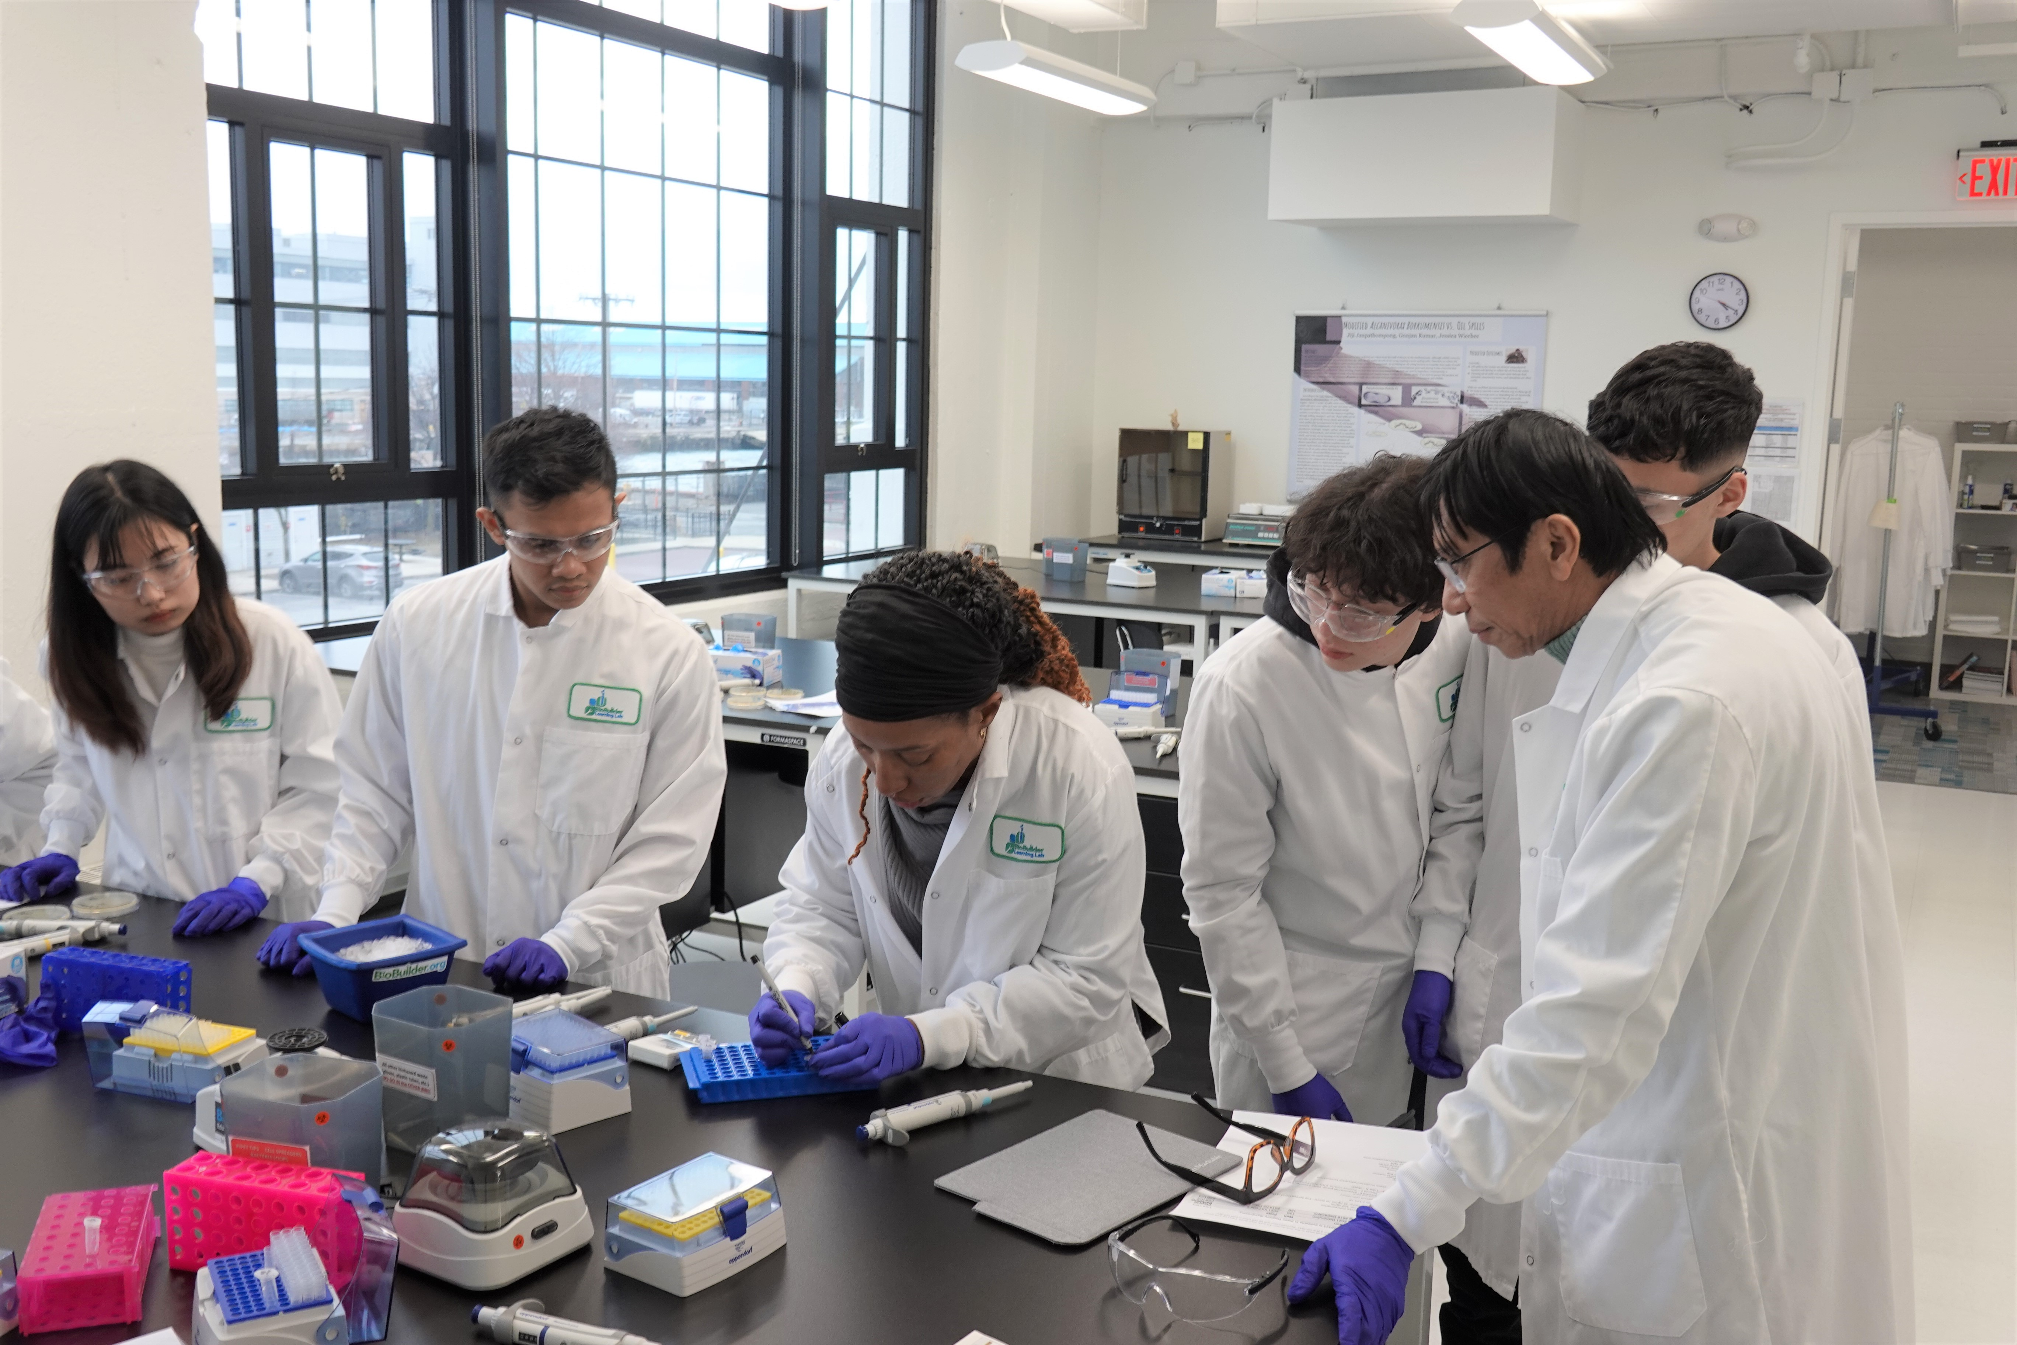
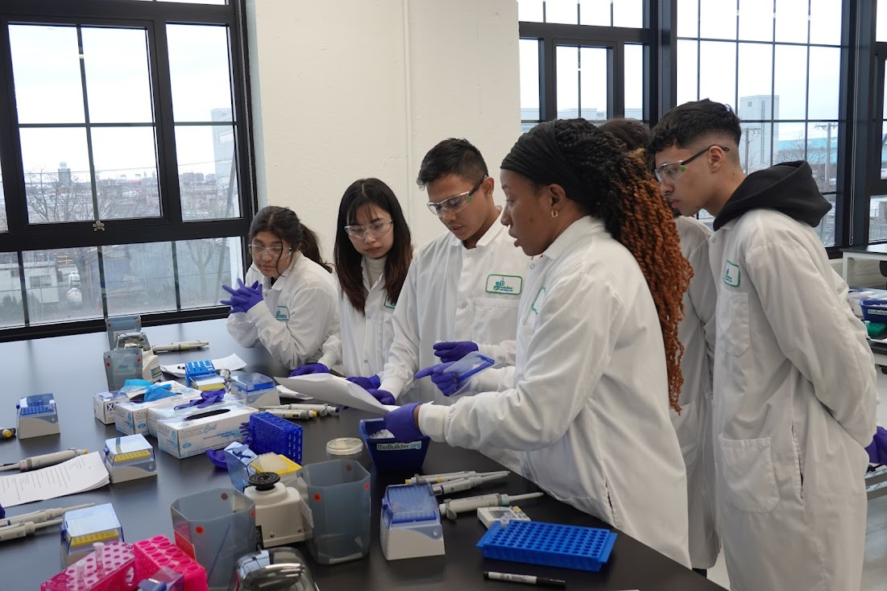
Testing Biosensor and Bioreporter
Theoretical Methods
We could not test our biosensor and bioreporter function due to mercury toxicity. However, we present our theoretical methods and results below.
1) Spread 100μl of each mercury nitrate solution (0-5 drops) onto individual plates onto
LB+Amp and LB+ Chloramphenicol. Allow plates to ‘dry.’
3) Use an inoculation loop to patch the GFP producer or engineered cells onto selective plates.
4) Incubate @ 37ºC O/N @ room temp.
5) Illuminate patches on the plate with blue light in a dark room.
6) Take a picture to record fluorescence.
Conclusion
We successfully transformed our chassis E.coli with a mercury biosensor and bioreporter and a constitutively expressed GFP plasmid as a positive control. Due to the toxicity of mercury, we could not test the function of our system. However, we hypothesize that our bioreporter patches would turn green when incubated with mercury. In contrast, our GFP control would fluoresce regardless of the presence of mercury. Our MCNDHS BioBuilder team has tremendously learned from this BioBuilder project.
Anticipated Results
If our bioreporter worked, we would anticipate that those patches would glow green in the presence of mercury and would not fluoresce on media lacking mercury.
Hg Biosensor and Reporter
GFP Reporter
(+ Control)
Acknowledgements
Our MCNDHS BioBuilder Team very much would like to express our heartfelt thanks to Dr. Natalie Kuldell and Stephanie Ovitt for their advice and support. We are greatly indebted to our mentor Racquet Kim Sherwood for her tireless mentoring throughout the project. Our profound thanks to Ms. Margaret Aylward and Mr. Robert, and the CYD team for their generous funding for the project, and our heartfelt thanks to Ms. Erickson, Ms. Nam, Ms. Hernandez, Ms. Lau, and all the faculty for their support.
Reference
Registry of Standard Biological Parts
parts.igem.org. (n.d.). https://parts.igem.org/
Mercury Contamination of Aquatic Environments https://www.usgs.gov/special-topics/water-science-school/science/mercury-contamination-aquatic-environments
Fundamentals of Biodesign https://biodesign.stanford.edu/programs/stanford-courses/biodesign-fundamentals.html
The Molecular Biology Toolkit https://bmcbioinformatics.biomedcentral.com/articles/10.1186/1471-2105-6-21
Development of a cell-free Optical Biosensor for detection of a Broad Range of Mercury Contaminants in Water:A Plasmid DNA-Based Approach https://pubmed.ncbi.nlm.nih.gov/31460039/
Detection of Mercury in Aquatic Environments Using EPRE Reporter Zebrafish https://www.ncbi.nlm.nih.gov/pmc/articles/PMC8898586
Gupta, S., Sarkar, S., Katranidis, A., & Bhattacharya, J. (2019). Development of a Cell-Free Optical Biosensor for Detection of a Broad Range of Mercury Contaminants in Water: A Plasmid DNA-Based Approach. ACS Omega, 4(5), 9480–9487. https://doi.org/10.1021/acsomega.9b00205
Mercury Poisoning Kills Lab Chemist https://www.science.org/content/article/mercury-poisoning-kills-lab-chemist
Mercury in drinking water https://www.epa.gov/mercury/health-effects-exposures-mercury
Nucifora, G., Chu, L., Silver, S., & Misra, T. K. (1989). Mercury operon regulation by the merR gene of the organomercurial resistance system of plasmid pDU1358. Journal of Bacteriology, 171(8), 4241–4247. https://doi.org/10.1128/jb.171.8.4241-4247.1989
Fan, C., Zhang, D., Mo, Q., & Yuan, J. (2022). Engineering Saccharomyces cerevisiae-based biosensors for copper detection. Microbial Biotechnology, 15(11), 2854–2860. https://doi.org/10.1111/1751-7915.14105
Fan, C., Zhang, D., Mo, Q., & Yuan, J. (2022). Engineering Saccharomyces cerevisiae-based biosensors for copper detection. Microbial Biotechnology, 15(11), 2854–2860. https://doi.org/10.1111/1751-7915.14105
IGEM. (n.d.). Igem.org. Retrieved March 14, 2023, from http://igem.org
- Hg
+ Hg
- Hg
+ Hg

