Slide 1

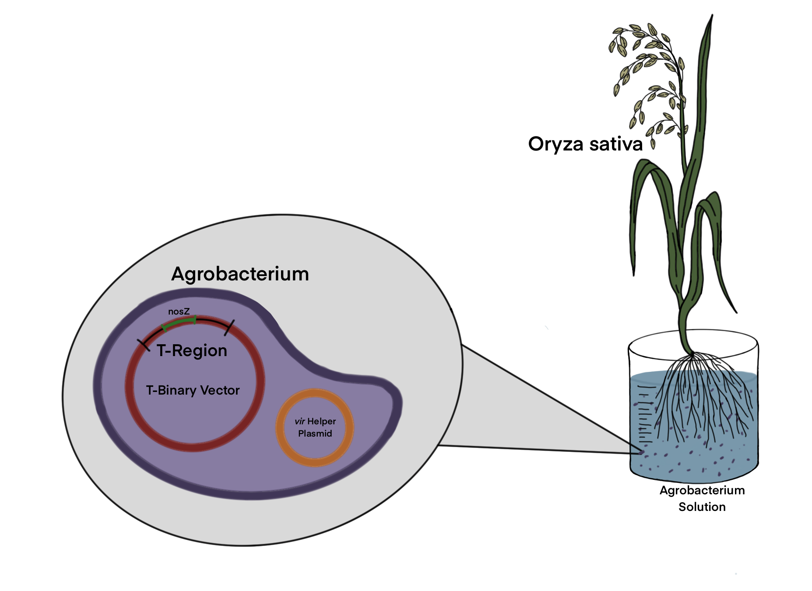
greeN2grOw
Angela Benzigar, Katya Luchette, Olivia Tagg, Audrey Weaver,
Junhao Zhang
Western Reserve Academy, Hudson, OH
Introduction & Project Details
Experiments We Planned
Nitrous oxide is a harmful greenhouse gas which lingers within the atmosphere for elongated periods before its decomposition. N₂O is produced by the burning of fossil fuels as well as the production and use of fertilizer.
A possible solution involves using Agrobacterium-mediated transformation to transform a plants genome to express the enzyme nitrous oxide reductase (N₂OR) from the soil bacterium Pseudomonas stutzeri.
The gene expression for N₂OR (NosZ) will be inserted into a disarmed Ti-plasmid existent within the Agrobacterium tumefaciens.
As the bacterium infects the plants, our selected enzyme will be transformed into a plants genome in order to take nitrous oxide from the atmosphere to digest it into nitrogen gas.
On the most basic level, the modified plant will do the following:
  N₂O –[Nitrous Oxide Reductase]–> N₂
Our plants will reduce the levels of harmful nitrous oxide and release harmless dinitrogen.
As one of the most popular farmed crops, our experiments will target Oryza sativa (rice) and the enzyme expression remains constant by using the root-specific rolD promoter from Agrobacterium rhizogenes
Floral-dip technique to transfer the agrobacterium into a subject rice plant - directly transfers gene of interest into rice plant’s reproductive cells
PCR to check if the plant is transformed
RT-PCR to check if the nosZ gene is transcribed into RNA
Western Blot to check if the nosZ gene is translated into protein
Methyl viologen linked assay to check if nosZ protein works in anaerobic environment

Slide 2


greeN2grOw
Angela Benzigar, Katya Luchette, Olivia Tagg, Audrey Weaver,
Junhao Zhang
Western Reserve Academy, Hudson, OH
Challenge for Next Year’s Team
About This Year’s Team
Current technology is not reliable enough to completely support our original, ambitious goal to transform nitrogenase and nitrous oxide reductase into a plant. Based on our current research:
  The t-region within T-binary plasmids is not able to accommodate both genes and their operons because each gene segment requires its own promoter taking up thousands of bp, limiting available space in the t-region to insert all of our genetic material.
  Nitrogenase funtions in an anaerobic environment; however, there have been studies done that show potential targeting the mitochondria or chloroplasts of host cells to circumvent this issue.
  Checking that our desired genes are successfully inserted into the T-binary plasmid
    Checking the specific genes, promoters, and regulators with PCR would be difficult due to the sheer number of working parts, but without this, all problems thereafter cannot be easily identified or addressed
Angela (‘22) : Second Year of BioBuilder from Twinsburg, OH
Audrey (‘22) : First Year of BioBuilder from Denver, CO
Junhao (‘22): First Year of BioBuilder from Chongqing, China
Katya (‘22): Second Year of BioBuilder from Aurora, OH
Olivia (‘22): First Year of BioBuilder from Lodi, OH
References & Acknowledgements
Dr. Beth Pethel, who guided us through our research process
Dr. William Beeson, our mentor

