Slide 1
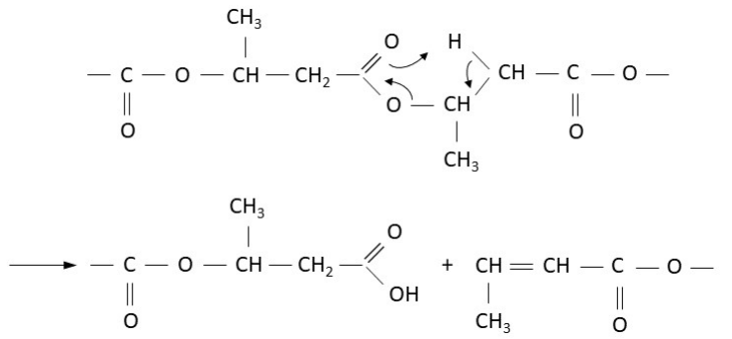
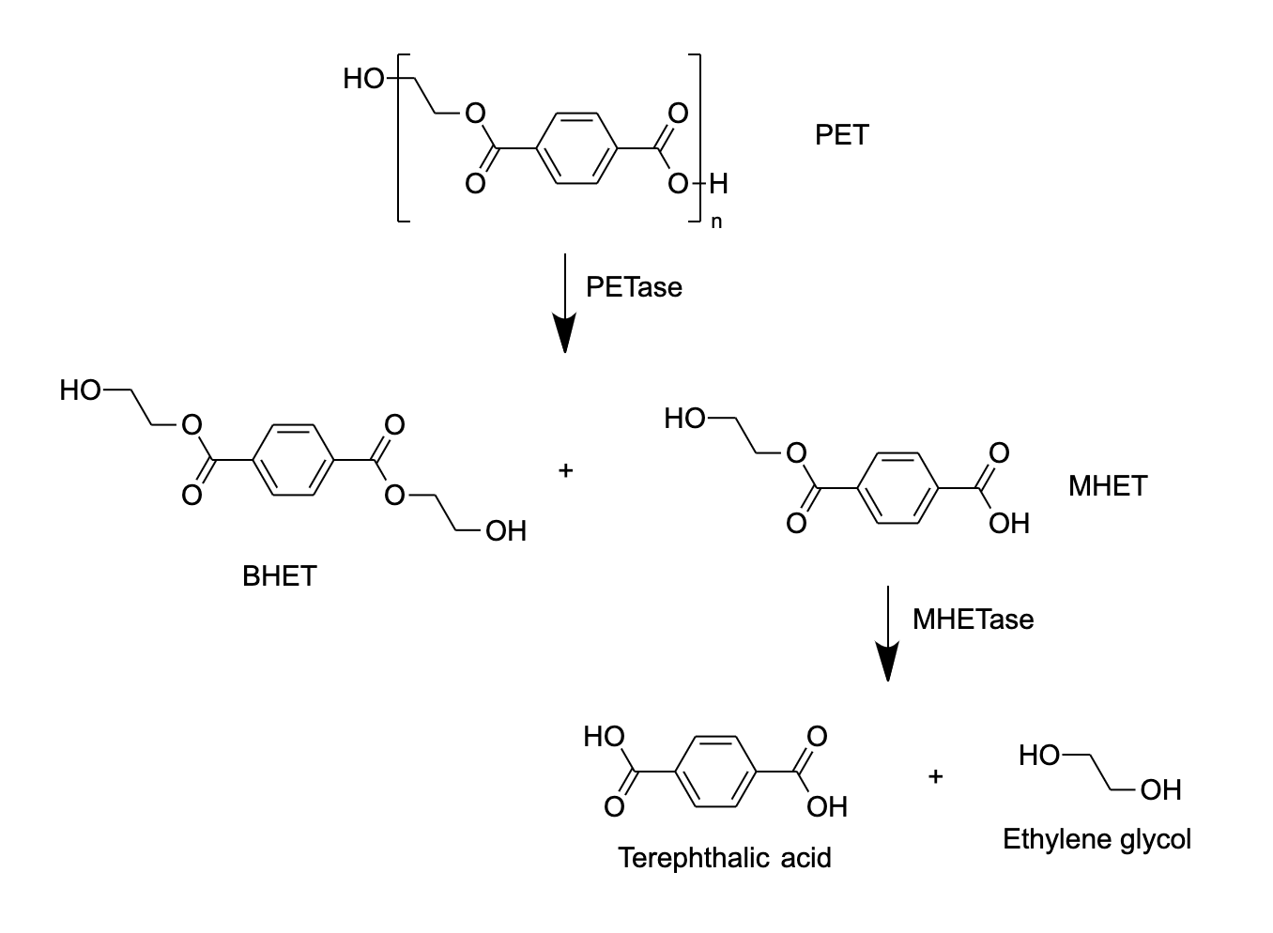
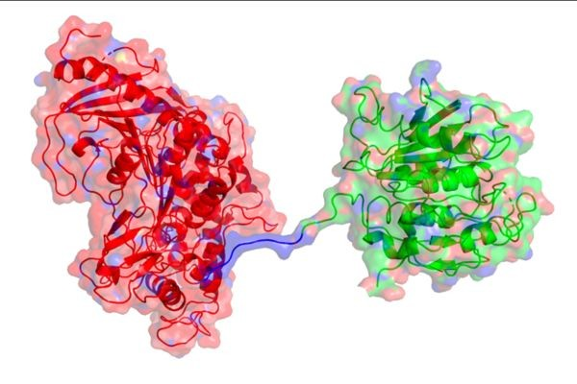

Investigations into creating more widely applicable plastic degradation tools
Anna Lian, Megan Malur, Risa Nawa, Jessy Wang, Irene Wu, Jacob Ye, Jessie Yuan, Yash Agarwal, Jonathan Lan, Dimitra Papageorgiou, Ellie Tillman-Schwartz, Chloe Zhong
Weston High School, Weston MA
Introduction & Project Details
Experiments Planned
Over 300 million tons of plastic are produced annually
Plastic takes centuries to degrade—current methods of plastic degradation are used for commercial recycling purposes, and are not widely applicable to different forms of plastic.
Not only are current recycling methods inefficient, they are also unsustainable and expensive.
To combat this issue, we investigated an enzyme capable of degrading polyethylene terephthalate (PET) plastic called PETase, and researched ways to use it to degrade more crystalline plastics such as PVC.
We also investigated the enzyme PHB depolymerase, which can break down other types of hard plastics like PVC, from the fungus Aspergillus fumigatus. We aim to introduce this enzyme into the bacteria Ideonella sakaiensis which contains PETase and MHETase.
The design also integrated past advances in this area by using the linked MHETase and PETase structure (Figure 3), created by a team from the University of Portsmouth center for enzyme innovation.
We researched possible drawbacks to engineering organisms in such a way. This included which combinations will decrease the efficiency of the enzyme in breaking down the plastic and which combinations would increase it, as well as whether and by how much it would increase the production costs.
Genetically engineer bacteria to produce the novel combination of enzymes
  Stimulate production of all enzymes in bacteria
  Remove enzymes from bacteria through lysis
Testing enzyme combination on different types of plastic, including PET and PVC
  Find the environmental conditions that allow the enzyme to operate most efficiently by changing: temperature, humidity, pH, and concentration.
  Build in purification mechanism that isolates target enzymes to create more pure solutions.
Figure 1: mechanism of PHB depolymerase
Figure 2: mechanism of PETase + MHETase
Figure 3: structure of genetically engineered linked MHETase and PETase
Figure 1: Dos santos, Antonio José, et al. "From Obtaining to Degradation of PHB: A Literature Review. Part II." Ingeniería Y Ciencia, vol. 14, no. 27, June 2018, pp. 207-28, https://doi.org/10.17230/ingciencia.14.27.9. Accessed 8 Feb. 2022.
Figure 2: created with ChemDraw
Figure 3: "Unique Enzyme Combination Could Reduce Global Plastic Waste." The Science Times, 29 Sept. 2020, www.sciencetimes.com/articles/27500/20200929/enzyme-pac-men-reduce-plastic.htm. Accessed 8 Feb. 2022.
Notes:
Maybe add how enzyme would react to changing environmental situations such as humidity and temperatures.
In 2020, an estimated 367 million tons of plastics were produced globally. Plastics take centuries to naturally degrade, and only a small percentage is recycled. This pollution buildup makes it necessary to create more efficient and broadly applicable plastic degradation methods. In our project, we investigated the known plastic degradation enzyme, petase, known for reducing the degradation time of polyethylene terephthalate (PET) plastics, and researched ways to redesign them so that the enzyme could also be used to degrade other plastic types, including crystalized plastics such as polyvinyl chloride (PVC). We decided it might be possible to introduce enzymes found in fungus Aspergillus fumigatus such as PHB depolymerase, which can break down hard plastics such as PVC, to the bacteria ideonella sakaiensis, which contains petase and mhetase. Some drawbacks of this biological engineering that may occur is a decrease in efficiency of the original degradation processes, as well as an increase in recycling costs. However, we believe that creating more widely applicable plastic degradation tools in this field is still extremely important, as it lays down the groundwork to refine the process, increasing efficiency and decreasing costs.

Slide 2
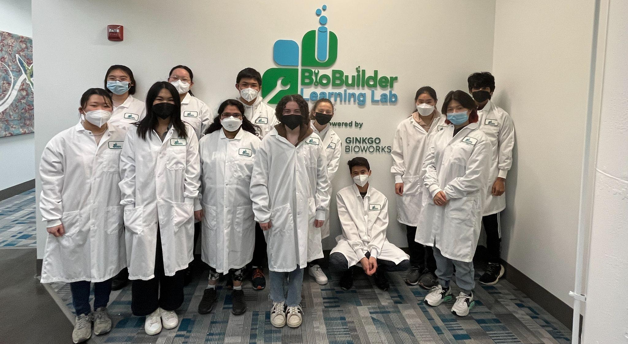


Investigations into creating more widely applicable plastic degradation tools
Anna Lian, Jessie Yuan, Jessy Wang, Irene Wu, Risa Nawa, Jacob Ye, Megan Malur, Jonathan Lan, Chloe Zhong, Dimitra Papageorgiou, Ellie Tillman-Schwartz, Yash Agarwal
Weston High School, Weston MA
Challenge for Next Year’s Team
About This Year’s Team
Carry out more investigations on the traits of the new enzyme combination.
  Investigate ways to link PHB depolymerase to PETase and MHETase
Investigate ways to make the enzyme combination more efficient.
Investigate how to make the enzymes in a more cost effective way.
Look for ways to introduce more enzymes into bacteria.
Study more real world situations that you can apply enzyme to.
Test out different combinations of enzymes.
Returning team
# of members on the team: 12
Members range from sophomore to seniors
Visited the Biobuilders lab in Boston and experimented with E. Coli to investigate the effect of promoter strength on protein synthesis
All members have taken or are currently taking at least one biology course
Conducted a lab for protein synthesis and analyzed the results
References & Acknowledgements
Thanks to our advisor Ms. Liu!
Kaushal, Jyoti, et al. “Recent Insight into Enzymatic Degradation of Plastics Prevalent in the Environment: A Mini - Review.” Cleaner Engineering and Technology, Elsevier, 28 Mar. 2021, https://www.sciencedirect.com/science/article/pii/S2666790821000434.
Tiesco, Ian. “Global Plastic Production 1950-2020.” Statista, 12 Jan. 2022, https://www.statista.com/statistics/282732/global-production-of-plastics-since-1950/
Giacovelli, Claudia. “Our Planet Is Drowning in Plastic Pollution. This World Environment Day, It's Time for a Change.” #BeatPlasticPollution This World Environment Day, UNN Environment, 2018, https://www.unep.org/interactive/beat-plastic-pollution/

