Slide 1
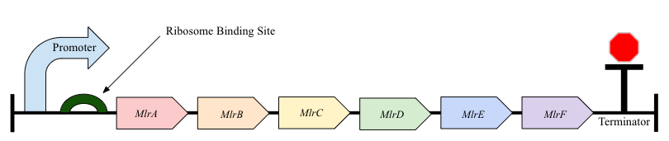
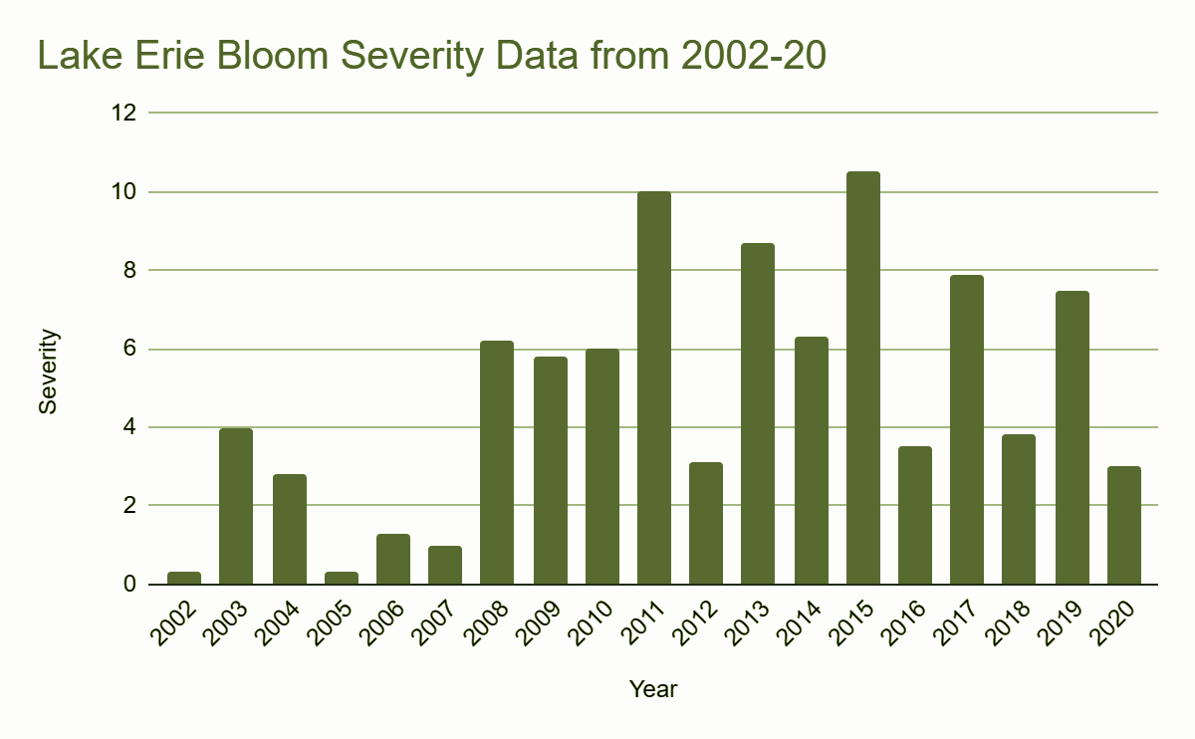
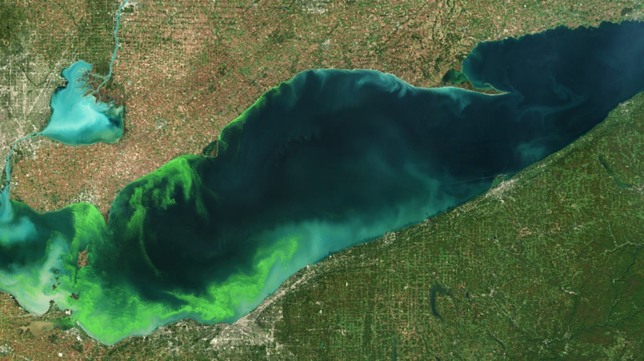
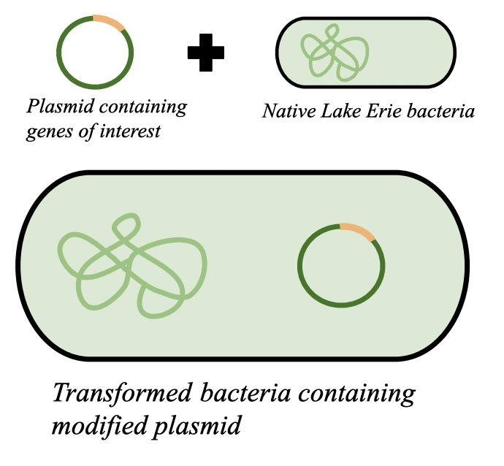
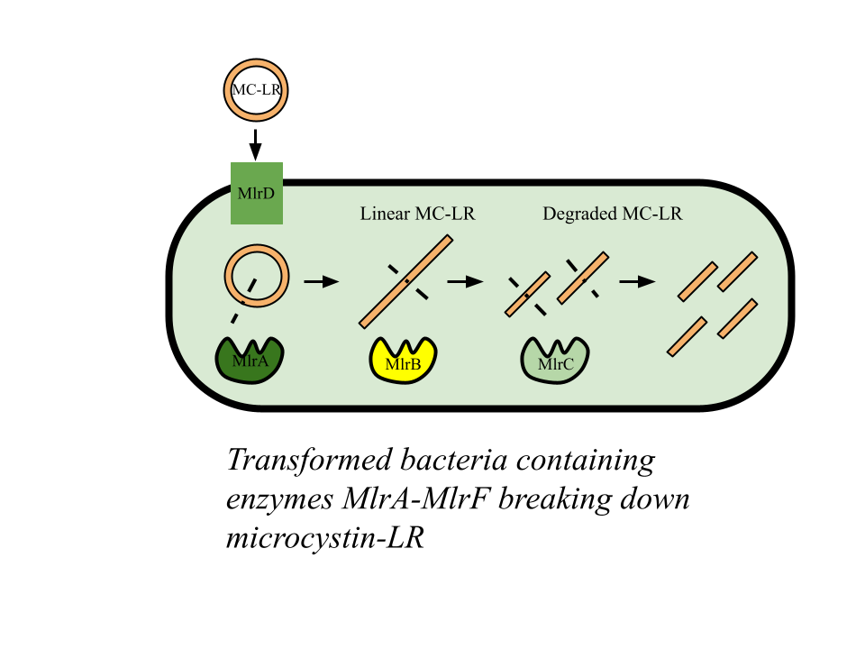
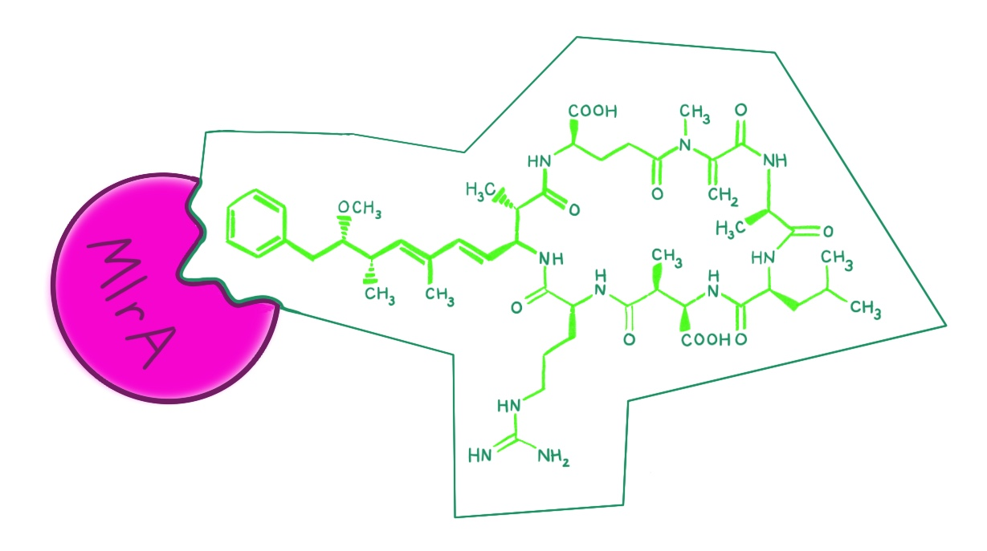
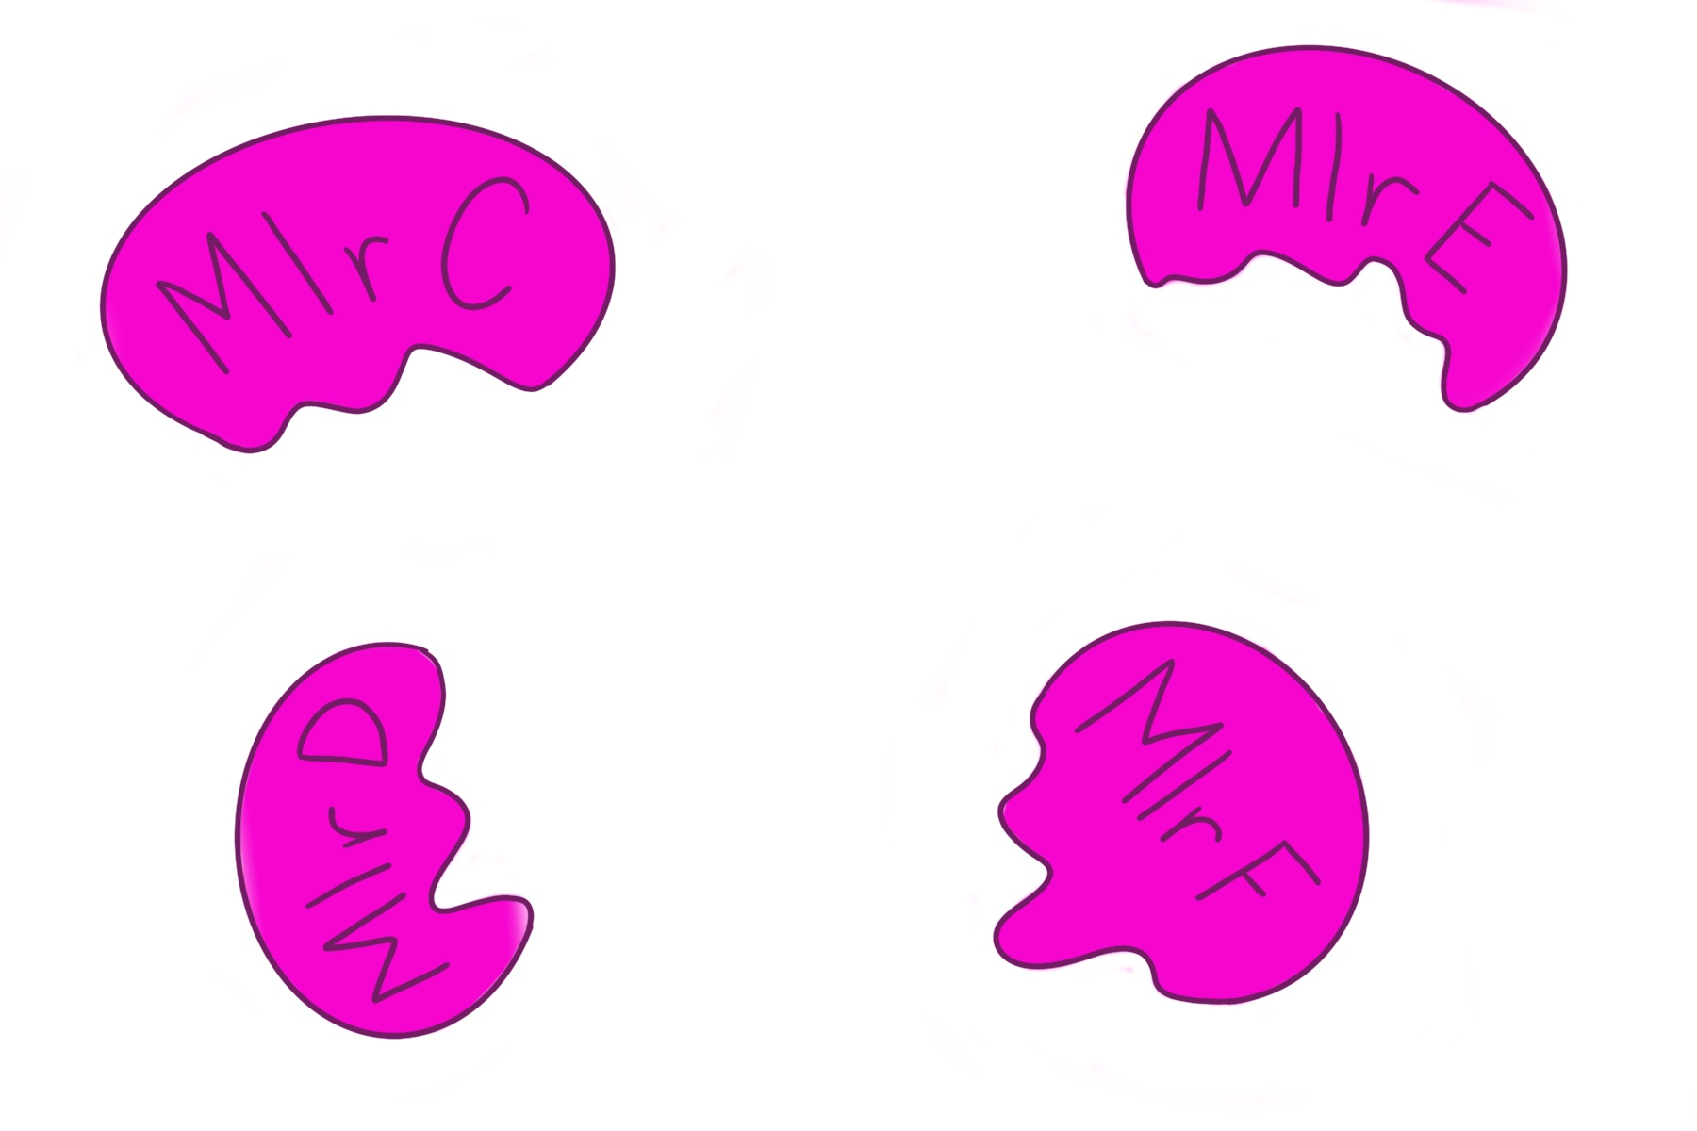
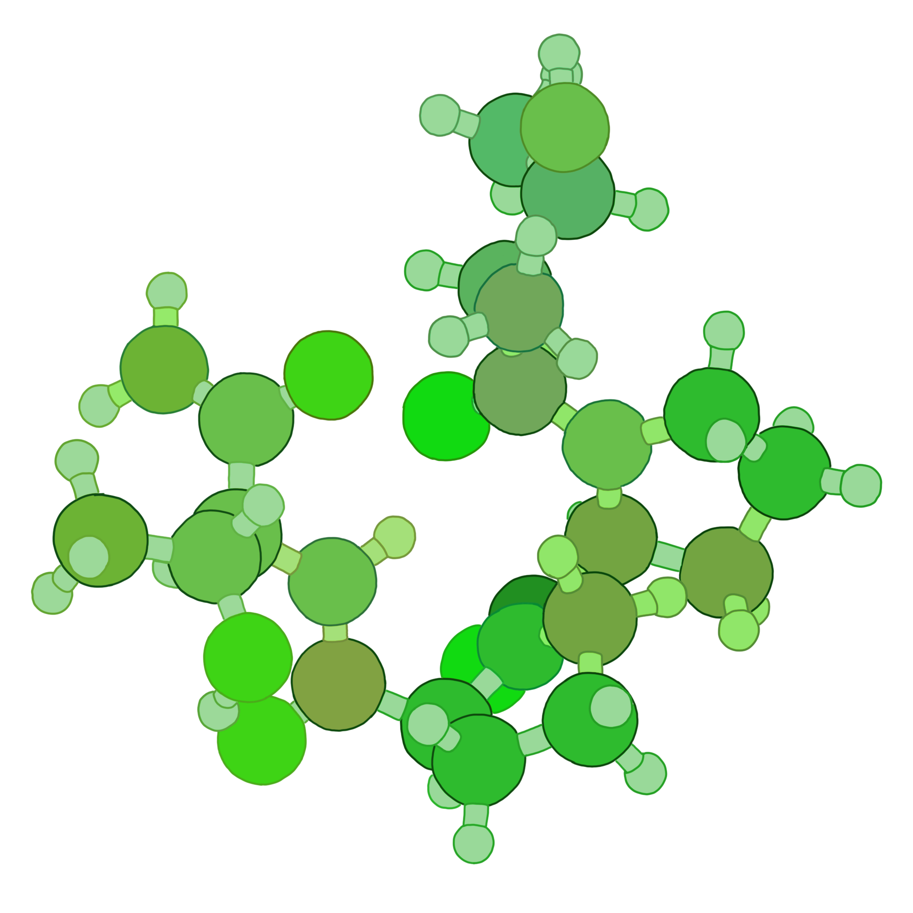
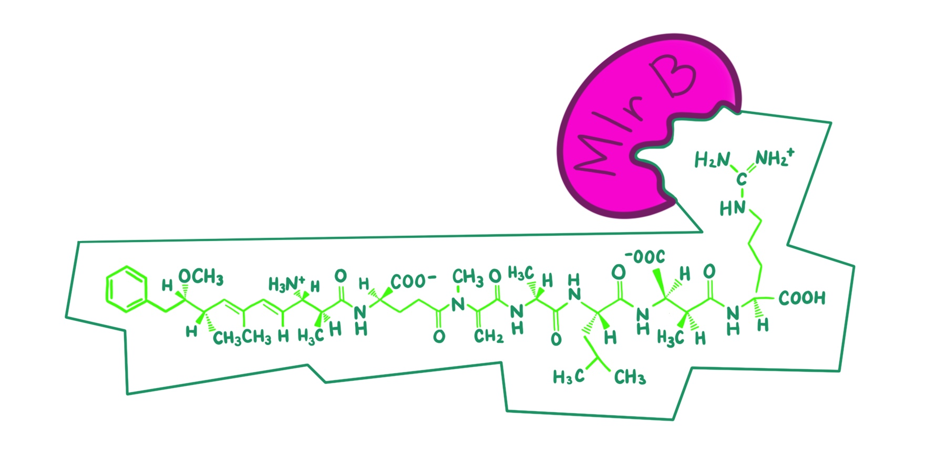


Harmful Algal Blooms in Lake Erie
Logan Amos, Angela Benzigar, Ella Bump, Erika Frohring, Natalie Ham, Isabella Haslinger-Johnson, Cynthia Li, Jessica Li, Lucy Li, Katya Luchette, Sheilla Muligande, Annie Nguyen, Adam Osman, Cavin Xue, Elena Yang, Mira Zamarro, Vivian Zhou
Western Reserve Academy, Hudson, Ohio
Introduction & Project Details
Experiments We Plan to Do
Microcystis aeruginosa, a common cyanobacteria species, causes algal blooms in Lake Erie that releases high doses of the toxin microcystin-LR. Toxic algae growth harms organisms in the ecosystem and humans in nearby areas. In our project, we plan to break down these toxins into non-toxic proteins through genetically engineered bacteria.
Fig.1
The proposed genetic construct containing genes MlrA-MlrF.
Graph on Severity of Lake Erie Blooms since Early 2000s
Severe Algal Blooms in Lake Erie (seen in green areas)
Fig. 3
Fig. 4
tetrapeptide
peptide
microcystin-LR
linearized microcystin-LR
Fig. 2
A plasmid containing the genetic construct shown in Fig. 1 will be inserted into a ubiquitous, non-toxic Lake Erie bacteria as shown in Fig. 2. The transformed bacteria will be able to produce enzymes MlrA-MlrF and break down microcystin-LR into harmless peptides and amino
acids.
Enzymes MlrA-F break down microcystin-LR. Mlr E&F are believed to aid MLRA-D. Fig. 5

Slide 2

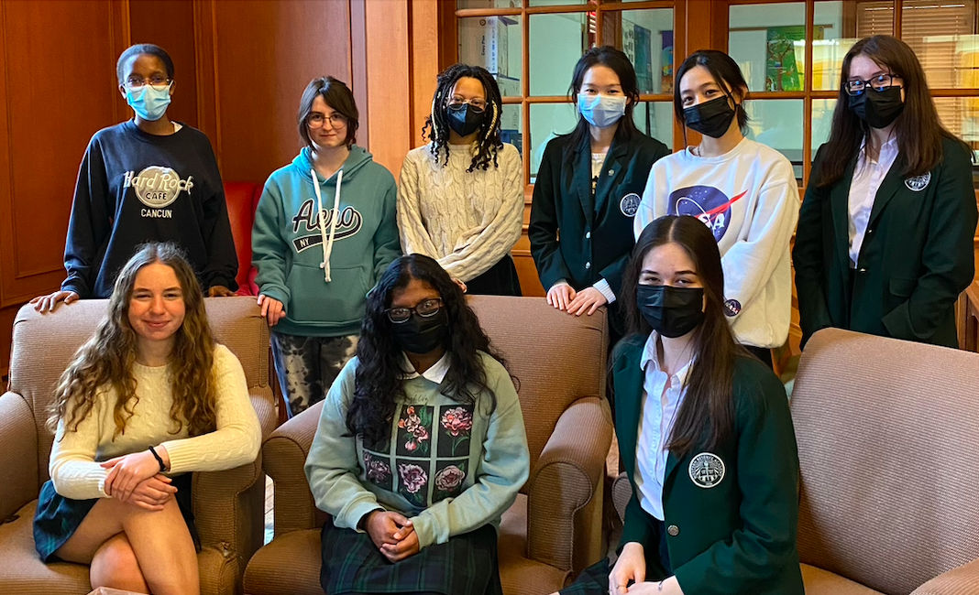


Harmful Algal Blooms in Lake Erie
Logan Amos, Angela Benzigar, Ella Bump, Erika Frohring, Natalie Ham, Isabella Haslinger-Johnson, Cynthia Li, Jessica Li, Lucy Li, Katya Luchette, Sheilla Muligande, Annie Nguyen, Adam Osman, Cavin Xue, Elena Yang, Mira Zamarro, Vivian Zhou
Western Reserve Academy, Hudson, Ohio
Challenge for Next Year’s Team
About This Year’s Team
The greatest challenge for the future of this project would be the modification process and the application itself. We have to work hard to engineer the microbe and then test if the toxins are successfully removed by the modified bacteria. We also have to ensure the containment of the bacteria as to not inadvertently cause harm to any fish or natural bacteria necessary for the ecosystem.
If another school were to pick this project up, a series of feasibility studies regarding the activation of the promoters prior to placing the plasmid into the bacteria will be necessary.
Logan (‘23): 2nd year, from Houston, TX
Angela (‘22): 2nd year, from Twinsburg, OH
Ella (‘22): 2nd year, from Sacramento, CA
Erika (‘23): 2nd year, from Newbury, OH
Natalie (‘22): 2nd year, from Old Tappan, NJ
Katya (‘22): 2nd year, from Aurora, OH
Sheilla (‘23): 1st year, from Abidjan, Côte d’Ivoire
Annie (‘23): 2nd year, from Marietta, OH
Adam (‘22): 2nd year, from Cupertino, CA
Cynthia (‘23): 1st year, from Hangzhou, China
Jessica (‘22): 1st year, from Broadview Heights, OH
Lucy (‘23): 2nd year, from Beijing, China
Cavin (‘24): 2nd year, from Hudson, OH
Mira (‘24): 2nd year, from Hudson, OH
Elena (‘23) 2nd year, from Chongqing, China
Vivian (‘23): 2nd year, from Shanghai, China
Isabella (‘25): 1st year, from Akron, OH
References & Acknowledgements
Dr. Beth Pethel, who guided us through this process
Rebecca Rubiano (‘23), for the basic project idea
Dr. Jason Boock, our BioBuilder mentor

