Slide 1

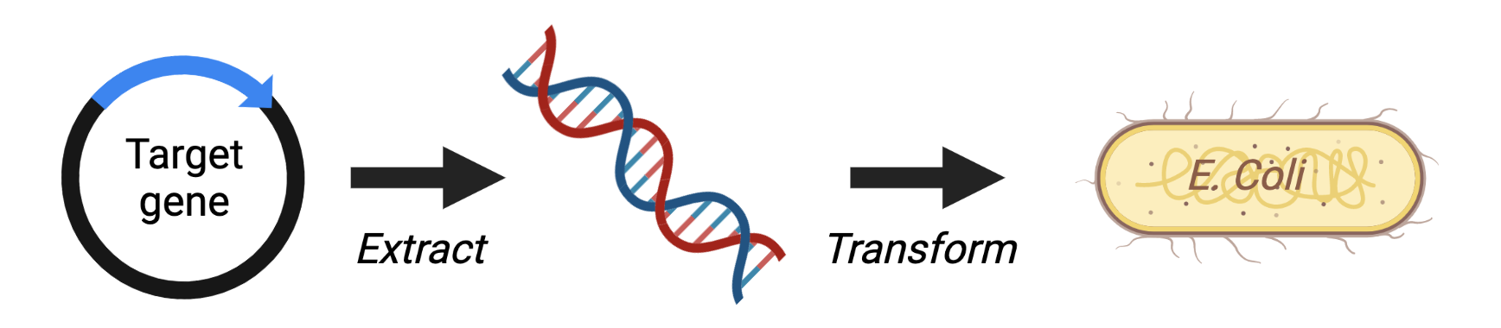
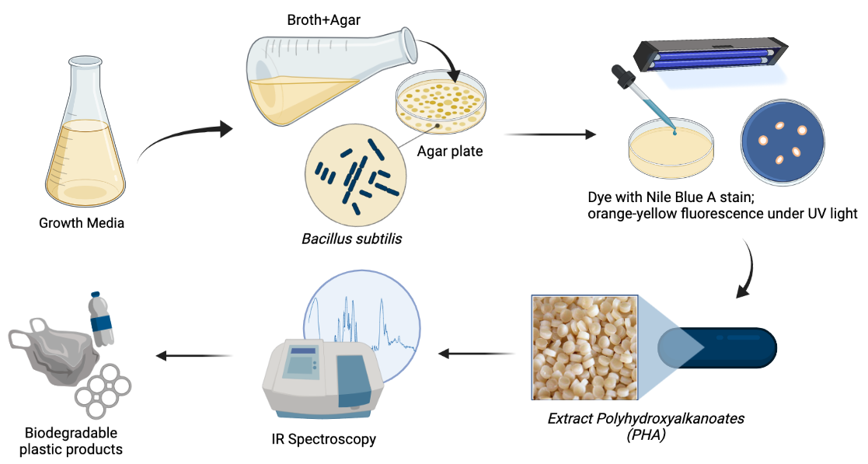
Polyhydroxyalkanoates: Biodegradable Plastics
Nicolas Wu, Jeffrey Yu, Derek Lee, Brian Liau
Taipei American School, Taipei, Taiwan
Introduction & Project Details
Planned Experiments
Problem:
Increasing plastic pollution and consumption
Solutions are time-consuming and costly
Our Goal:
We aim to design a genetic system in E. coli that produces polyhydroxyalkanoates more efficiently
Our Project Design:
Polyhydroxyalkanoates (PHA) is a natural biodegradable plastic that is produced from numerous microorganisms
Isolate the genetic sequence from Bacillus subtilis and create a plasmid that produces PHA in E. coli.
  Rod-shaped bacteria
  Recombinant of Bacillus sp. is used in production of PHA
Produce PHA from Bacillus subtilis
Grow Bacillus subtilis in specific growth medium (broth or agar plate)
Identification of PHA plastic using Nile Blue A stain and UV light
Extract the PHA from the bacteria through a lyophilization, dehydration, and centrifugation process
Infrared Spectroscopy analysis (carbonyl peak at 1728 cm⁻¹)
Notes:
For PHA analysis, sludge samples (ca. 10 mL) were mixed with
0.4 mL of formaldehyde to inhibit biological activity. Subsequently, the
protocol described by Werker et al. (2008) was followed. Briefly,
samples were centrifuged and the obtained pellet was lyophilized.
Lyophilized samples were weighted and benzoic acid was added as
internal standard. Butanol (1.5 mL) and chlorhydric acid (0.5 mL) were
added to each tube and incubated at 100 °C for 8 h. After, 2.5 mL of
hexane and 4 mL of MilliQ grade water were added. The tubes were
vortex mixed and let stand for 15 min to achieve phase separation. The organic phase was transferred to 15 mL clean falcon tubes and a second
4 mL aliquot of MilliQ grade water was added and the tubes were vortex
mixed and centrifuged at 2500×g for 10 min. The organic phase was
extracted, filtered through 0.22 μm filters and transferred into gas
chromatography (GC) vials. Then, it was analysed following the GC
protocol stated by Montiel-Jarillo et al. (2017).
from PHA extraction

Slide 2
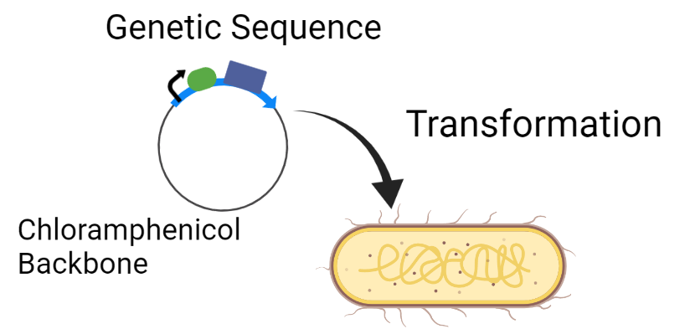
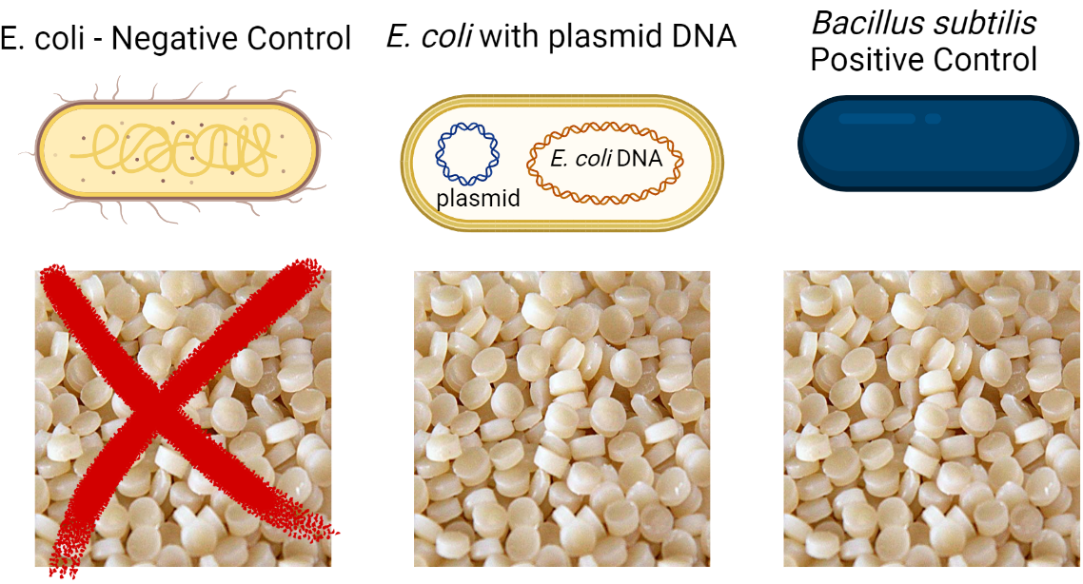
Polyhydroxyalkanoates: Biodegradable Plastics
Nicolas Wu, Jeffrey Yu, Derek Lee, Brian Liau
Taipei American School, Taipei, Taiwan
Planned Experiments Continued
Challenge for Next Year’s Team
Isolate the Genetic Sequence from Bacillus Subtilis
Create a genetic sequence as a plasmid for E. coli
After producing the plastic, potential modifications can be done to the experimental method in order to increase the strength/elasticity of the produced material
  Can then compare the difference in strengths of the plastic produced with different modifications in methods
New Experimental Method:
  Using food waste as a source of energy or media for the targeted bacteria to grow / grow in
1
About This Year’s Team
Our team consists of 4 juniors
  Derek L. (11), Brian L. (11), Nicolas W. (11), Jeffrey Y. (11)
We hope to advance bioplastic utilization with synthetic biology
We hate single-use plastic #savetheturtles
2
References & Acknowledgements
Thanks to Dr. Jonathan Hsu, Mr. Jude Clapper, Dr. Grace Cheng Dodge, Mr. Andrew Lowman, Mr. Sean Tsao, 沈宏明, 黃育輝, 郭子青, 黃世佑, 邱文英
News, A. B. C. “What to Know about PHA Biodegradable Plastic and How It Could Help Southeast Asia.” ABC News, https://abcnews.go.com/Business/pha-biodegradable-plastic-southeast-asia/story?id=78859058. Accessed 28 Feb. 2022.
Getachew, Anteneh, and Fantahun Woldesenbet. “Production of Biodegradable Plastic by Polyhydroxybutyrate (PHB) Accumulating Bacteria Using Low Cost Agricultural Waste Material.” BMC Research Notes, vol. 9, no. 1, Dec. 2016, p. 509. BioMed Central, https://doi.org/10.1186/s13104-016-2321-y.
McAdam, Blaithín, et al. “Production of Polyhydroxybutyrate (PHB) and Factors Impacting Its Chemical and Mechanical Characteristics.” Polymers, vol. 12, no. 12, Dec. 2020, p. 2908. PubMed Central, https://doi.org/10.3390/polym12122908.
Mannina, Giorgio, et al. “Bioplastic Recovery from Wastewater: A New Protocol for Polyhydroxyalkanoates (PHA) Extraction from Mixed Microbial Cultures.” Bioresource Technology, vol. 282, June 2019, pp. 361–69. ScienceDirect, https://doi.org/10.1016/j.biortech.2019.03.037.
Law, K. H., et al. “Construction of Recombinant Bacillus Subtilis Strains for Polyhydroxyalkanoates Synthesis.” Biochemical Engineering Journal, vol. 16, no. 2, Nov. 2003, pp. 203–08. ScienceDirect, https://doi.org/10.1016/S1369-703X(03)00039-1.
Notes:
Insert the genetic sequence into a chloramphenicol resistant backbone with fluorescent gene.
Follow the experimental set up in the image below

