Slide 1

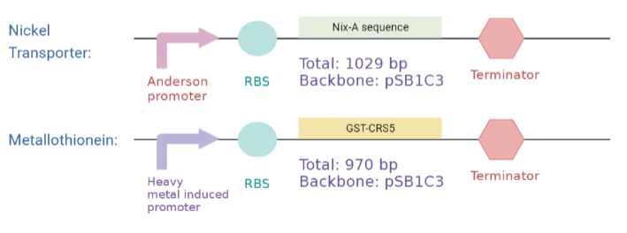
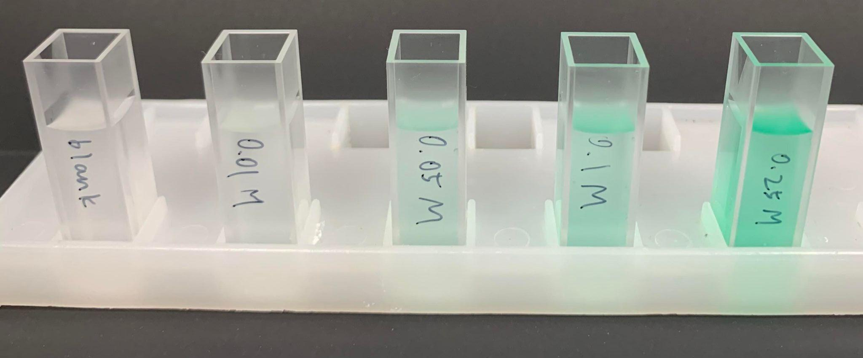
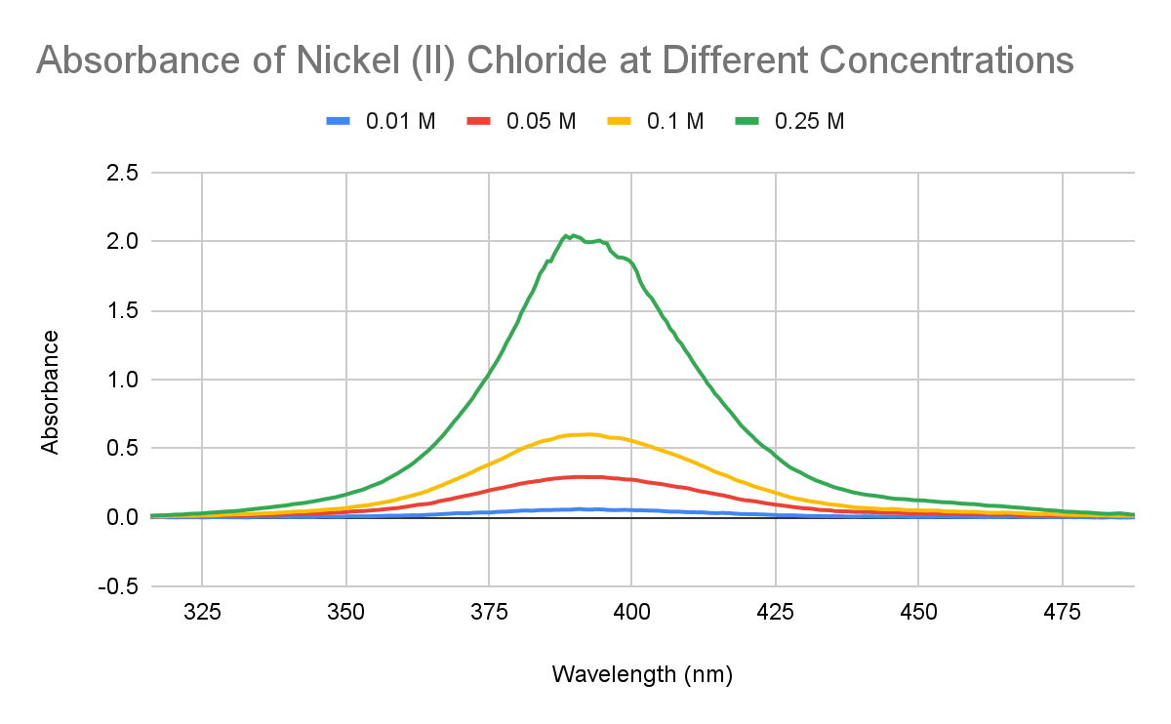
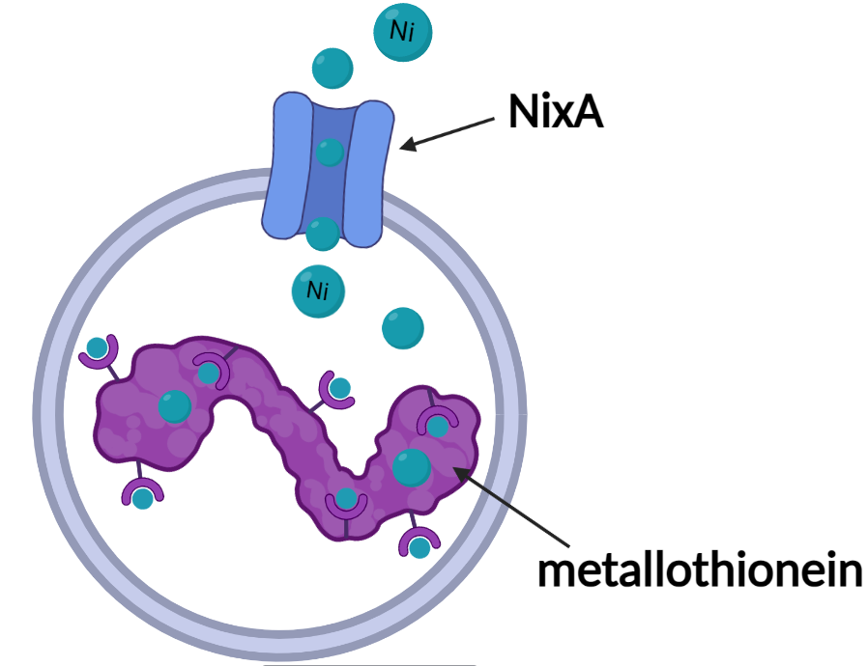
Filteristic Milk: Heavy Metal Filtration of Breast Milk
Jay Ann Kan, Katie Chu, Vienna Sun, Kristina Hong, Reese Reduta,
Justin Wang, Angeline Sun, Zoe Shong, Oscar Chen, Gabriel Lin
Taipei American School, Taipei, Taiwan
Introduction & Project Details
Planned Experiments
Problem:
Heavy metals, such as lead and nickel, were found present in breast milk with levels above tolerable limits by 54% and 12% respectively in mothers living in areas with poor environmental safety regulations
Side effects of nickel consumption: gastrointestinal distress, dermatitis, neurological effects
Our Goal: Create a filtration system that removes heavy metal ions from breast milk
Project Design: Utilize NixA (ion transport protein) to transport metals into bacteria cytoplasm; expressed metallothionein binds and sequester breast milk heavy metals
Expressing nickel transporter and binding proteins
Construct heavy metal inducible promoter / constitutive promoter + RBS + nickel transporter / metallothionein
Determining peak nickel absorbance rate
Figure 2. Planned bacterial plasmids
Figure 1. Nickel moving through nickel transporter and binding to metallothionein
Figure 3. Different concentrations of NiCl₂
Figure 4. Absorbance of different concentrations of NiCl₂ with highest peak at 392 nm

Slide 2
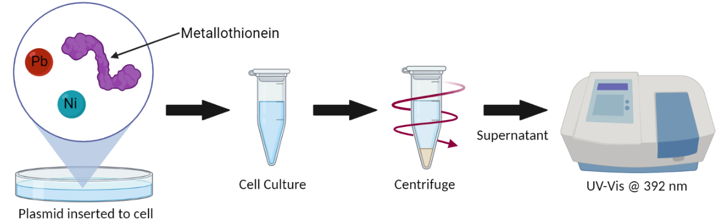
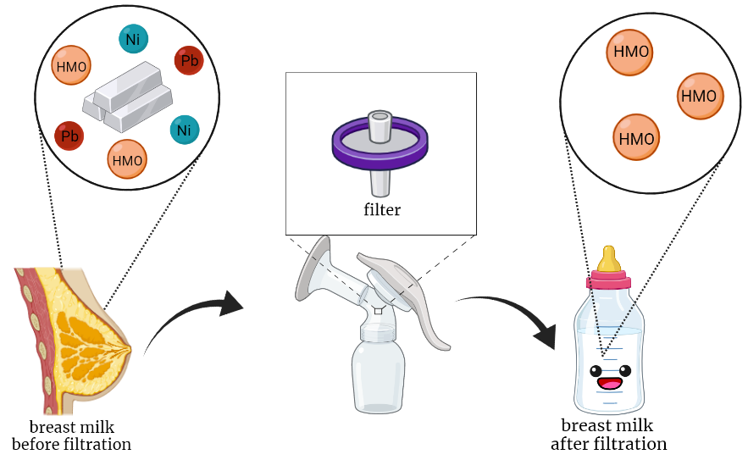



Filteristic Milk: Heavy Metal Filtration of Breast Milk
Jay Ann Kan, Katie Chu, Vienna Sun, Kristina Hong, Reese Reduta, Justin Wang, Angeline Sun, Zoe Shong, Oscar Chen, Gabriel Lin
Taipei American School, Taipei, Taiwan
Planned Experiments Contd.
Testing nickel transport + metal binding neutralization
Test substrate heavy metal concentration drop with UV-Vis Spectroscopy at 392 nm after protein activity and centrifugation cell spin down (Figure 5.)
Testing filter functionality
Test 0.22 μm syringe filter semipermeable membrane functionality in filtering out metal absorbing bacteria
Figure 5. Plasmid inserted to cells, supernatant and UV-Vis
Prototype & Future Work
About This Year’s Team
Semi-permeable membrane filter functionality
Testing in lab and evaluating filter efficiency
Consider product ethical concerns
Our team consists of 7 high school juniors and 3 seniors.
References & Acknowledgements
Special thanks to Dr. Hsu, Mr. Clapper, Mr. Lowman, and Dr. Dodge for their unwavering support.
Sullivan, R. J. (Litton Systems, Inc.) Air Pollution Aspects of Nickel and Its Compounds. NTIS No. PB188070. September 1969. P.18.
"Pathophysiology and Etiology of Lead Toxicity ." Pathophysiology and Etiology of Lead Toxicity. Medscape, n.d. Web. 15 Oct. 2014.
Motas, Miguel et al. “Heavy Metals and Trace Elements in Human Breast Milk from Industrial/Mining and Agricultural Zones of Southeastern Spain.” International journal of environmental research and public health vol. 18,17 9289. 2 Sep. 2021, doi:10.3390/ijerph18179289
Figure 6. Breast milk filtration system plan overview

