Slide 1

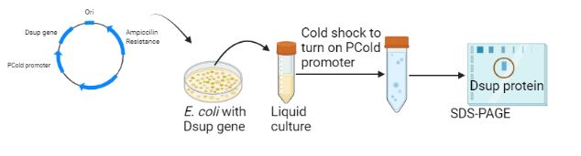
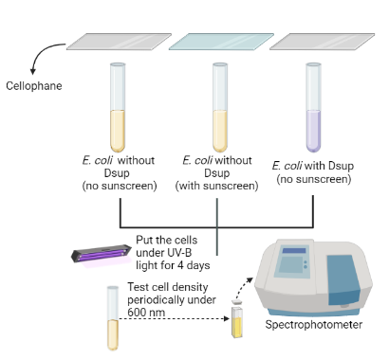
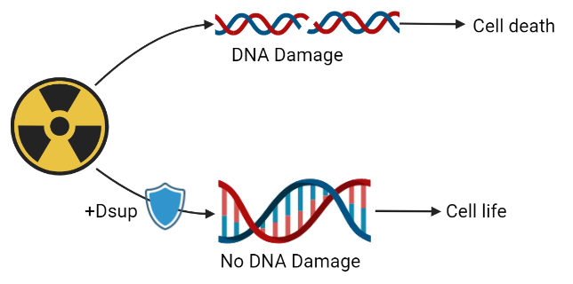
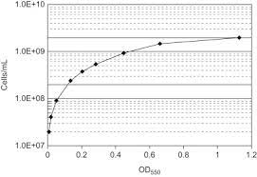
DSUP Protectors
Andrew Ko, Annie Yang, Catrina Yeh, Charis Chiu, Dillon Su, Ethan Dunn
Taipei American School, Taipei, Taiwan
Introduction & Project Details
Experiments Planned: Confirmation/Approach 1
UV radiation can lead to skin cancer, eye damage, and immune system suppression.
Tardigrades are organisms that can survive in extreme conditions due to the presence of Dsup in their bodies.
Dsup proteins both protect DNA from UV radiation, and can repair damaged DNA.
Goal: Our project aims to utilize Dsup to protect eukaryotic cells from UV radiation.
Fig 2. Protein Expression to Confirm Dsup expression
2 Goals:
Express Dsup
Test Dsup ability to block UV inside and outside of cell
Fig 1. DNA Protection by Dsup Protein from Radiation Damage
Cell density and analysis
Fig 3. Procedure for testing expressed Dsup in comparison to sunscreen

Slide 2
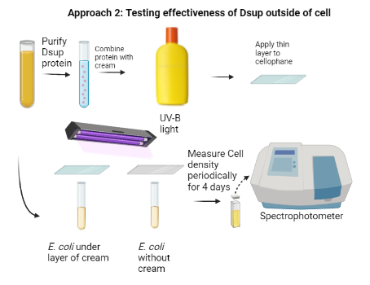
DSUP Protectors
Andrew Ko, Annie Yang, Catrina Yeh, Charis Chiu, Dillon Su, Ethan Dunn
Taipei American School, Taipei, Taiwan
Experiments Planned: Approach 2
Challenge for Next Year’s Team
Purify Dsup more effectively.
Test Dsup cream UV protection on mammals.
Test whether Dsup can be transfected into human cells.
Test whether Dsup cream is comedogenic or causes acne.
About This Year’s Team
We are Team Red from Taipei American School consisting of 5 juniors and 1 senior.
References & Acknowledgements
Thank you to Dr. Jonathan Hsu, Mr. Jude Clapper, Dr. Ying Zhang, Mr. Sean Tsao, and the Scientific Research Department
References
Hashimoto, Takuma, Daiki D. Horikawa,, et al. “Extremotolerant Tardigrade Genome and Improved Radiotolerance of Human Cultured Cells by Tardigrade-Unique Protein.” Nature Communications 7, no. 1 (September 20, 2016): 12808. https://doi.org/10.1038/ncomms12808.
Hashimoto, Takuma, and Takekazu Kunieda. “DNA Protection Protein, a Novel Mechanism of Radiation Tolerance: Lessons from Tardigrades.” Life 7, no. 2 (June 2017): 26. https://doi.org/10.3390/life7020026.
Elena, Kravchenko. “Study of the radioprotective properties of the Damage Suppressor (Dsup) protein on a model organism D. melanogaster and human cell culture HEK293T.” https://dlnp.jinr.ru/image
Addgene: Takekazu Kunieda Lab Plasmids. (n.d.). Retrieved February 22, 2022, from https://www.addgene.org/Takekazu_Kunieda/
Lakshmipathy, U., Pelacho, B., Sudo, K., Linehan, J. L., Coucouvanis, E., Kaufman, D. S., & Verfaillie, C. M. (2004). Efficient transfection of embryonic and adult stem cells. Stem Cells (Dayton, Ohio), 22(4), 531–543. https://doi.org/10.1634/stemcells.22-4-531
Maruyama, H., Ataka, K., Higuchi, N., Sakamoto, F., Gejyo, F., & Miyazaki, J. (2001). Skin-targeted gene transfer using in vivo electroporation. Gene Therapy, 8(23), 1808–1812. https://doi.org/10.1038/sj.gt.3301604
Mirus Bio Contact Information. (n.d.). Retrieved February 22, 2022, from https://www.mirusbio.com/contact
Transfection Guide | Overview of Transfection Methods | Promega. (n.d.). Retrieved February 22, 2022, from https://worldwide.promega.com/resources/guides/cell-biology/transfection/
Fig 4. Procedure for Testing Dsup’s external effectiveness
Notes:
https://dlnp.jinr.ru/images/jevents/5e85c1ec4ca019.87998701.pdf

