Slide 1

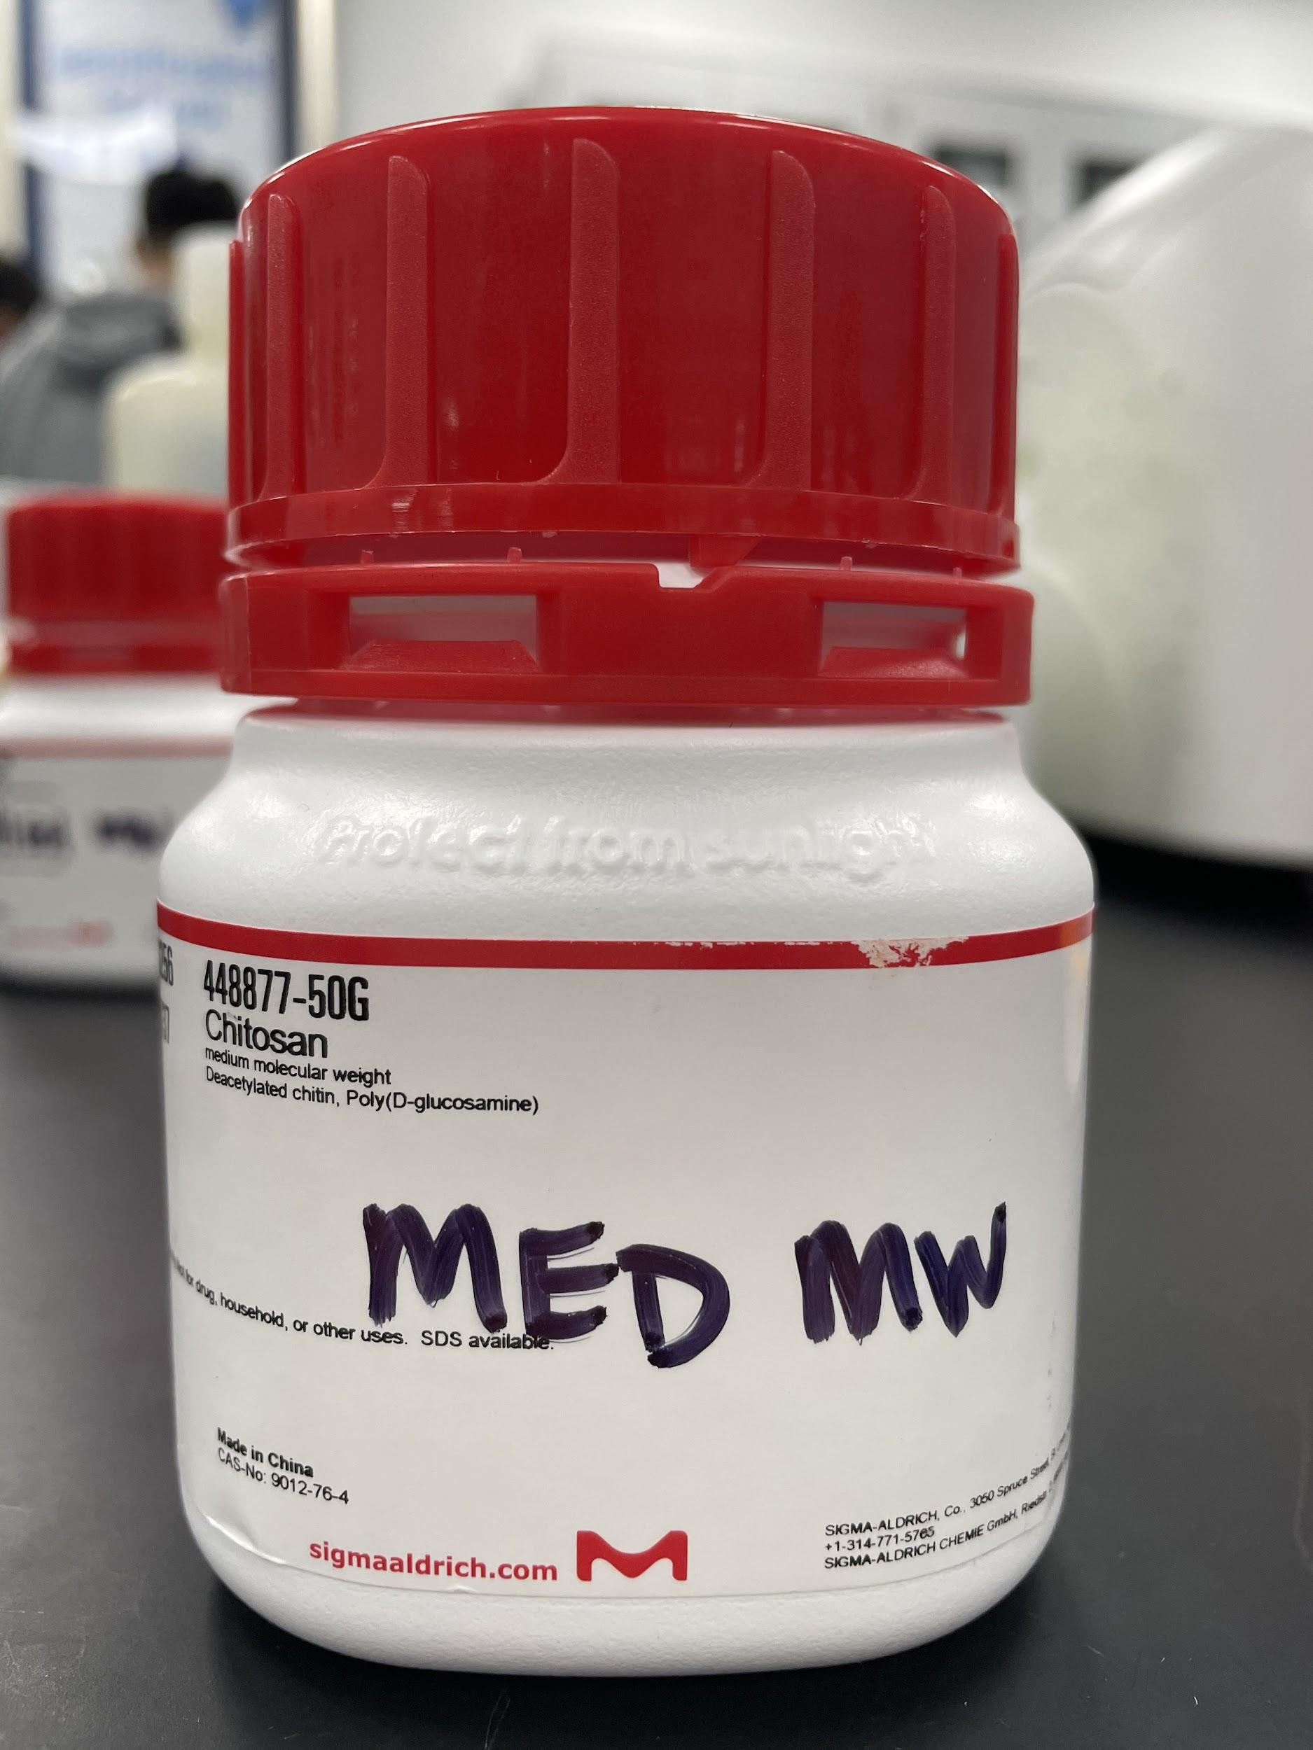
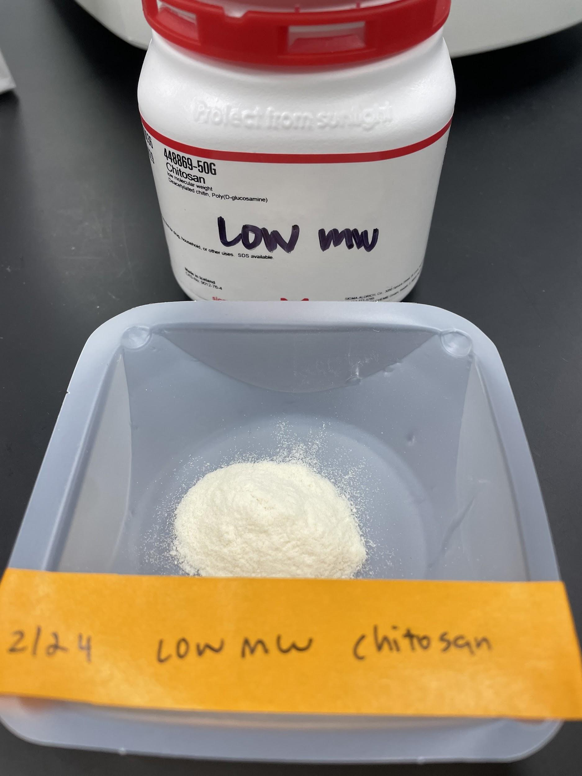
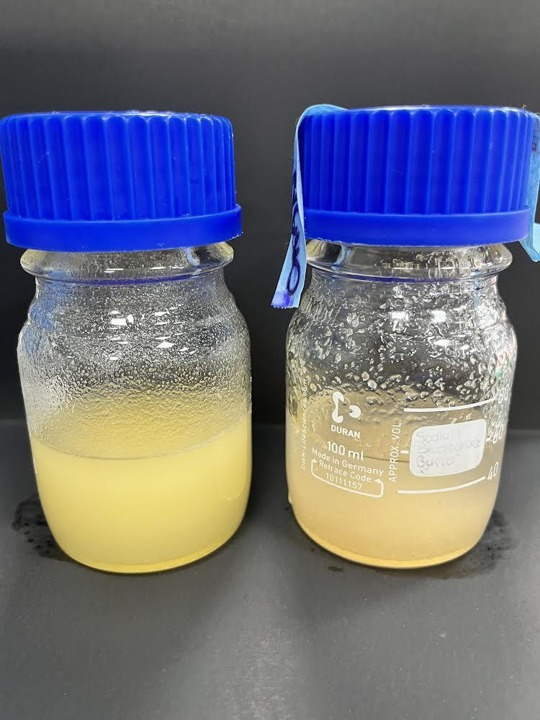
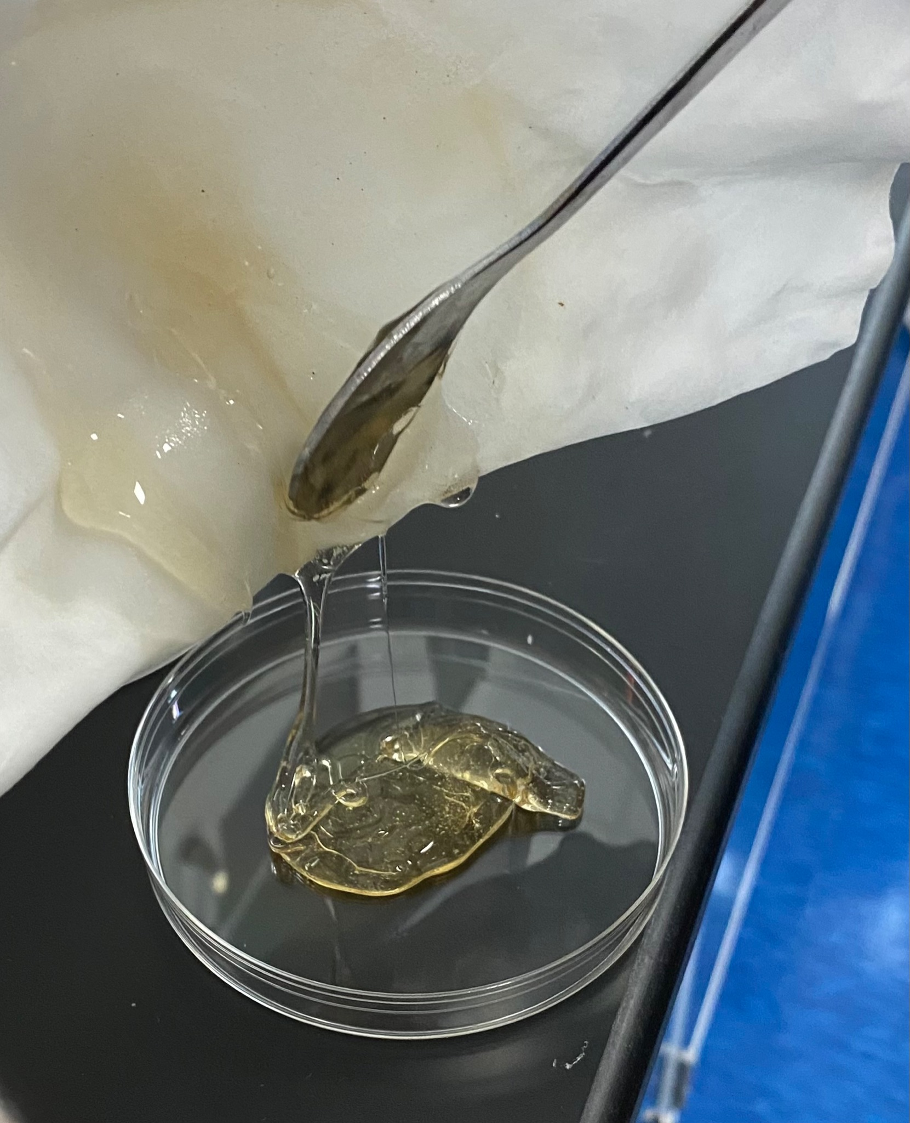
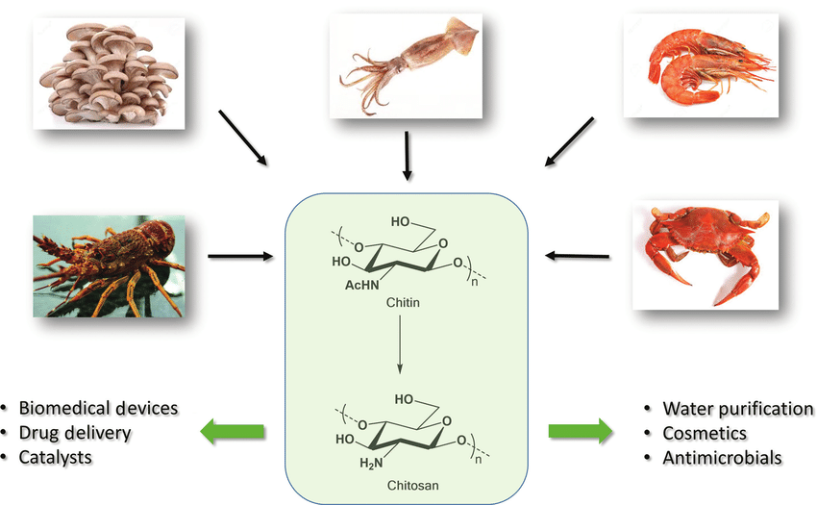
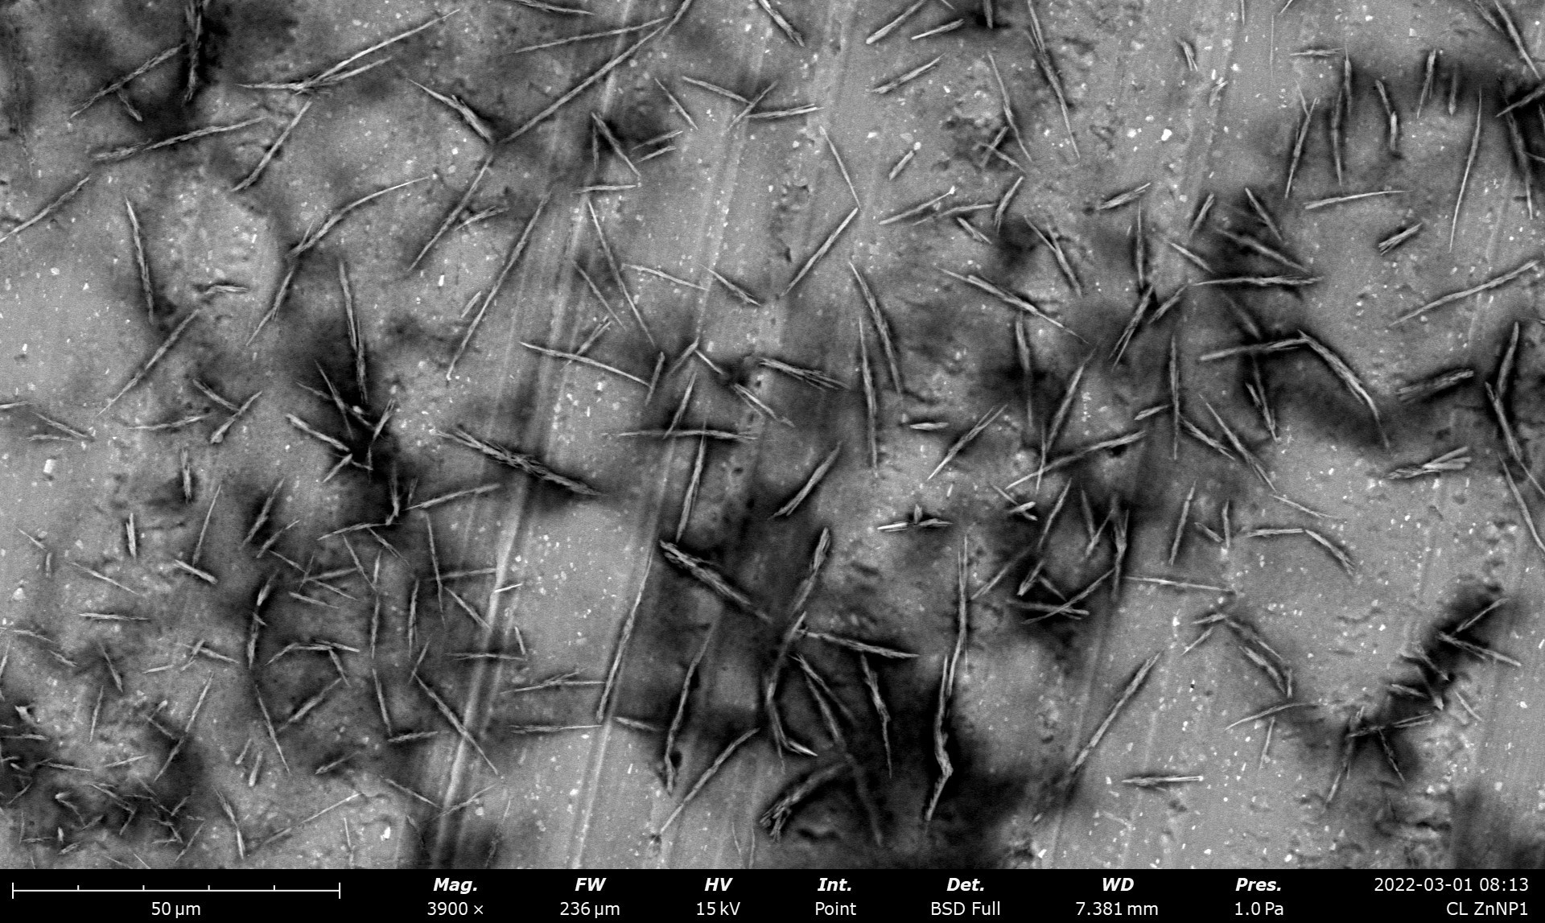
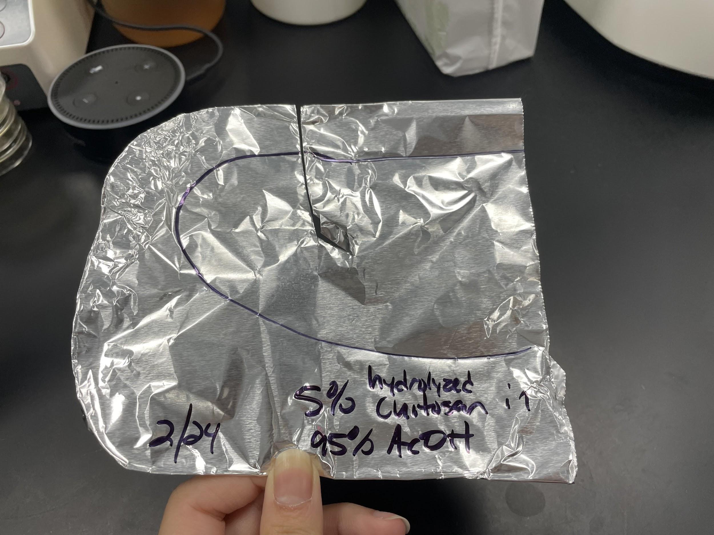
Chito-Plan for the Future
TAS_Taipei Orange
Taipei American School, Taipei TW
Introduction & Project Details
Experiments We Did &/or Planned
Chitosan is deacetylated chitin, a natural polysaccharide
Chitosan fabrics have antibacterial and resilient properties
  Applications include biofunctional textiles, medical coating, etc.
We aim to produce chitosan in E. coli using chitin synthase and chitin deacetylase
We aim to electrospin to produce chitosan fibers
Fig. 2: Commercial medium / low molecular weight chitosan
Fig. 3: Low mw (left) / med mw (right) chitosan dissolved in NaOH and heated in 85º C
Fig. 4: Med mw chitosan (hydrolyzed / rinsed / neutralized with acetic acid)
Fig. 6: SEM diagram showing bits of chitosan fibres (average length is ~15 μm / average diameter is ~1 μm)
Fig. 5: 5% med mw chitosan in 95% acetic acid after electrospinning at 26 kV
Fig. 1: Chitin is the second-most abundant biopolymer in nature
Notes:
hai hai
Experiment 1 (2/14/2022): Hydrolyzing Medium weight Chitosan with 50% NaOH
The 50% NaOH was achieved by
100mL H2O/100.093g NaOH
50 mL 50% NaOH solution and 2.013 g Med Chitosan
Heated for 48 hrs at 85ºC
Experiment 2: Low weight Chitosan (2/18/2022)
50 mL of 50% NaOH solution and 2.007 g Low Chitosan
Heated over the weekend
Experiment 3: Making acetic acid (2/22/2022)
50 mL 99.81% Aqueous acetic acid + 50 mL water = 50% acetic acid solution
what i deleted from the slide^

Slide 2
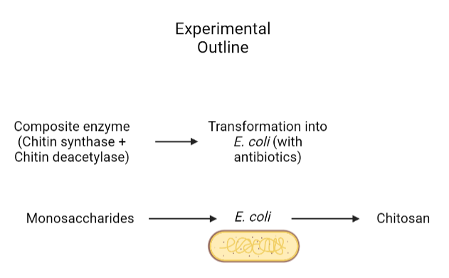
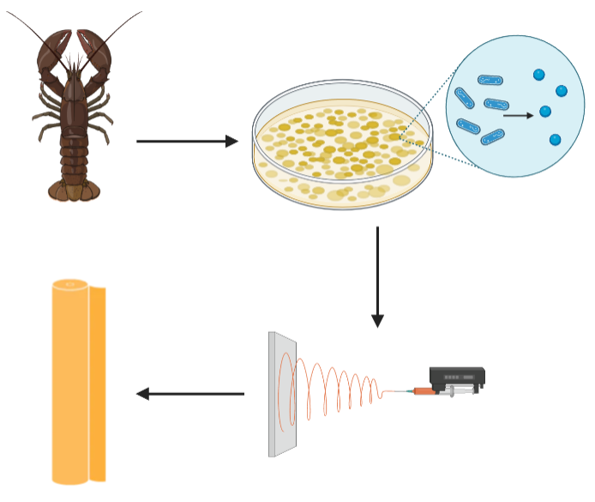
Chito-Plan for the Future
TAS_Taipei Orange
Taipei American School, Taipei TW
Plans for Future Experiments
About This Year’s Team
Experiment with different combinations of electrospinning factors to find optimal combination (electric voltage, viscosity, feeding rate, tip-to-collector distance)
Research / experiment with different nanoparticles to include
Weave chitosan fibres into fabric and create various prototypes depending on the application
Synthetically produce chitosan from E. coli
Guan C. (11), Dylan C. (11), Alex C. (11), Ashley K. (11), Eowyn W. (11), Amanda S. (11), Jamie L. (12)
We are the Orange Team of Taipei American School
Our team consists of 1 senior and 6 juniors
This is our first year participating in the BioBuilder club, and with the guidance of Dr. Hsu and Mr. Clapper, we hope to grow our skills as scientists and further the development of our synthetic biology project
References & Acknowledgements
Thank you to Dr. Hsu and Mr. Clapper for assisting us throughout the research and experiment process :)
References
Homayoni, Homa, et al. “Electrospinning of Chitosan Nanofibers: Processing Optimization.” Carbohydrate Polymers, vol. 77, no. 3, July 2009, pp. 656–61, https://doi.org/10.1016/j.carbpol.2009.02.0
Pakravan, Mehdi, et al. “A Fundamental Study of Chitosan/PEO Electrospinning.” Polymer, vol. 52, no. 21, Sept. 2011, pp. 4813–24, https://doi.org/10.1016/j.polymer.2011.08.034.
Desai, Keyur, et al. “Morphological and Surface Properties of Electrospun Chitosan Nanofibers.” Biomacromolecules, vol. 9, no. 3, Jan. 2008, pp. 1000–6, https://doi.org/10.1021/bm701017z.
“Morphological and Surface Properties of Electrospun Chitosan Nanofibers.” ACS Publications, 2021, pubs.acs.org/doi/10.1021/bm701017z.
“Polyethylene Oxide - PEO, PEG.” Sigmaaldrich.com, 2022, https://doi.org/Dogri.
Fig. 7: Synthetic solution flowchart
Fig. 8: Project flowchart

