Slide 1

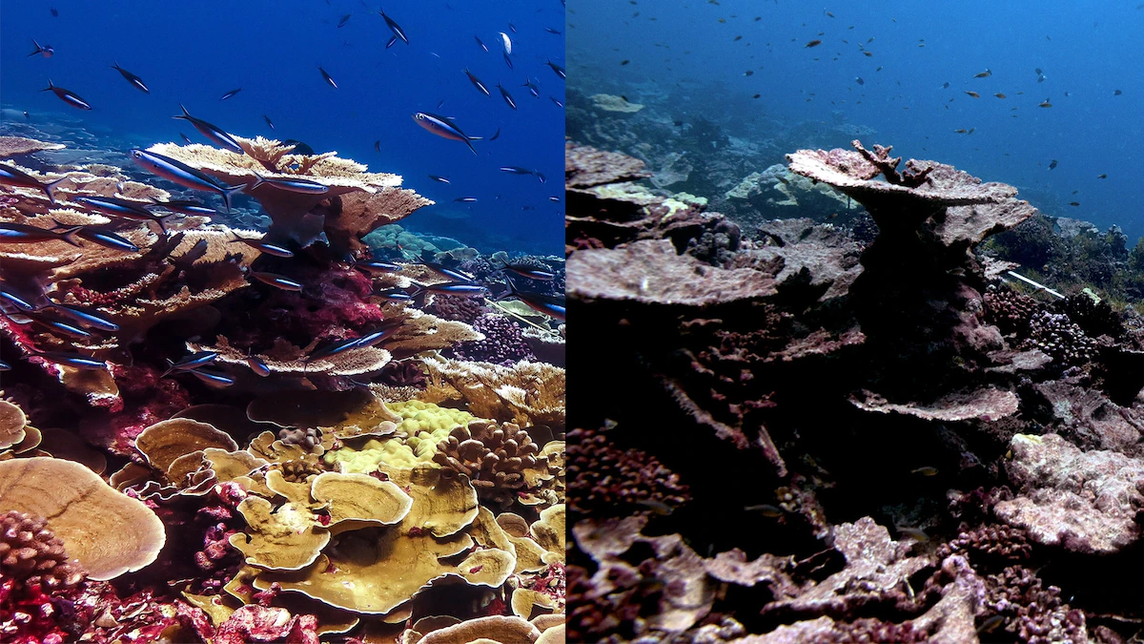


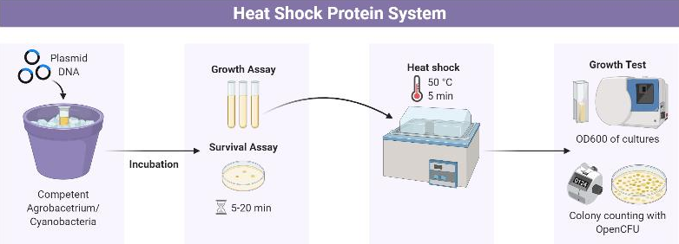
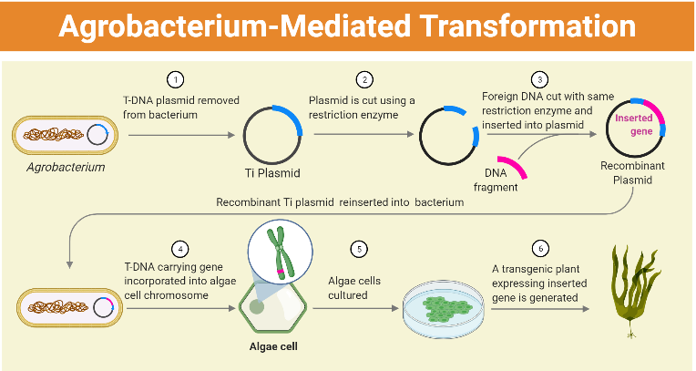
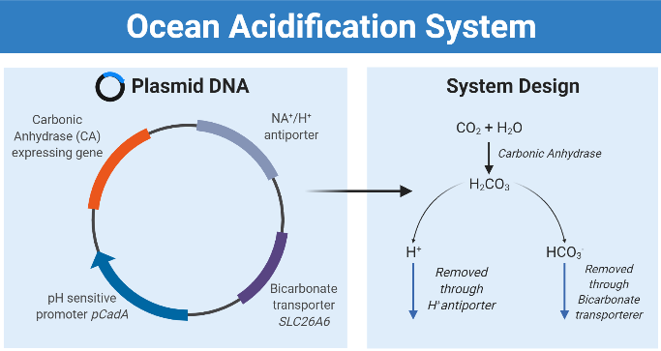
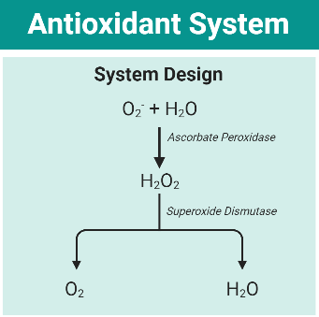
Reef-vive: A comprehensive approach
towards increased coral survivability
Andre Hsieh, Dylan Liu, Ethan Hirai, Marvin Li, Rex Liu, Sonia Fan
Taipei American School, Taipei, Taiwan
Introduction & Project Details
Experiments We Did &/or Planned
Coral reefs support biodiverse ecosystems and provide indispensable coastline protection for millions of people.
Rising ocean temperatures & acidification triggers algae overproduction of Reactive Oxygen Species (ROS), causing algae expulsion from coral host¹.
Project Aim: Three-fold process towards greater coral survivability: increased thermal (Fig. 2), acidic (Fig. 3), and oxidative stress (Fig. 4), resistance.
Delivery mechanisms:
      Algae transformation through Agrobacterium (Fig. 1)
      External regulation through Cyanobacteria
Figure 2: Diagram of Heat Shock Protein System Experimental Protocol
Figure 3: Diagram of Acidification System Design
Figure 4: Diagram of Antioxidant System Design
Figure 1: Diagram of Agrobacterium-Mediated Transformation Protocol
Notes:
Window to Save World's Coral Reefs Closing Rapidly (nationalgeographic.com)
Plan to use agrobacterium to insert heat shock plasmids and antioxidant (APX and Superoxide dismutase) plasmids into algae
Heat shock algae will be tested by heat shocking the algae and testing cell survival by regrowing from heat shocked sample
Antioxidant algae will be tested by placing in water containing H2O2 and testing cell death via same method as heat shock proteins.

Slide 2
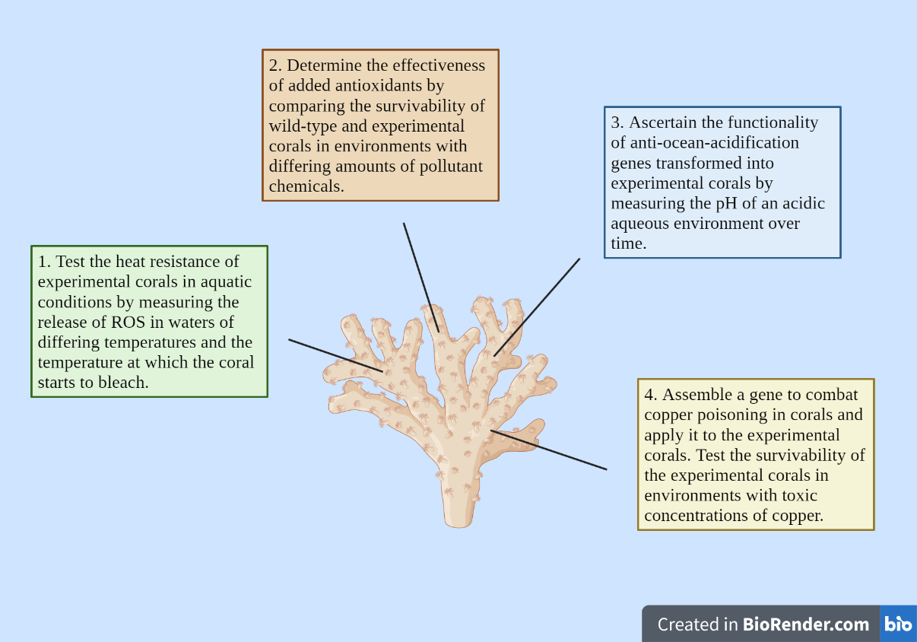
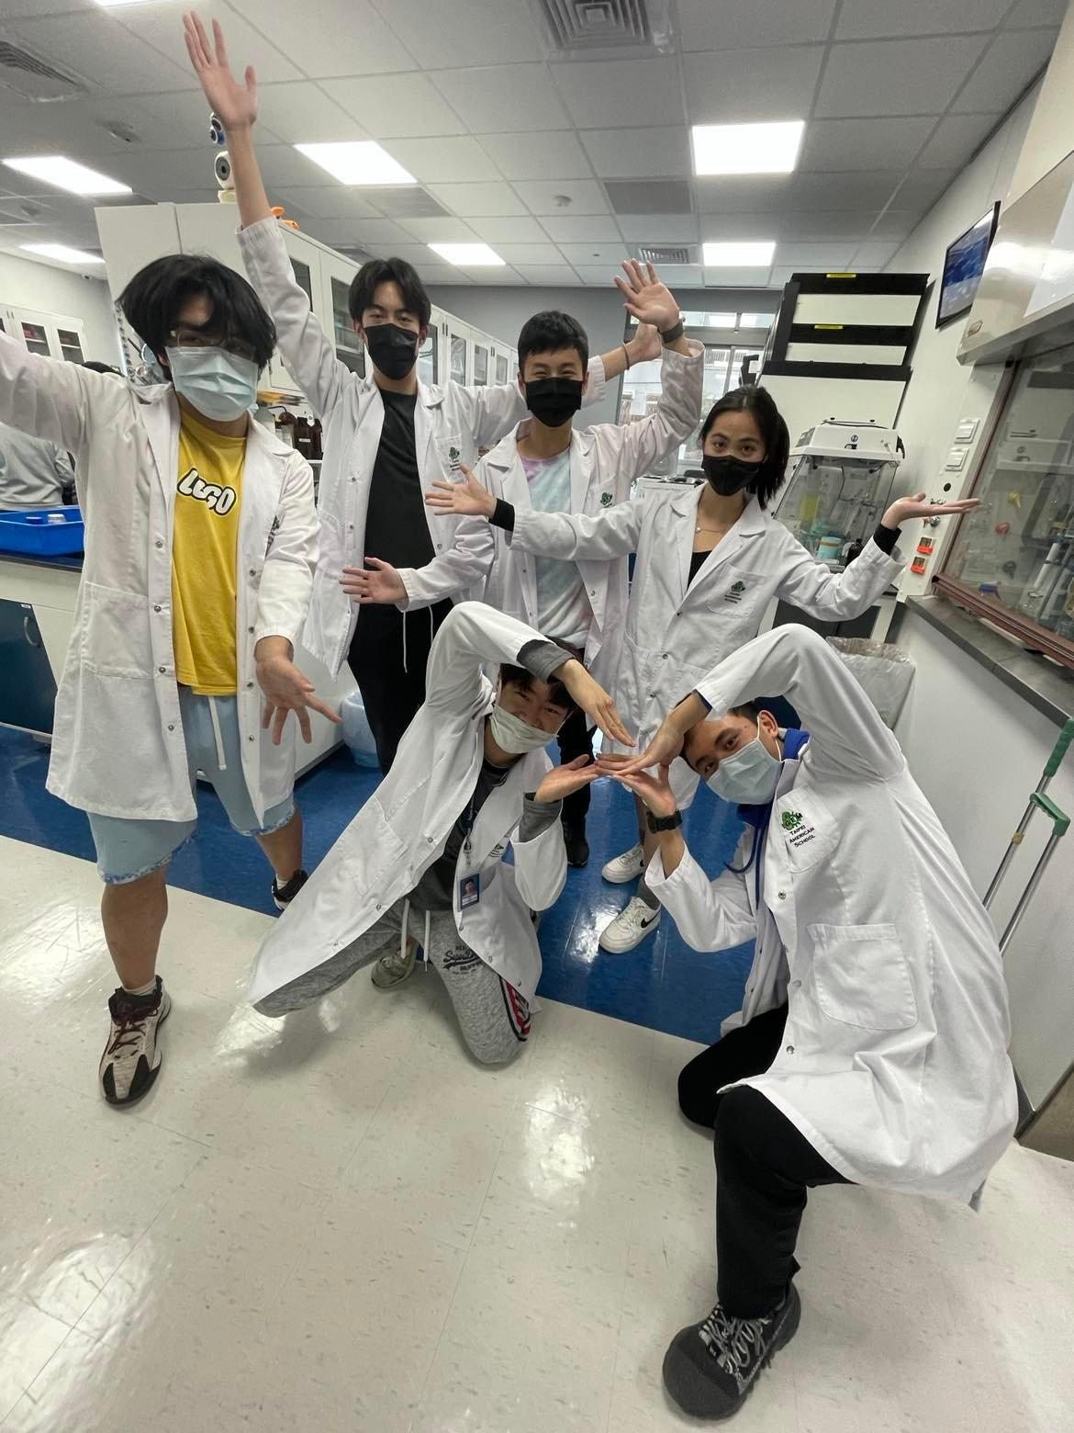


Reef-vive: A comprehensive approach
towards increased coral survivability
Andre Hsieh, Dylan Liu, Ethan Hirai, Marvin Li, Rex Liu, Sonia Fan
Taipei American School, Taipei, Taiwan
Future Work
Ascertain a reliable method to determine algae survivability under non-simulated, in vivo conditions.
Include additional components to further increase coral survivability;
  ex) a copper transport system to treat copper poisoning.
Create molecular & mathematical models to simulate coral compatibility.
References & Acknowledgements
Our research would not be possible without the help of these awesome people: our team mentors, Mr. Clapper & Dr. Hsu, as well as Mr. Tsao & the TAS community.
[1] Nielsen, Daniel Aagren, Katherina Petrou, and Ruth D. Gates. “Coral Bleaching from a Single Cell Perspective.” The ISME Journal 12, no. 6 (June 2018): 1558–67. https://doi.org/10.1038/s41396-018-0080-6.
[2] “Team:UNSW Australia - 2021.Igem.Org.” Accessed March 2, 2022. https://2021.igem.org/Team:UNSW_Australia.
[3] “Team:VIT Vellore/Description - 2018.Igem.Org.” Accessed March 2, 2022. http://2018.igem.org/Team:VIT_Vellore/Description.
[4] Pasaribu, Buntora, and Pei-Luen Jiang. “Agrobacterium Tumefaciens Mediated Transformation of Symbiodinium Spp.” Turkish Journal of Fisheries and Aquatic Sciences, vol. 21, no. 06, Mar. 2021, pp. 291–98. DOI.org (Crossref), https://doi.org/10.4194/1303-2712-v21_6_04.
[5] Ortiz-Matamoros, Mario Fernando, et al. “Heterologous DNA Uptake in Cultured Symbiodinium Spp. Aided by Agrobacterium Tumefaciens.” PLOS ONE, edited by Christian R Voolstra, vol. 10, no. 7, July 2015, p. e0132693. DOI.org (Crossref), https://doi.org/10.1371/journal.pone.0132693.
About This Year’s Team
We are Team Indigo from Taipei American School. Our team of 6 juniors is dedicated to exploring and developing plausible synthetic biology solutions to combat the issue of coral bleaching.
Figure 5: A visualization of possible future experiments
Notes:
superscript acknowledgements

