Slide 1


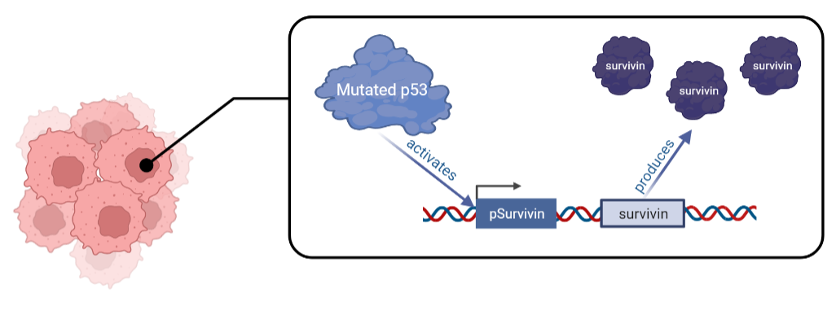
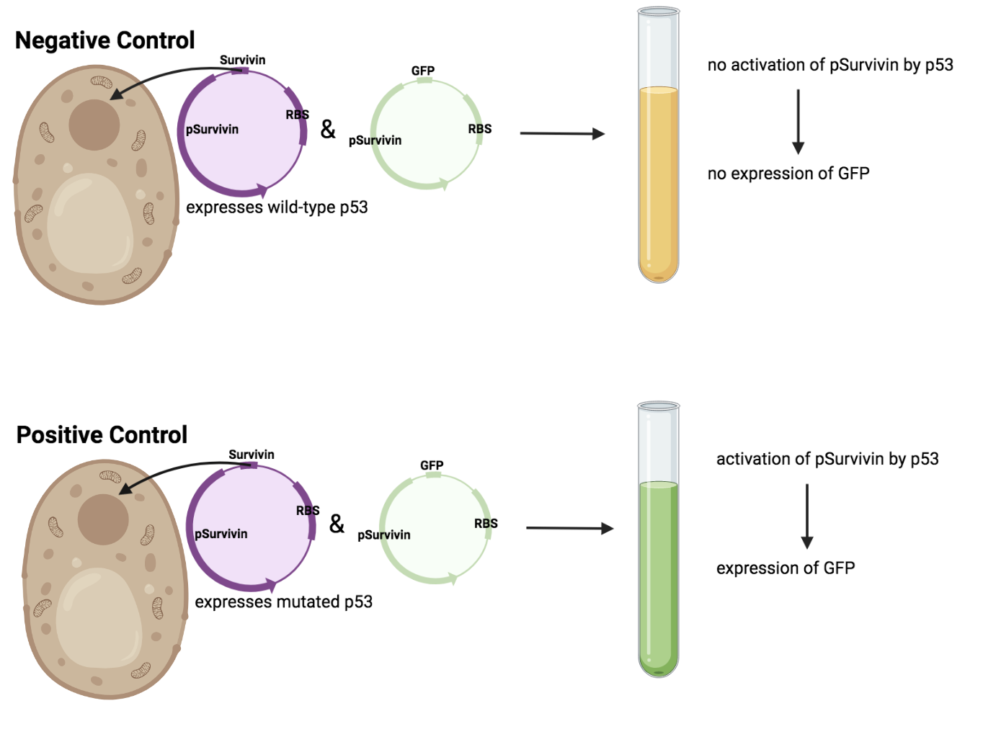
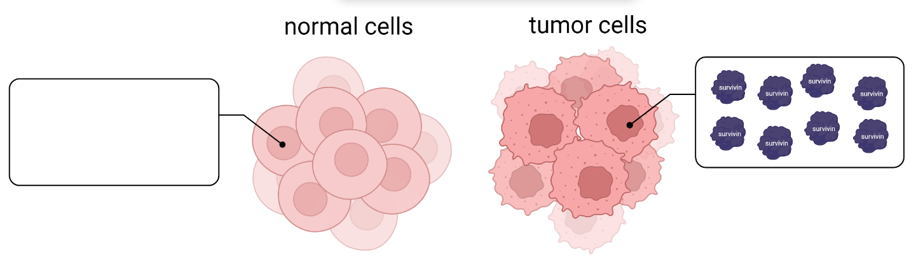
“Survivin” Cancer
Angelina Chen, Chloe Wang, Destiney Chen, Emma Chow,
Veronica Kuo
Taipei American School, Taipei, Taiwan
Introduction & Project Details
Planned Experiments
Problem: Cancer cases have been on the incline; 50% of all cases have been caused by mutations of the tumor suppressor protein p53
Figure 1. Mutated p53’s effect on the expression of pSurvivin.
Figure 2. Concentration of survivin in normal cells vs tumor cells.
Goal: Create a cancer detection kit that can diagnose cancer at an early stage, using pSurvivin and a reporter gene (GFP).
Figure 3. The pSurvivin + RBS + GFP sequence we plan to express.
Figure 4. Expected results for our experiments on yeast.
Notes:
Step 1: Contruct a plasmid containing -p53 in yeast, in addition to pSurvivin + GFP gene sequence
Negative control
Step 2: Experiment on mutated p53
Theoretically, the gene above (fig. 3) will signal a positive sign (fluorescence) for cancerous cells
Determining whether the degree of fluorescence can:
Detect preliminary stages of cancer
Indicate the stage of cancer
To optimize the signal of a positive test, we will modify our experimental design according to the results we get at this stage.
Step 3: Create a kit for public use with standards for interpretation of the results of the test

Slide 2
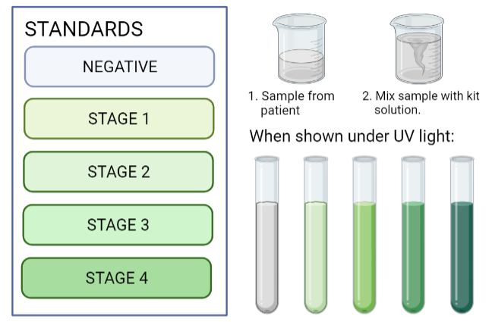
“Survivin” Cancer
Angelina Chen, Chloe Wang, Destiney Chen, Emma Chow,
Veronica Kuo
Taipei American School, Taipei, Taiwan
Challenges for Next Year’s Team
About This Year’s Team
Test the detection kit using mammalian cancer cells
How cells will be acquired to use the kit (ex. urine, cotton swab sample, etc.)
Making a practical prototype of the kit for at-home use
Find a definitive way to show varying results of the kit as colors may be ambiguous
TAS Taipei iGEM’s 2022 Green Team consists of five high school students: one senior (Angelina Chen) and four juniors (Chloe Wang, Emma Chow, Destiney Chen, Veronica Kuo).
References & Acknowledgements
Thanks to:
Leah Davis, team mentor
Jude Clapper
Jonathan Hsu
Figure 5. The proposed cancer detection kit and its expected results.

