Slide 1
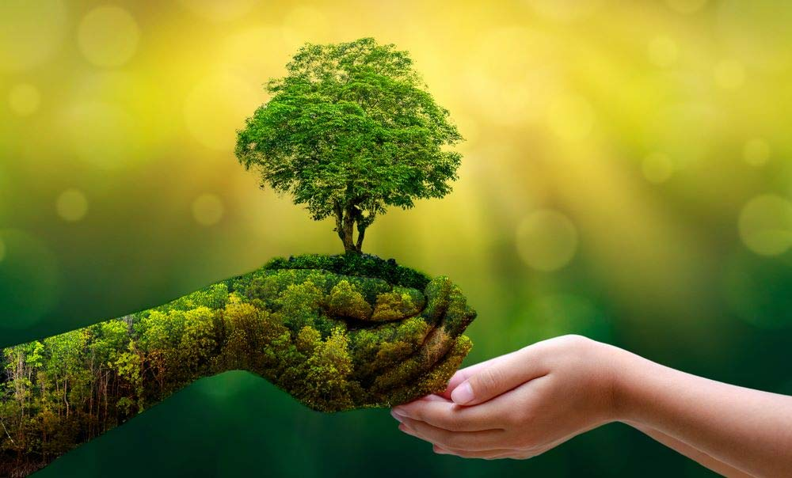

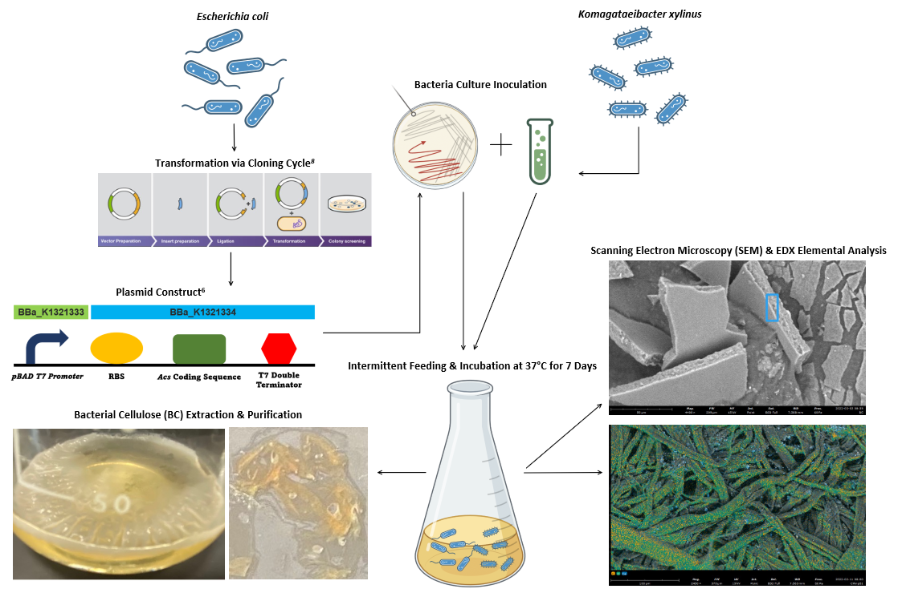
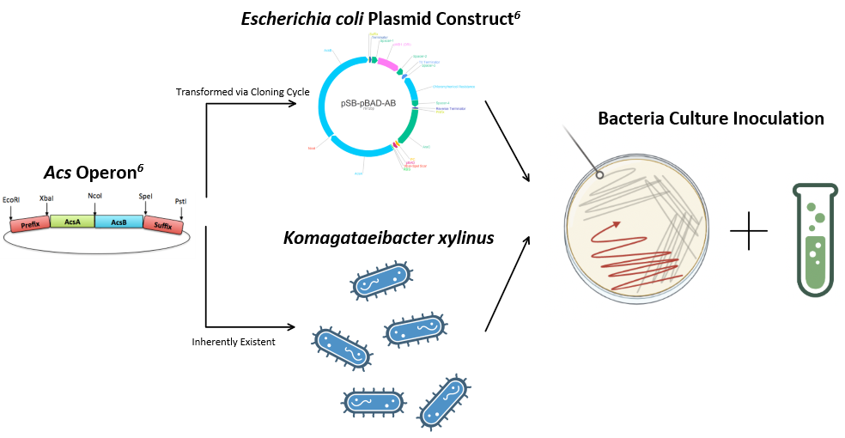
BC, A Tree-Free Guarantee: Producing Alternate Paper with Bacterial Cellulose
Austin Chang, Candice Hsu, Chia-Shuan Yeh, Evan Liu, Ruby Kuo, Stevin Yang, William Wang
TAS_Taipei_Blue, Taipei American School, Taipei
Introduction & Project Details
Experiments We Performed & Planned
Problem:
422 million metric tons of paper consumed globally in 2018¹
High demand for paper leads to mass deforestation²
Goal: Produce alternative paper source - Bacterial Cellulose (BC)
Project Design:
Acetobacter cellulose synthesis (Acs) operon - produces BC^{3,6}
  Gene in Komagataeibacter xylinus (K. xylinus)
  Expression of Acs in Escherichia coli (E. coli)
    More commonly found, has optimal growth kinetics^{4,5,6}
Creation of BC Polymer:
Intermittent Feeding Strategy
  Fresh nutrients supplied to bacteria cultures
  Multilayer BC formation to improve polymer strength⁷
Figure 1: Project Design for the Present Study
Figure 2: Experimental Flowchart for the Present Study

Slide 2
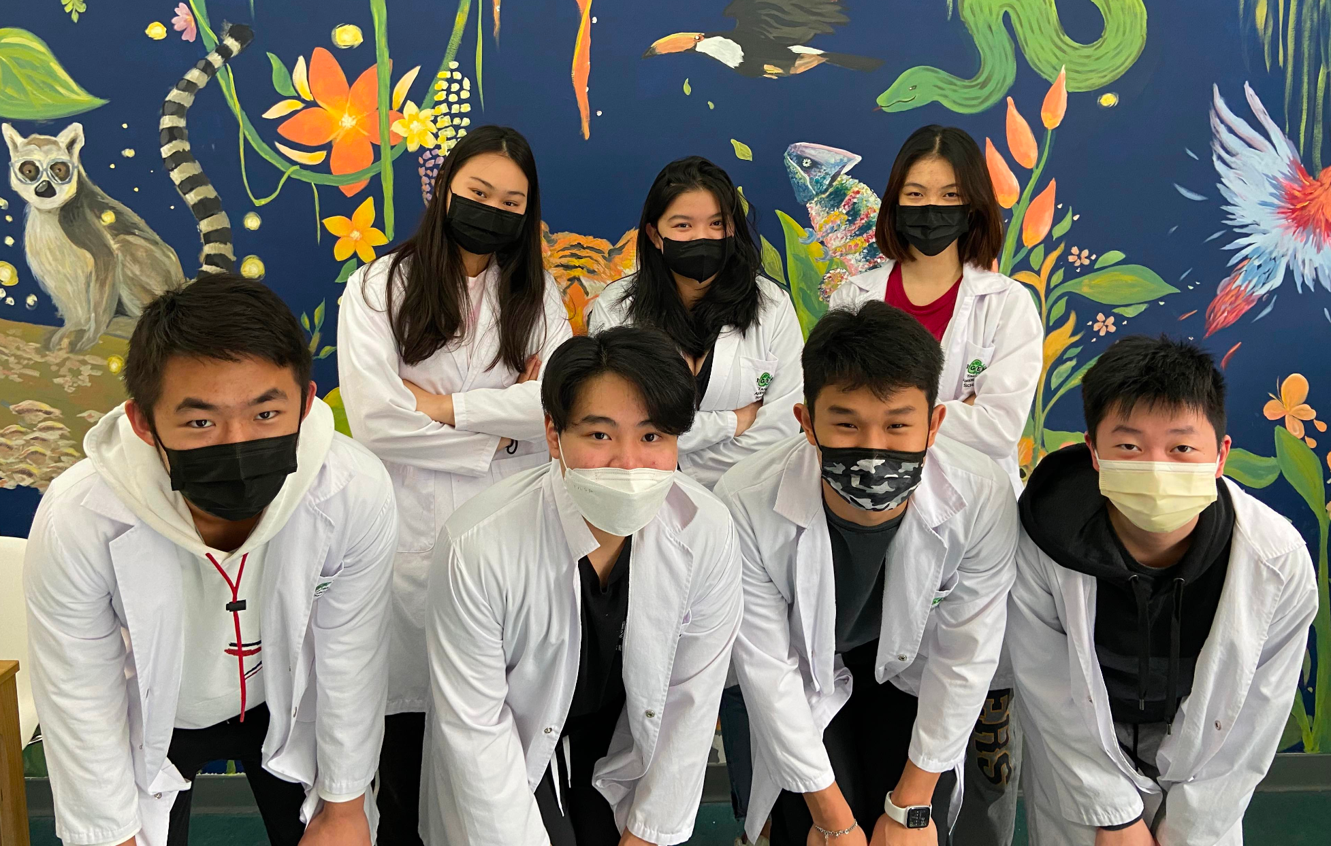
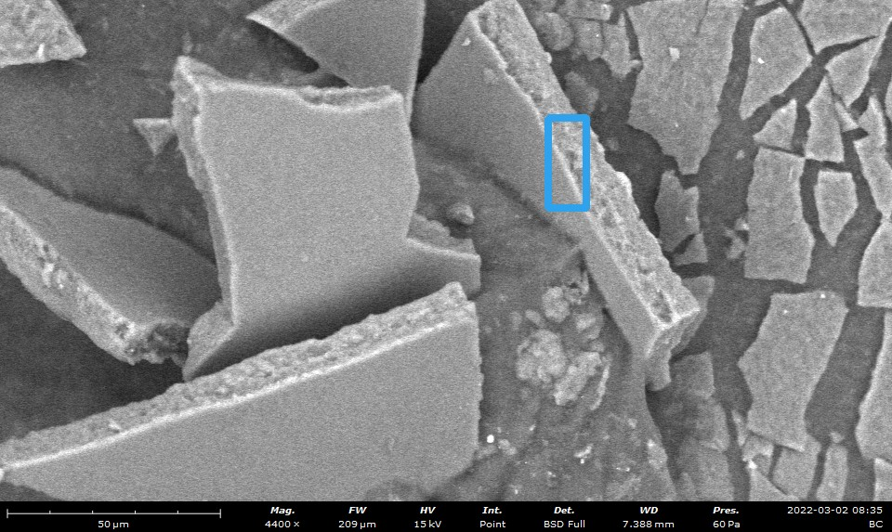


BC, A Tree-Free Guarantee: Producing Alternate Paper with Bacterial Cellulose
Austin Chang, Candice Hsu, Chia-Shuan Yeh, Evan Liu, Ruby Kuo, Stevin Yang, William Wang
TAS_Taipei_Blue, Taipei American School, Taipei
Results & Analysis
About Our Team
Scanning Electron Microscopy & EDX Elemental Analysis:
BC elemental atomic concentrations compared with Paper Towel (PT) positive control; similar carbon contents
Our team consists of 7 juniors from Taipei American School.
Atomic % | BC | PT
C | 48.8 | 49.6
O | 28.7 | 49.5
N | 14.9 | -
Na | 3.4 | -
Cl | 2.8 | -
Ca | - | 0.9
Figure 4: Photo of Team TAS_Taipei_Blue
Figure 3: SEM Image of BC from K. xylinus
Table 1: Elemental Analysis Data
References & Acknowledgements
Future Works & Applications
Special thanks to Dr. Jonathan Hsu, Mr. Jude Clapper, Mr. Sean Tsao, and the Taipei American School Scientific Research Department for making this project possible!
"Topic: Paper Industry Worldwide". 2022. Statista. https://www.statista.com/topics/1701/paper-industry/#:~:text=With%20some%20422%20million%20metric,tons%20of%20paper%20and%20paperboard.
Hoang, Nguyen Tien, and Keiichiro Kanemoto. 2021. "Mapping The Deforestation Footprint Of Nations Reveals Growing Threat To Tropical Forests". Nature Ecology & Evolution 5 (6): 845-853. doi:10.1038/s41559-021-01417-z.
Saxena, I M. 2022. "Characterization Of Genes In The Cellulose-Synthesizing Operon (Acs Operon) Of Acetobacter Xylinum: Implications For Cellulose Crystallization". Journal Of Bacteriology. https://journals.asm.org/doi/abs/10.1128/jb.176.18.5735-5752.1994.
Sajadi, Elaheh, Valiollah Babaipour, Ali Asghar Deldar, Bagher Yakhchali, and Seyed Safa-Ali Fatemi. 2017. "Enhancement Of Crystallinity Of Cellulose Produced By Escherichia Coli Through Heterologous Expression Of Bcsd Gene From Gluconacetobacter Xylinus". Biotechnology Letters 39 (9): 1395-1401. doi:10.1007/s10529-017-2366-6.
"Team:Tokyo Metropolitan - 2010.Igem.Org". 2022. 2010.Igem.Org. http://2010.igem.org/Team:Tokyo_Metropolitan.
"Team:Imperial - 2014.Igem.Org". 2022. 2014.Igem.Org. http://2014.igem.org/Team:Imperial.
Hsieh, Jung-Ting, Meng-Jiy Wang, Jinn-Tsyy Lai, and Hwai-Shen Liu. 2016. "A Novel Static Cultivation Of Bacterial Cellulose Production By Intermittent Feeding Strategy". Journal Of The Taiwan Institute Of Chemical Engineers 63: 46-51. doi:10.1016/j.jtice.2016.03.020.
Sciences, Life, Molecular Education, Molecular Education, Traditional Education, and Traditional Basics. 2022. "Traditional Cloning Basics | Thermo Fisher Scientific - UK". Thermofisher.Com. https://www.thermofisher.com/tw/zt/home/life-science/cloning/cloning-learning-center/invitrogen-school-of-molecular-biology/molecular-cloning/cloning/traditional-cloning-basics.html.
Nakagaito, A.N., S. Iwamoto, and H. Yano. 2005. "Bacterial Cellulose: The Ultimate Nano-Scalar Cellulose Morphology For The Production Of High-Strength Composites". Applied Physics A 80 (1): 93-97. doi:10.1007/s00339-004-2932-3.
Ul-Islam, Mazhar, Taous Khan, and Joong Kon Park. 2012. "Water Holding And Release Properties Of Bacterial Cellulose Obtained By In Situ And Ex Situ Modification". Carbohydrate Polymers 88 (2): 596-603. doi:10.1016/j.carbpol.2012.01.006.
Meza-Contreras, Juan C., Ricardo Manriquez-Gonzalez, José A. Gutiérrez-Ortega, and Yolanda Gonzalez-Garcia. 2018. "XRD And Solid State 13C-NMR Evaluation Of The Crystallinity Enhancement Of 13C-Labeled Bacterial Cellulose Biosynthesized By Komagataeibacter Xylinus Under Different Stimuli: A Comparative Strategy Of Analyses". Carbohydrate Research 461: 51-59. doi:10.1016/j.carres.2018.03.005.
Khaira, Ashish, and R.K. Dwivedi. 2018. "A State Of The Art Review Of Analytical Hierarchy Process". Materials Today: Proceedings 5 (2): 4029-4035. doi:10.1016/j.matpr.2017.11.663.
Improve BC production rate and polymer quality
  Strength/malleability⁹, water absorption¹⁰, crystallinity¹¹
Collect advice from experts in paper industry/BC production
Mathematical models (i.e. AHP¹², regression) to simulate product supply/demand trends and paper/BC production efficiency

