Slide 1

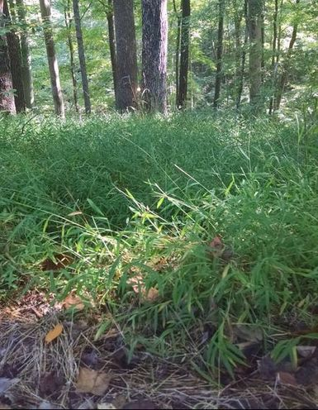
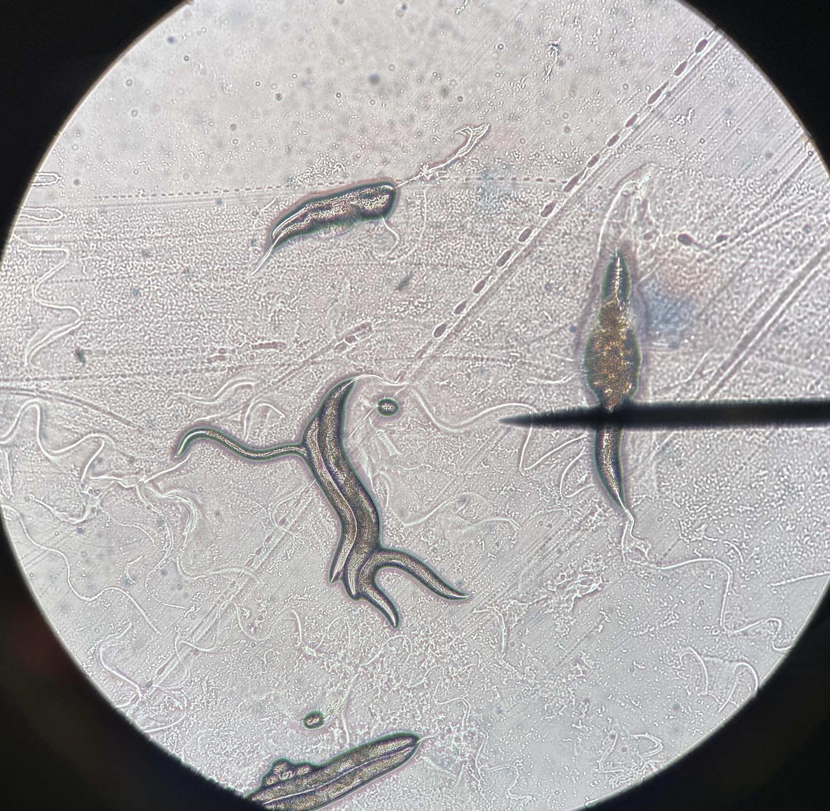
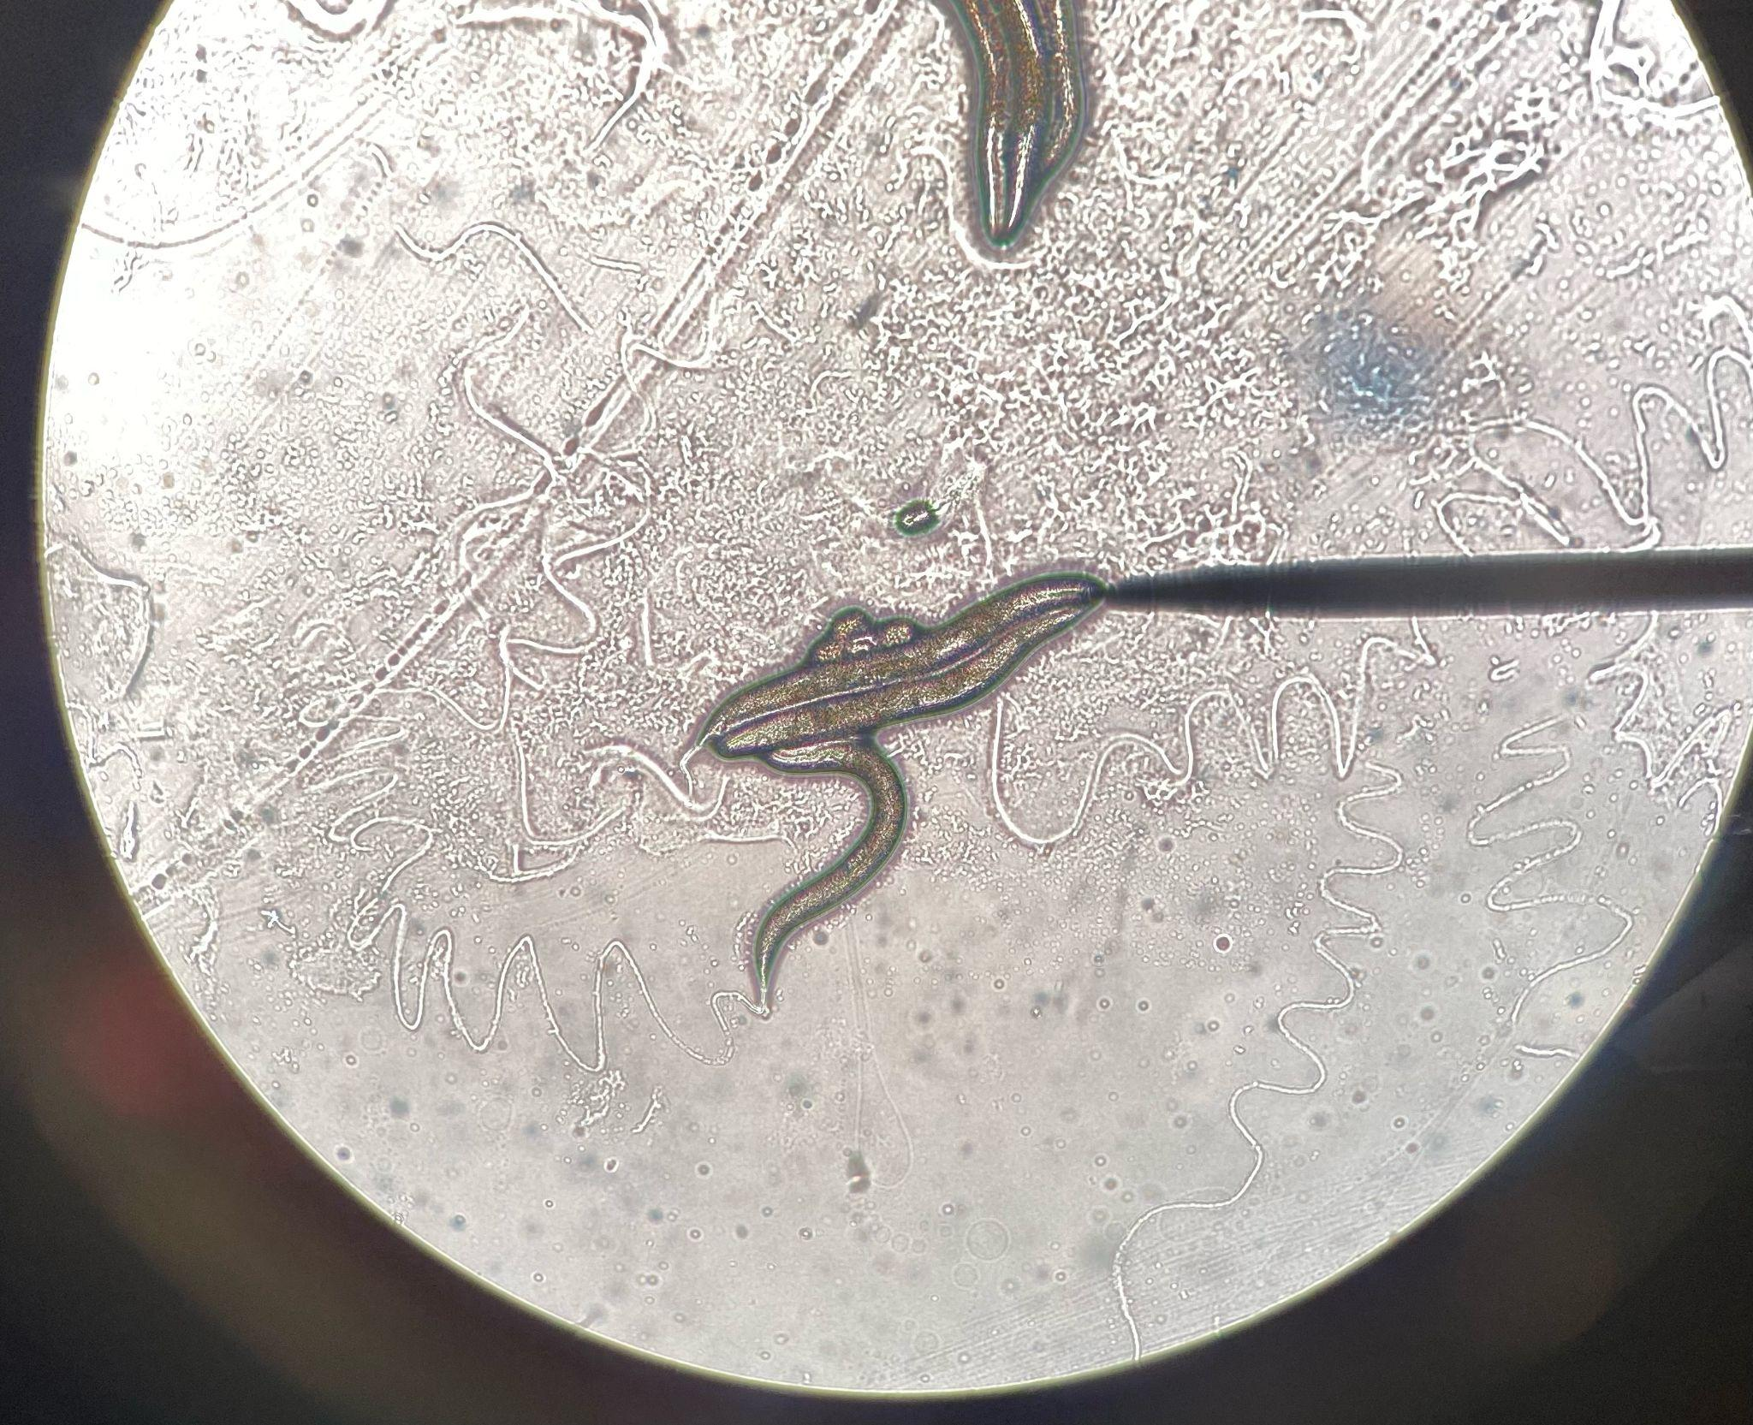
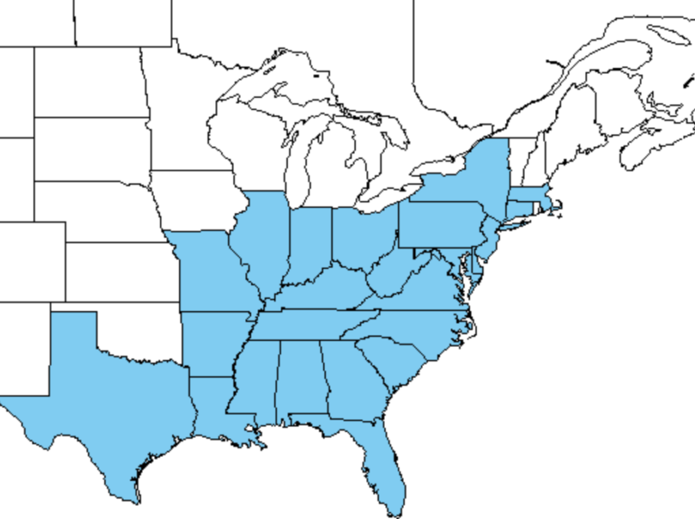
Non-Destructive Chemical Control of M. vimineum Using RNAi
Holly Gardner, Tao Groves, Sofia Lee, Kate Turman
Renaissance School, Charlottesville VA
Introduction & Project Details
Experiments We Did &/or Planned
The invasive species Microstegium vimineum is a
monocotyledon in the poaceae family, an annual
and shade-tolerant plant with a mixed mating
system. Currently, removal of this invasive species
is only possible through chemical control, fire, or
manual extraction, which negatively impacts
surrounding plant life. RNAi technology has been
shown to be effective in amplifying and silencing
genes in similar monocots such as corn, asparagus, and onions.
In this project, RNAi technology will be used to silence the gene petN (that codes for the cytochrome b6/f complex subunit VIII) in M. vimineum, inhibiting photosynthesis and killing the stiltgrass. The selective nature of this technology will make it possible to significantly
reduce M. Vimineum populations without causing damage to the ecosystem. M. vimineum is prevalent in ecosystems all across the United States. This map depicts the spread of M. vimineum since its introduction to the U.S in the early 1900s.
As the first step towards executing our project, we completed a lab using C. Elegans to practice using RNAi to limit or alter gene expression. The goal of the lab is to mutate the dpy-13 gene which codes for the synthesis of a collagen protein that affects the overall body shape of C. Elegans. By allowing wild-type worms to feed on an OP50 strain of E. coli expressing a plasmid which codes for the production of anti-RNA to the dpy-13 gene, C. elegans offspring expresseed a mutated dpy-13 collagen protein and stunted growth.
This lab provided some introductory experience in the process of RNAi and served as practice before we
attempt to use RNAi on M. vimineum. In the
future, we plan to test our project by
conducting an experiment
with real M. Vimineum
specimens from the
local ecosystem.
Unmutated C. Elegan worms in various stages of their lifecycle

Slide 2
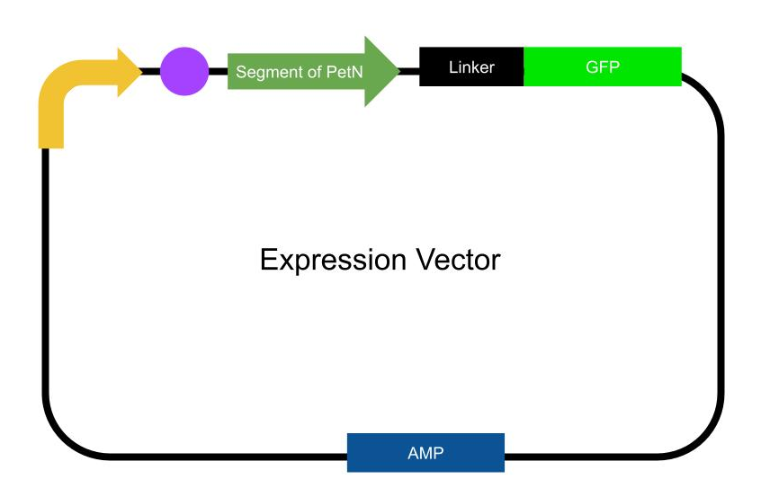
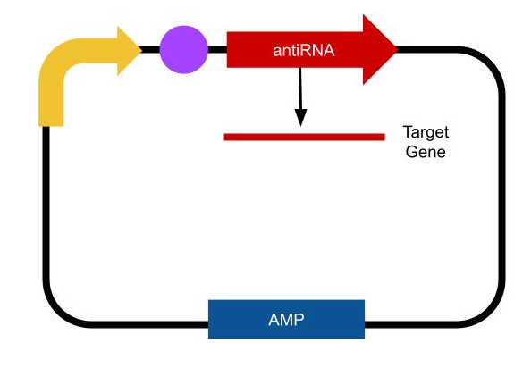
Non-Destructive Chemical Control of M. vimineum Using RNAi
Holly Gardner, Tao Groves, Sofia Lee, Kate Turman
Renaissance School, Charlottesville
Target Gene and Sequencing
About This Year’s Team
Gene petN codes for the cytochrome b6/f complex subunit VIII, which aids in electron transfer between photosystem II and photosystem I and electron flow in photosystem I. This gene was chosen because it is not highly conserved within plants in the U.S. There are nine subunits in cytochrome b6/f and not much is known about many of their functions. However, it has been shown that the silencing of petN can cause loss of photosynthetic electron transport function.
In order to be able to use the petN gene in this research, a RNAi sequence needed to be generated detailing the exact base pairs needed for this project. A program titled P-SAMS, created by the Carrington Lab, was used to generate the sequence which follows:
Forward Oligo: 5' TGTATAGAGTCCACTCCTCCCCCAAATGATGATCACATTCGTTATCTATTTTTTTTGGGGGAGGCGTGGACTCTA 3'
Reverse Oligo: 5' AATGTAGAGTCCACGCCTCCCCCAAAAAAAATAGATAACGAATGTGATCATCATTTGGGGGAGGAGTGGACTCTA 3'
This sequence will be used
in an expression vector, which
will produce an mRNA that is
complimentary to the target
gene’s mRNA thus silencing
expression. Additionally, a second vector containing a segment of the target gene linked to GFP will be used as a signalling vector to determine efficacy of the RNAi sequence.
This year’s Bio Builder Team is comprised of 4 students:
  Sofia Lee
  Kate Turman
  Holly Gardner
  Tao Groves
Our team and our school community as a whole are dedicated to robust learning experiences, multifaceted approaches/views, and having fun. We have had such a great time working with our Bio Builder advisor, Carine Robichon-Iyer, and experimenting with RNAi.
References & Acknowledgements
We would like to thank our mentor, Carine Robichon-Lyer, as well as our faculty lead, Anna Minutella.
Mickiewicz, A., Rybarczyk, A., Sarzynska, J., Figlerowicz, M., & Blazewicz, J. (2016). AmiRNA Designer—New method of artificial
miRNA design. Acta Biochimica Polonica, 63(1), 71–77. https://doi.org/10.18388/abp.2015_989
Microstegium vimineum. (n.d.). Retrieved March 11, 2022, from
https://www.fs.fed.us/database/feis/plants/graminoid/micvim/all.html
PETN - Cytochrome b6-f complex subunit 8, chloroplastic—Chlamydomonas reinhardtii—PETN gene & protein. (n.d.). Retrieved
March 11, 2022, from https://www.uniprot.org/uniprot/P0C1D4
Schwenkert, S., Legen, J., Takami, T., Shikanai, T., Herrmann, R. G., & Meurer, J. (2007). Role of the low-molecular-weight
subunits PetL, PetG, and PetN in assembly, stability, and dimerization of the cytochrome b6f complex in tobacco. Plant
physiology, 144(4), 1924–1935. https://doi.org/10.1104/pp.107.100131

