Slide 1

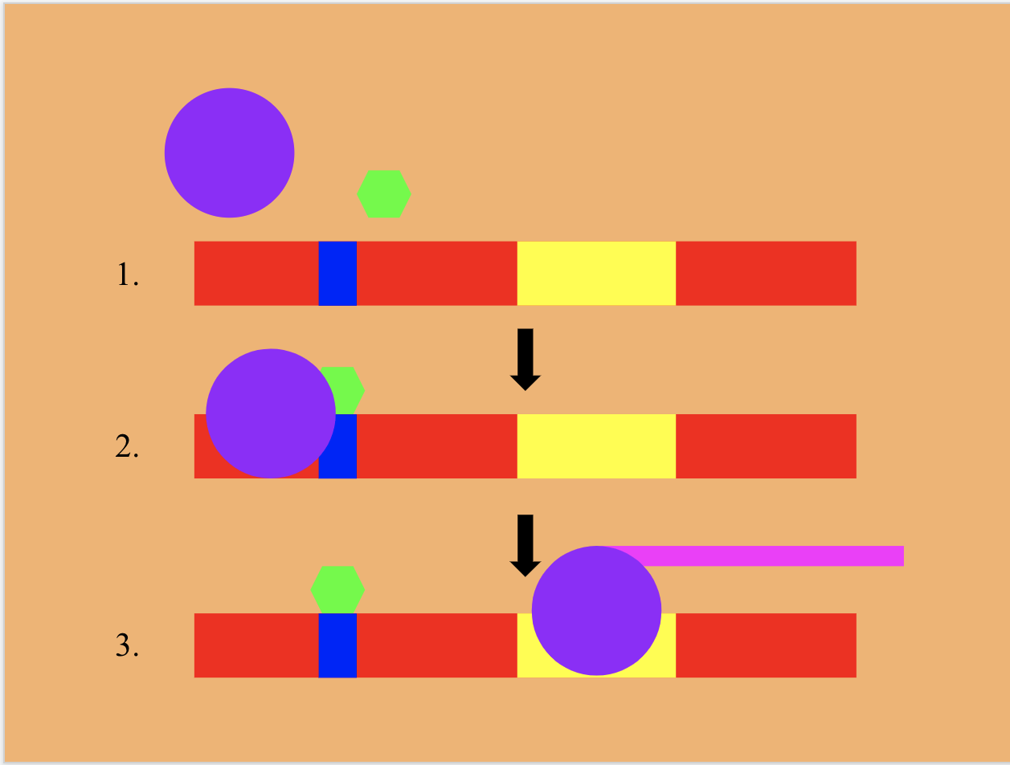
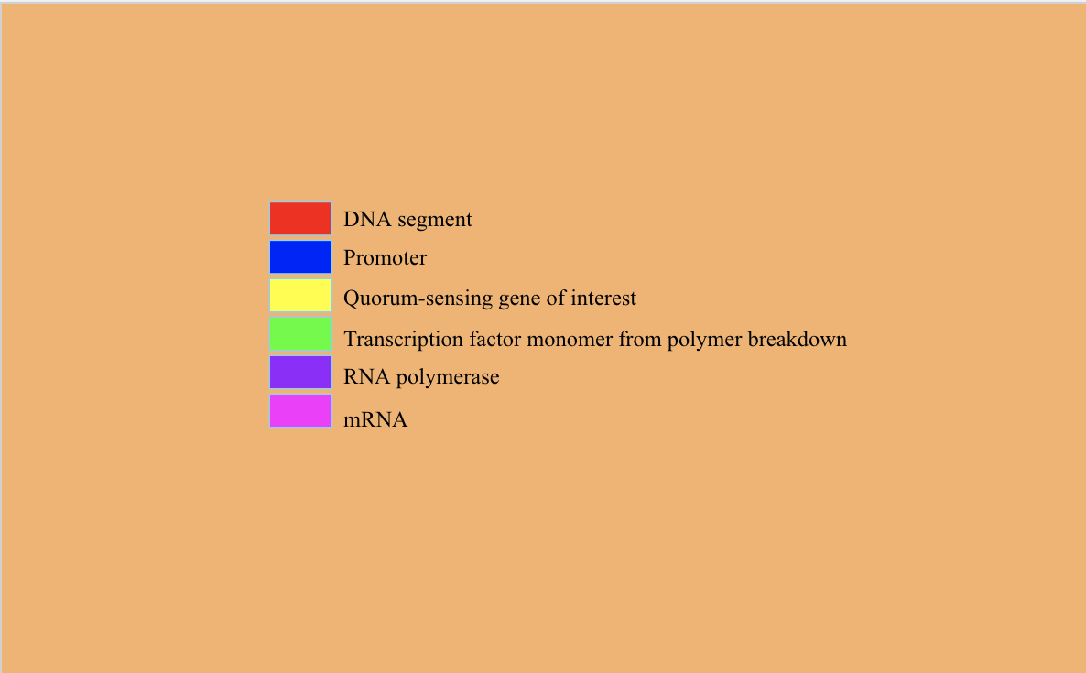
Modifying Algae to Combat Microplastic Pollution
Larry Huang, Aakash Jha, Chris Ji, Maria Karakousis, Tino Karakousis, Justin Liu,
Yehuda Mahlab, Neel Pandula, Liam Silverberg
Julia R. Masterman, Philadelphia PA
Introduction & Project Details
Experiments We Did &/or Planned
Background: Microplastics are fragments of any type of plastic less than 5 mm in length that are derived from a variety of sources, including from larger plastic debris that degrade into smaller segments. Consumption of these particles can reduce growth, reproductive output, blockage of the digestive tract, suffocation, starvation, and drowning in many aquatic animals and can enter into human diet through ingestion of contaminated organisms and water. Although there have been many solutions developed to deal with larger plastics, their counterparts microplastics, are much more difficult to address.
Solution: The proposed solution is to create a strain of filamentous algae that can absorb microplastics, efficiently retain them, and then change to a certain color not common in marine algae to indicate that absorption of microplastics is complete. The algae would also be altered so as to prevent algae reproduction and the formation of harmful algal blooms. Once the engineered algae has served its function and changes color, the algae would be removed from the water body and the high microplastic concentration along with it.
Specifically, our proposed chassis is ostreococcus, a simple strain of green algae with a very compact genome amenable to genetic engineering. Our target is polyethylene terephtalate, a plastic used in water bottles that leaches antimony, which poses both acute and chronic health effects in humans. The captured polyethylene will be broken down with the help of an enzyme in ethylene and propylene molecules, which are two monomers that can attach to the green fluorescent protein (GFP), causing the release of a fluorescent glow when stimulated by a ultraviolet light.
Objective: Modifying ostreococcus to promote microplastic aggregation and removal.
Techniques - Microplastic Absorption: A plasmid will be constructed using bio-blocks (pre-assembled genes/nucleotide sequences) of the following genes: BBa_E0040 (green fluorescent protein, or GFP) and BBa_J04450 (RFP). PETase and MHETase enzymes will be employed to break down polyethylene terephthalate. Said plasmid will then be inserted into the ostreococcus genome. Successful transformation and insertion of desired genes will be detected by luminescence above threshold presence of polyethylene terephthalate in surrounding environment.
Techniques - Algae Retention and Collection: Genetically modified algae will be placed within a sealed container of any size and either placed in water with a tracker or attached to a ship in the desired cleanup location. A pump on the device will intake water into the container, which will be filtered by the algae. When the container is full, the pump will shut off and the container will be effectively sealed. The container can then be retrieved and the algae containing microplastics processed. In this way, spread of harmful algal blooms is prevented while maintaining a capability to cleanse large amounts of water.

Slide 2
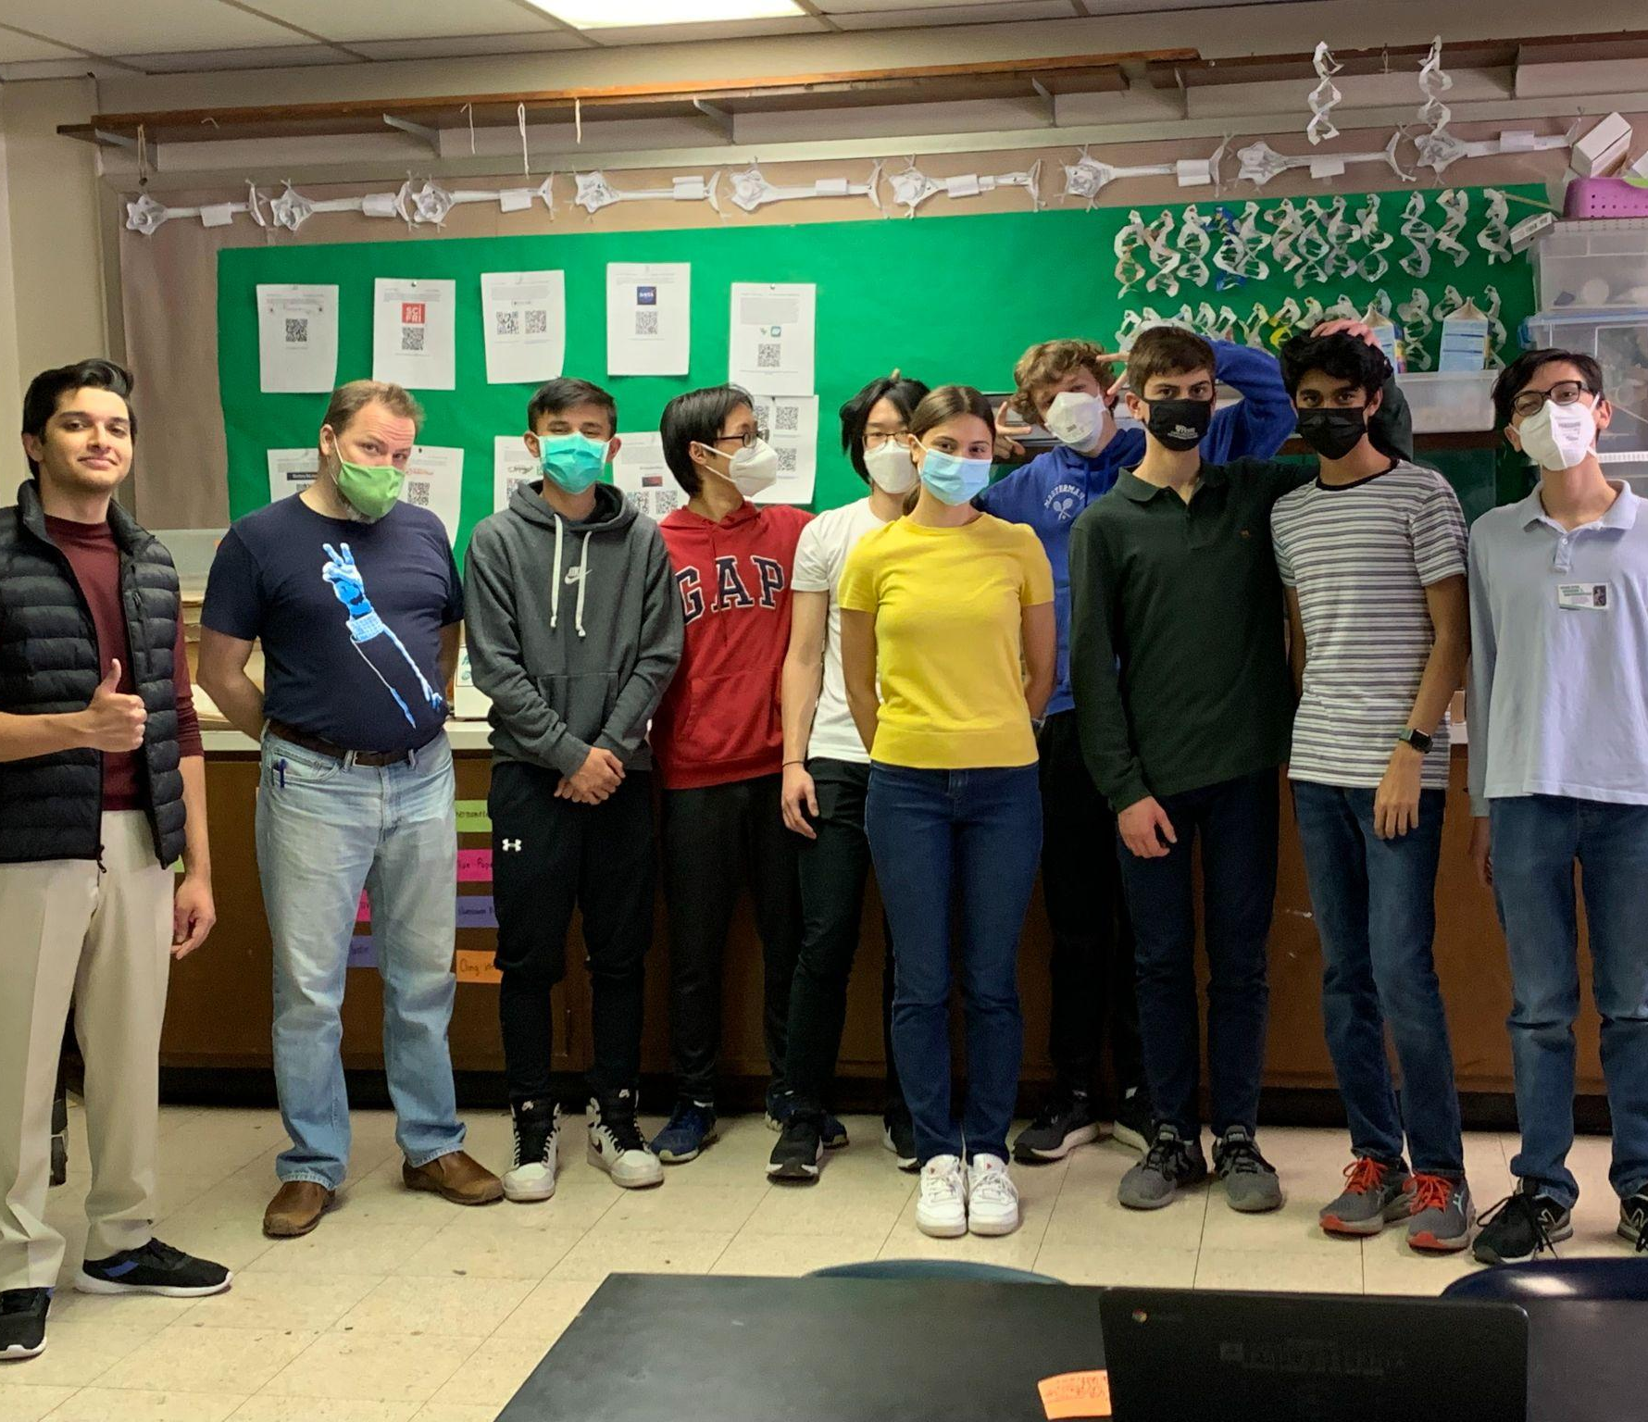


Project Title
Participating Students (first and last names)
School Name, Location
Modifying Algae to Combat Microplastic Pollution
Larry Huang, Aakash Jha, Chris Ji, Maria Karakousis, Tino Karakousis, Justin Liu,
Yehuda Mahlab, Neel Pandula, Liam Silverberg
Julia R. Masterman, Philadelphia PA
Limitations and Challenges for Next Year’s Team
About This Year’s Team
Investigating success of device in different water pH levels and compositions (salt water, fresh water, etc…)
Conducting the experiment in at least triplicates for increased statistical significance
  Generating accurate and precise results
Considering other methods to counteract the rapid reproduction of algae, which is known to worsen the presence and stifling effects of algal blooms
  Evaluate viability and feasibility of different mitigation options, including:
    Physical enclosure of algal population without bringing harm to aquatic life
    Deactivating or removing certain genes responsible for algal reproduction
    Boosting microplastic absorption so that a significant amount can be removed from an aquatic environment before reproduction begins
    Moving water in need of treatment to facilities where algae can be introduced in a controlled manner, instead of introducing algae directly into environments
Limitations
  Access to necessary materials and equipment, limited vigor of response in chassis to environmental stimuli, and the feasibility of inserting the proposed genes into algal genome are challenges to address in the implementation of our idea.
  We plan to conduct our experiment in E. Coli prior to attempting modifications of ostreococcus.
We are a returning and expanded team of about ten members who are grateful to be able to meet in person following a year and a half of entirely virtual school and activities. We have thoroughly enjoyed thinking through experiment ideas together. In particular, we greatly appreciated having the opportunity to conduct the Bio Builder “Eau That Smell Lab” as part of our education in synthetic biology.
References & Acknowledgements
We would like to thank our teacher, Richard Zimny, and mentor, Irene Reizman, for their guidance and time.
National Geographic Society. “Microplastics.” National Geographic Society, 28 June 2019, www.nationalgeographic.org/encyclopedia/microplastics/.
NOAA. “What Are Microplastics?” NOAA's National Ocean Service, National Oceanic and Atmospheric Administration, 13 Apr. 2016, oceanservice.noaa.gov/facts/microplastics.html.
Catalog, parts.igem.org/Catalog.

