Slide 1

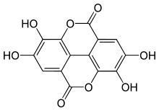
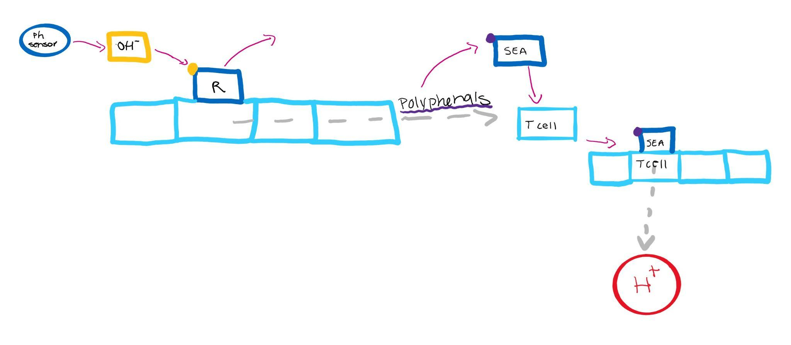
Curbing Inflammation with Phenolic Compounds
Leslie Baker, Cate Lynch, Hana Shinzawa, and Liesl-Ann Vaz
Montrose School, Medfield, MA
Introduction & Project Details
Experiments We Planned/ Pictures
Overactive Th2 cells, which are activated in a cycle of epithelial barrier damage, lead to increased inflammation. This inflammation causes autoimmune conditions such as asthma, eczema, and allergies.
Enterotoxins from common human pathogen S. Aureus, known as SEs, can act as superantigens and activate T cells, generating an exacerbated immune response which can lead to increased risks of asthma and eczema. Superantigen SEA has been inhibited when added to apple juice, suggesting that phenolic compounds may be effective in inactivating SEA and thus curbing immune response.
In order to combat this overactive immune response, an organism can be engineered to produce SEA-inactivating phenolic compounds in order to reduce immune response and thus the symptoms of eczema.
Because eczema is accompanied by an increase in skin acidity, we can engineer a sensor to detect when skin pH rises above the normal 5.5 pH. This sensor would then trigger our organism to produce phenolic compounds, inhibiting superantigens contributing to inflammation. These systems would be contained in a lotion applied to the skin.
Polyphenol
Our System

Slide 2


Curbing Inflammation with Phenolic Compounds
Leslie Baker, Cate Lynch, Hana Shinzawa, and Liesl-Ann Vaz
Montrose School, Medfield, MA
Challenge for Next Year’s Team
About This Year’s Team
In order to advance our project, we would need to explore the possible organisms that could be suitable for production of phenolic compounds. We would also need to determine specifically which compounds we want to produce.
We also need to research possible sensors that could be engineered to detect pH changes and determine how this sensor could then activate the phenolic-compound-producing organism.
After determining the organisms that we want to use, we could then begin experimenting to see if the selected organism could really produce the desired phenolic compound.
We are a new team of 3 sophomores and 1 freshman.
We were inspired to join BioBuilders after taking AP Biology and realizing that we were interested in further exploring synthetic biology.
References & Acknowledgements
Cezmi A. Akdis for sending us “Does the epithelial barrier hypothesis explain the increase in allergy, autoimmunity and other chronic conditions?”
Dr. Patricia Silveyra as our team’s mentor
Mrs. Dimitriou and Ms. Hanna

