Slide 1

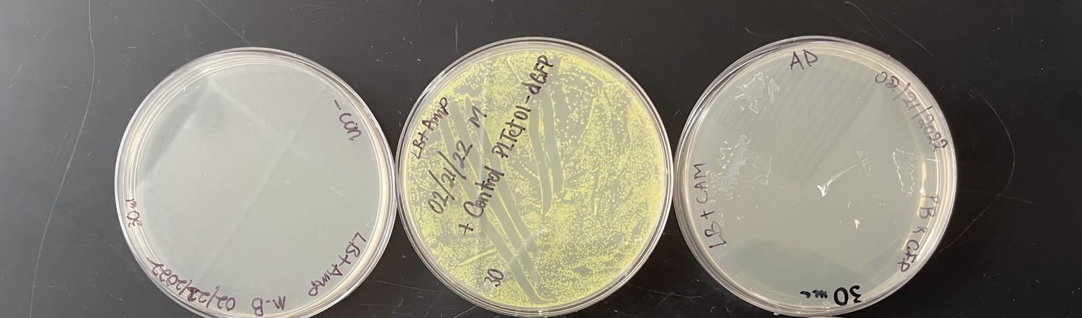
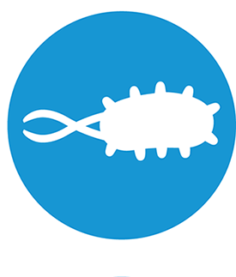
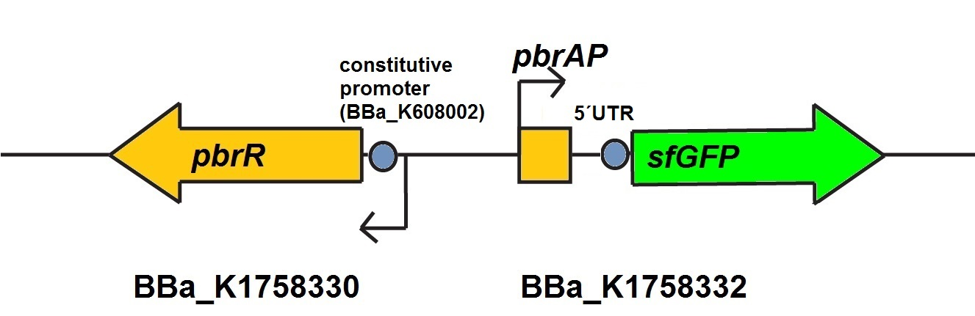
Engineering a biological system capable of sensing and removing lead from the environment.
Participating Students: Mamadou Barry, Monica Cen Cen, Simbala Camara, Aliou Diop and Keisi Goxhaj
Team leader: Alfred Lwin, Mentor: Racquel Kim Sherwood
School Name: Manhattan Comprehensive Night and Day High School, New York, NY
Abstract
According to a World Health Organization report, heavy metal pollutants from the environment pose a global health risk, resulting in approximately 12.6 million deaths each year. Lead is one of the major contaminants in the environment. Research shows that currently available remediation technologies to remove lead from the environment are expensive and produce a large amount of waste. Removing lead from the environment by bioremediation is less costly and restores the environment. Therefore, our MCNDHS Bio Builder team is interested in a bioremediation project. We want to engineer a biological system capable of detecting and removing lead from the environment. Reviewing the literature, we learned about an operon containing lead-specific binding protein Pbr from an extremophilic bacteria called Cupriavidus metallidurans. We plan to utilize this lead-specific operon from this bacteria and designed a whole-cell biosensor and bioremediation system to isolate environmental lead. We searched the standard iGEM library of parts with this information and identified it as Part: BBa_K1758333, a GFP reporter controlled by the lead responsive promoter from the same bacteria. We believe that this part could be an important first step in our project to build a whole-cell biosensor capable of sensing and removing lead from the environment. During our winter break, we transformed lead-specific binding protein Pbr (BBa_K1758333) into E.coli at the BioBuilder Learning Lab at Ginkgo Bioworks.
Engineering a Biosensor
Materials and Methods
NEB 5⍺ Competent E. coli cells
Control Plasmid: GFP Producer Experimental Plasmid: BBa_K1758333 (Bioreporter)
LB Liquid
42ºF Heat Block
37ºF Shaking incubator
LB+Ampicillin plates
LB+Chlormphenicol plates
1) Collect competent cell and plasmid DNA and incubate them on ice for 30 mins.
2) Gently aspirate 2µl of appropriate plasmid and gently add to competent cells.
3) Flick 4-5 times to mix cells and DNA. Immediately Return to ice.
4) Incubate cell + Plasmid mix on ice for 30 minutes on ice. Do not mix.
5) Heat shock at exactly 42°C for exactly 30 seconds. Do not mix.
6) Place on ice for 5 minutes.
7) Add 950 µl of room temperature LB medium to transformation tube
8) Place in shaker and incubate at 37°C for 60 minutes
9) Using spreader, spread 30 µl (+70µl LB) on selection plate 1 and 100 µl of bacterial transformation onto selection plate.
10) Incubate at 30°C for 24-36 hours. Store plates in the refrigerator
Transformation Plates
Lead detector, PBr and color generator GFP.
Pb
Chassis
E. coli
- Control = Water
+ Control= GFP producer
Bioreporter

Slide 2
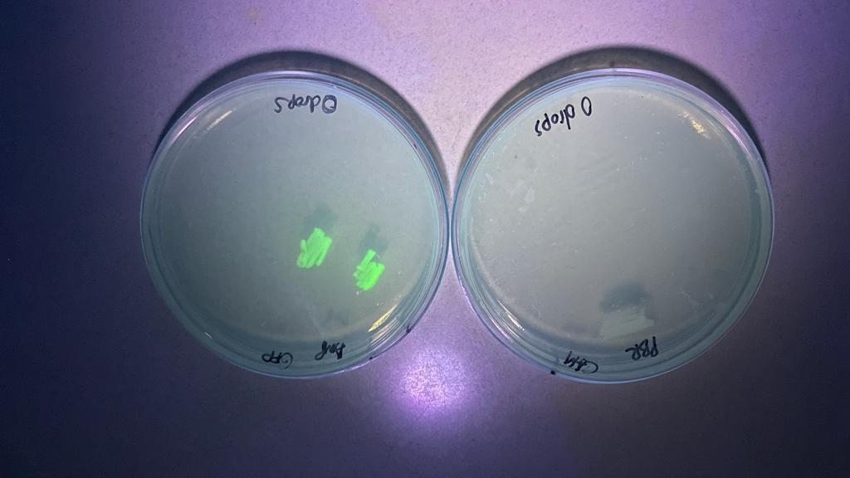
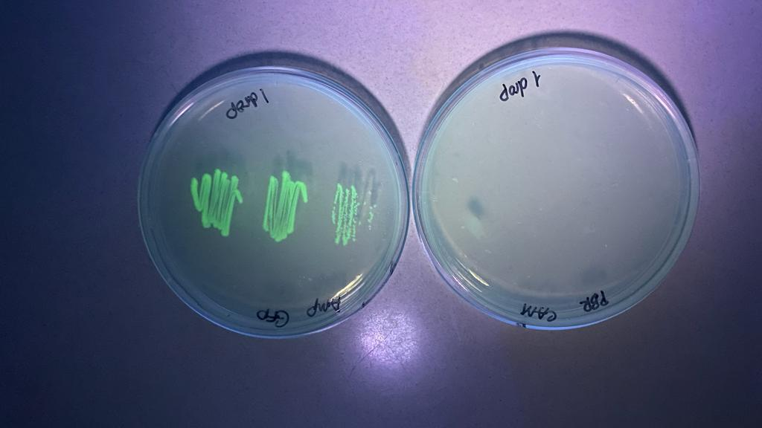
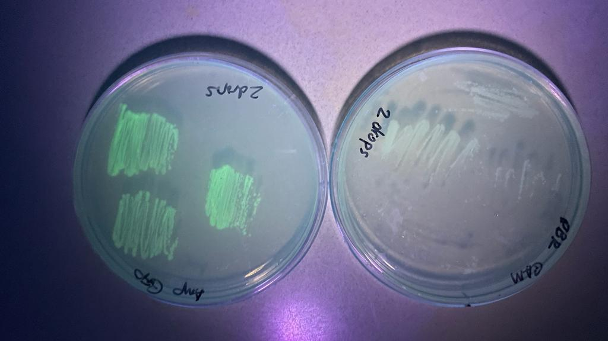
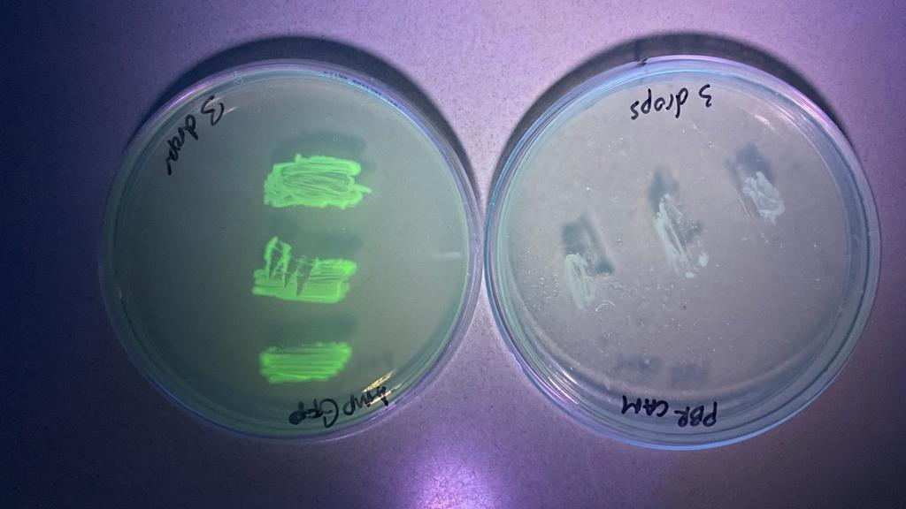
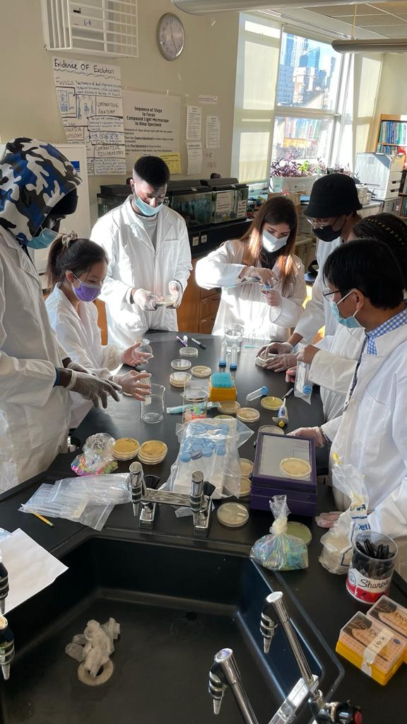
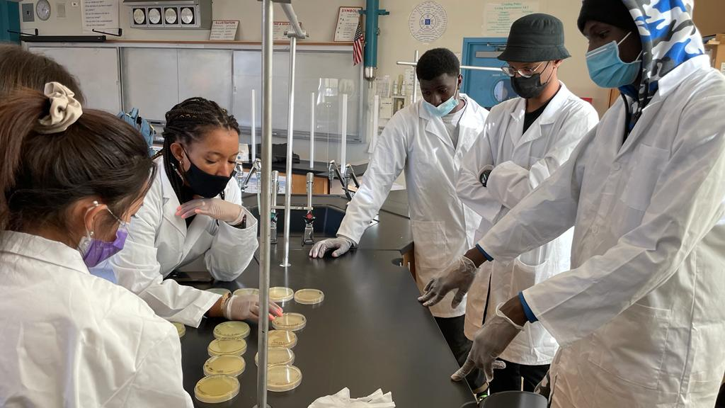
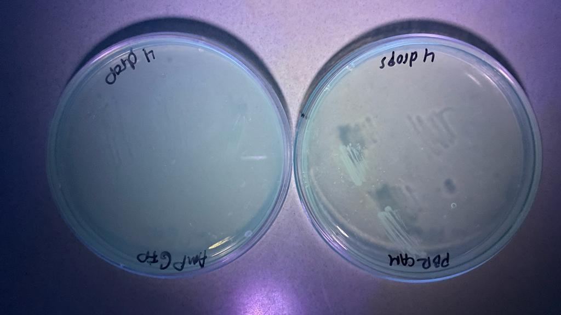
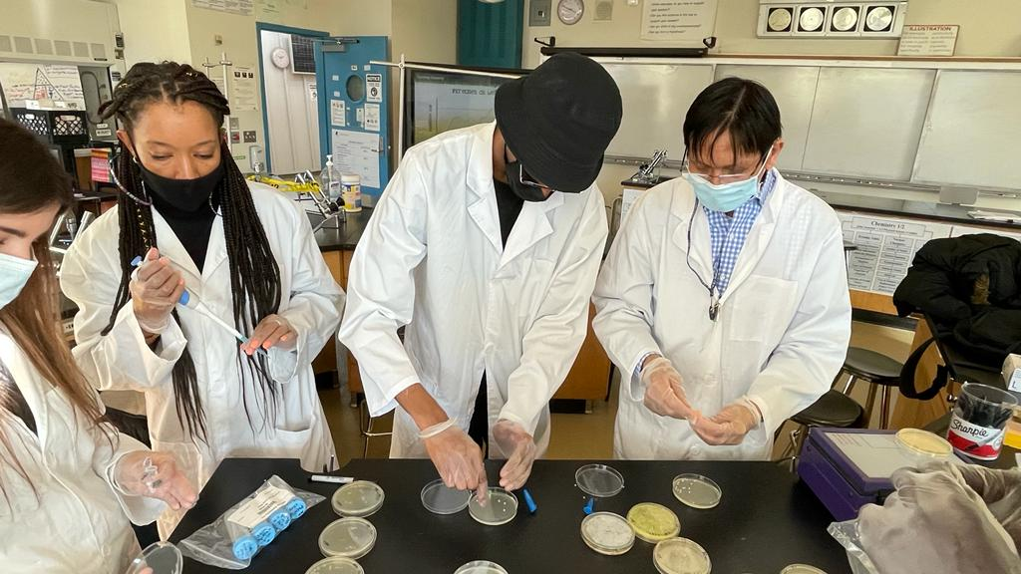
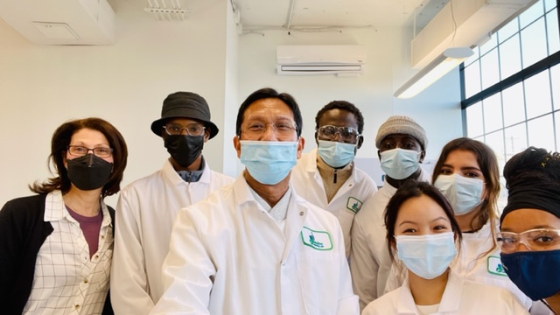
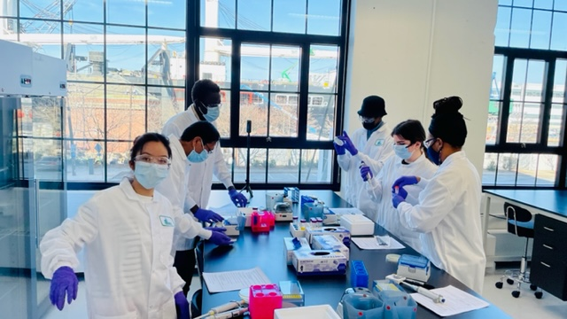
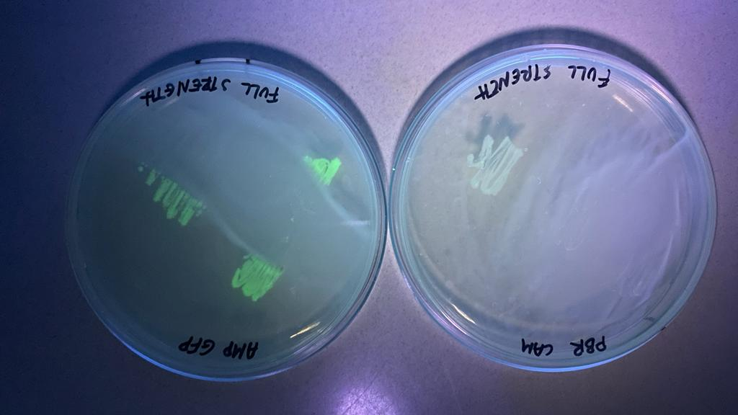
Testing Biosensor
Materials and Methods
1) Spread 100μl of each lead solution (0-5 drops Pb(NO₃)₂) onto individual plates onto LB+Amp and LB+ Chloramphenicol. Allow plates to ‘dry’.
3) Use inoculation loop to patch GFP producer or engineered cells onto both plates indicated below
4) Incubate @ 37ºC O/N @ room temp.
5) Illuminate patches on the plate with blue light in a dark room.
6) Take a picture to record fluorescence.
Response to Lead
Results
Unfortunately, we did not have many PBR transformants to test. Although cell patches grew in the presence of all concentrations of lead, the were not able to report the presence of lead by turning green. And, due to time constraints, we were unable to repeat the transformation and troubleshoot our experiment and determine if the the transformation did not work or if the reporter construct isn’t functioning as anticipated.
We hope that future MCNDHS Biobuilders are able to repeat overcome transformation challenges and test the function of this bioreporter. Because we believe that it is possible to fully engineer bacteria that can sense and remove lead from the environment.
Bioreporter GFP Producer
Lead solutions
5x LB Plate + AMP/Chloramphenicol
Sterile Water
Sterile glass beads
Inoculation loop
Darkened room
Black Light/UV light
Cell phone camera
References
Heavy Metal Removal by Bioaccumulation Using Genetically Engineered Microorganisms file:///E:/Synthetic%20biology/Lead%20contamination%20folder%20for%20BioBuilder/Heavy%20metal%20removal%20by%20bioaccumulation.pdf
How Synthetic Biology Can Help Bioremediation. White Rose Research Online URL for this paper:
https://eprints.whiterose.ac.uk/165288/
Lead Poisoning WHO
file:///E:/Synthetic%20biology/Lead%20contamination%20folder%20for%20BioBuilder/Lead%20poisoning.pdf
Simple Whole-Cell Biodetection and Bioremediation of Heavy Metals Based on an Engineered Lead-Specific Operon
file:///E:/Synthetic%20biology/Lead%20contamination%20folder%20for%20BioBuilder/Simple%20Whole-Cell%20Biodetection%20and%20Bioremediation%20of%20Heavy%20Metals.pdf
Microbes used as a tool for bioremediation of heavy metal from the environment Molalign Medfu Tarekegn , F
https://www.tandfonline.com/doi/full/10.1080/23311932.2020.1783174
Acknowledgements
Our MCNDHS BioBuilder Team very much would like to thank
Dr. Natalie Kuldell and Stephanie Orvitt for their advice and support. We are imminently grateful to our mentor Racquet Kim Sherwood for her mentoring throughout the project. Our profound thanks to Ms. Margaret
Aylward and Mr. Robert and CYD team and our heartfelt thanks to Ms. Erickson, Ms. Lau, Ms. Nam, Ms. Hernandez, Mr. Matura and all the faculty for their support.

