Slide 1


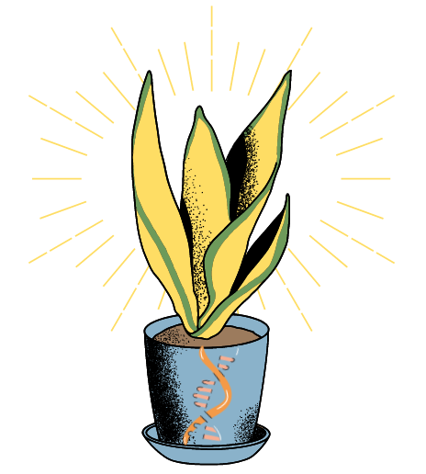
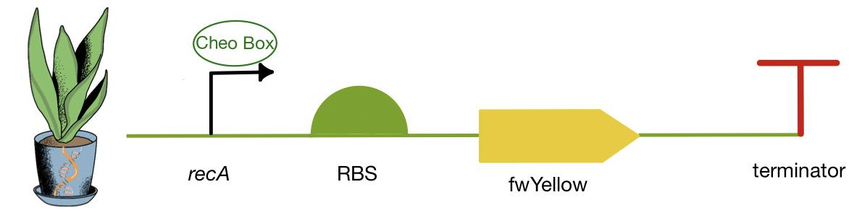
Detecting Radiation with Plants
Ella Bump, Parik Nepal, Rebecca Rubiano, Diana Yuan, Andy Zhao
Western Reserve Academy, Hudson, Ohio
Introduction & Project Details
Experiments We Plan to Do
High levels of radiation cause health issues,such as difficulty breathing and even cancer, in humans. Our project involves genetically altering the houseplant Tradescantia, commonly known as spiderwort, to turn yellow when exposed to high concentrations of radiation—effectively and visually alerting those around to evacuate and treat the high concentration of radiation appropriately.
Tradescantia will be used because its DNA has been shown to be damaged by radiation exposure. We will be using recA, a promoter activated by the radiation-caused breaks in Tradescantia’s DNA. A Cheo box, a specific operator sequence for amplifying the reaction to DNA damage, will be added to the recA promoter, as it increases promotor reactiveness to DNA breakage. The recA promoter will induce the expression of the chromoprotein fwYellow, causing the plant’s leaves to turn yellow when presented with radiation-induced DNA damage and thus fulfilling the purpose of warning the plant owner of high radiation levels by producing a visible signal.

Slide 2


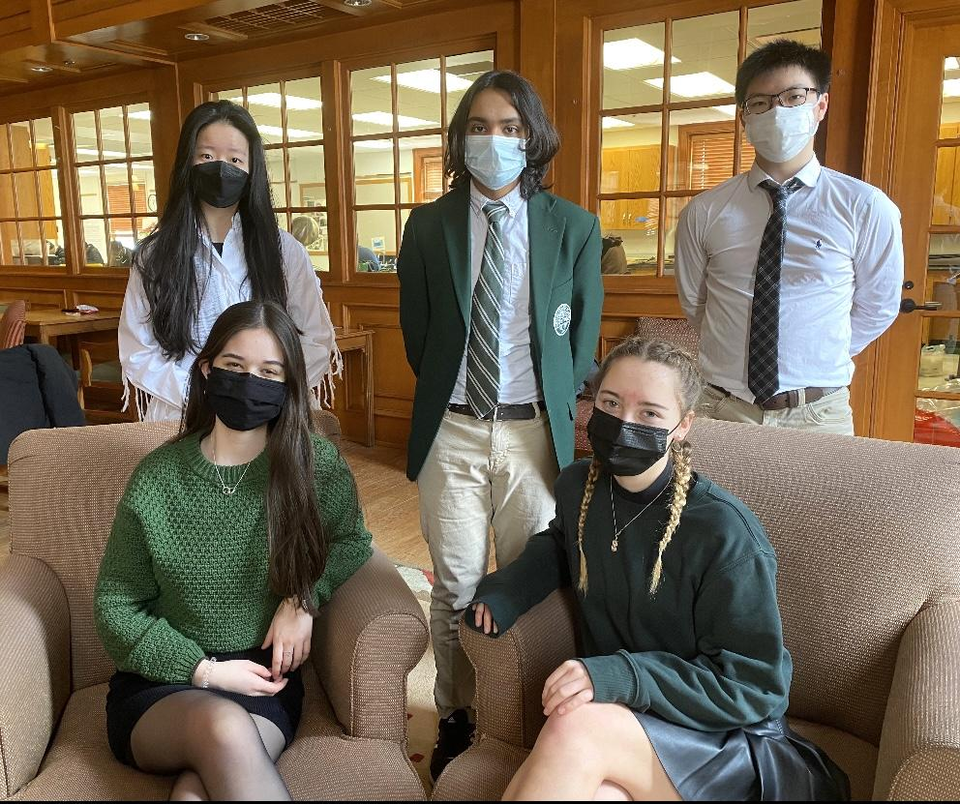
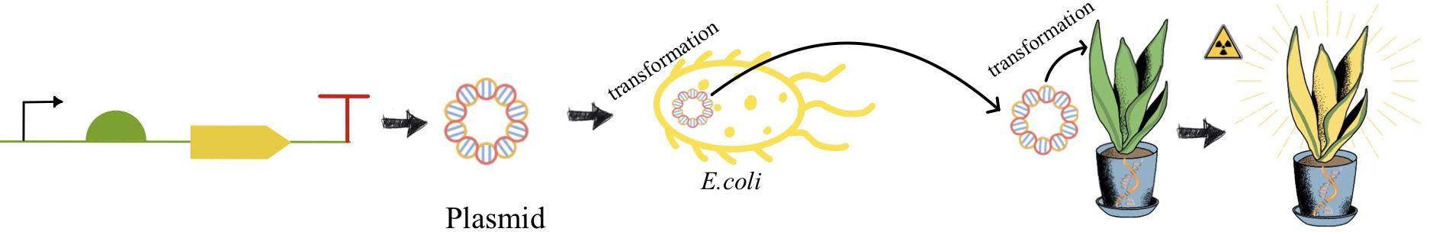
Detecting Radiation with Plants
Ella Bump, Parik Nepal, Rebecca Rubiano, Diana Yuan, Andy Zhao
Western Reserve Academy, Hudson, Ohio
Challenge for Next Year’s Team
About This Year’s Team
Next year’s challenges of this project are to determine the transformation method and to assess the visibility of the pigment produced within the plant. First, we will test the construct for pigment production in E. coli before testing it in plants. Once the system has been tested in bacteria, the device will be inserted into the plant. Next year’s team will grow the altered Tradescantia plant next to the unaltered Tradescantia plant to examine the difference of color once exposed to radiation.
Two forms of genetic transformation methods, including particle gun delivery and electroporation, will be evaluated.
Ella Bump (‘22): Second year of BioBuilder, from Sacramento, CA
Parik Nepal (‘22): First year of BioBuilder, from Hudson, OH
Rebecca Rubiano (‘23): First year of BioBuilder, from Hudson, OH
Diana Yuan (‘22): First year of BioBuilder Jiangsu province, China
Andy Zhao (‘22): First year of BioBuilder from Shanghai, China
Although the members have varying levels of experience, this is the team’s first year working on the Detecting Radiation with Plants project.
References & Acknowledgements
Thank you to Dr. Beth Pethel, our instructor, and Dr. Bob Trachman, our research mentor.

