Slide 1

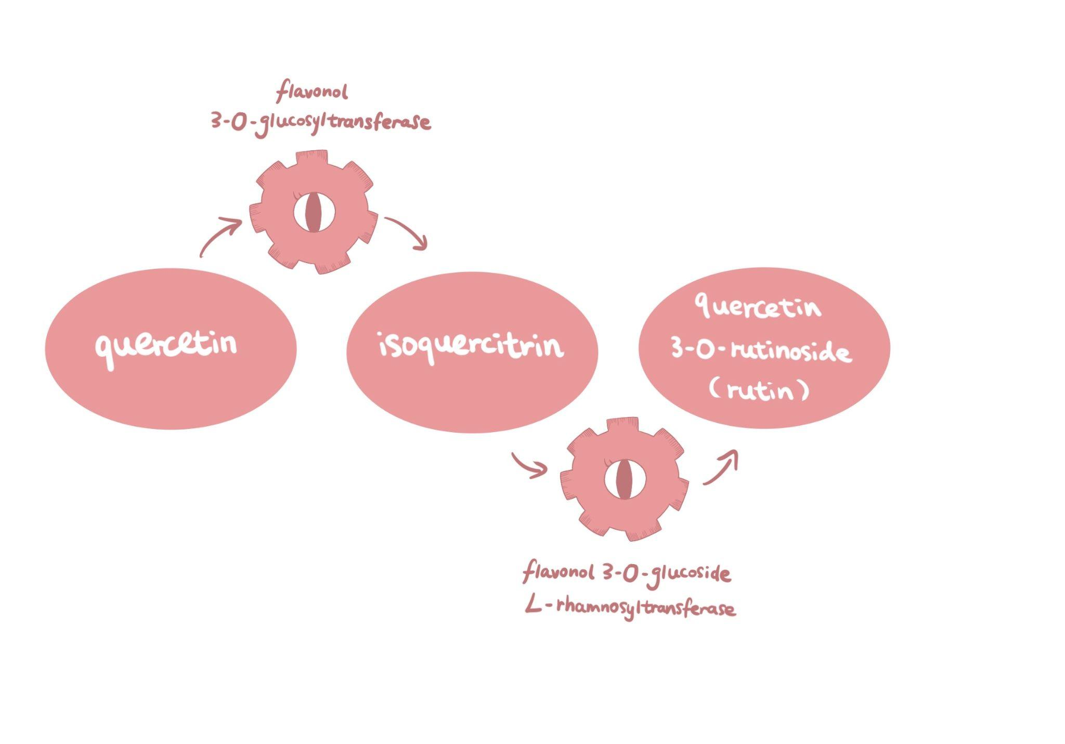

Flayevonoid
Zoe Lai, Cynthia Li, Corinne Meng, Paris Weaver
Western Reserve Academy, Hudson, OH
Introduction & Project Details
Experiments We Planned
Presbyopia, or age-related farsightedness, is caused by a loss of lens flexibility due to aging and oxidative stress. It is the most common eye disease in the world, affecting lives of people aged 50 and above. Oxidative stress is considered one of the major causes of presbyopia, and daily intake of antioxidants, specifically bioflavonoids, has been shown to prevent the hardening of the lens.
The project genetically engineers Bifidobacterium, a probiotic ubiquitous in the human gastrointestinal tract, to produce a bioflavonoid, quercetin 3-O-rutinoside, or rutin, within our bodies. We hypothesize that rutin produced by the engineered Bifidobacterium in the intestines will go into the bloodstream and travel to the eyes where it will reduce oxidative stress, and inhibit the accumulation of lipids, preventing lens hardening. Therefore, in this study, the engineered Bifidobacterium will become part of our gut bacteria and the product quercetin will affect aldose reductase, an enzyme that affects lens hardening.
This design forms a self-sustaining bacteria that consistently produces a flavonoid with a built-in flavenoid delivery system, the circulatory system, to treat/prevent presbyopia. The engineered Bifodobacterium
producing quercetin will become part of the gut microbiome
and the quercetin will be delivered by the nervous system,
traveling to our eyes and preventing the loss of elasticity
in the lens. People everywhere will no longer be frantically
looking for their reading glasses repeatedly throughout
the day!
Design Product
Our team plans to have the bacteria undergo metabolic pathways to produce quercetin:
Quercetin to Rutin:
1. Catalyzed by UDP-glucose flavonoid 3-O-glucosyltransferase to produce isoquercitrin
2. Catalyze isoquercitrin by flavonoid 3-O-glucoside L-rhamnosyltransferase to produce rutin
Plasmid design:
Promoter: Pgap-Blo
Reporter: α-galactosidase (α-Gal) gene
Restriction Sites: Hindlll and Xbal
Terminator: TdppA2
Notes:
Comment: scientific citation (APA)

Slide 2
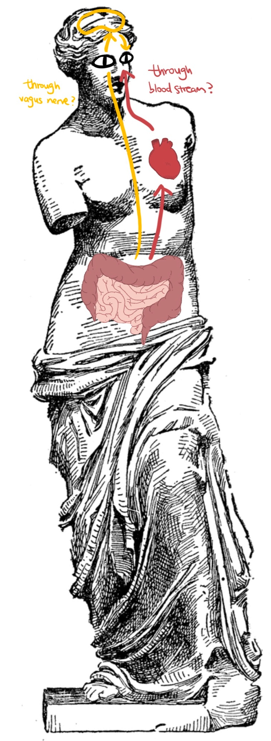
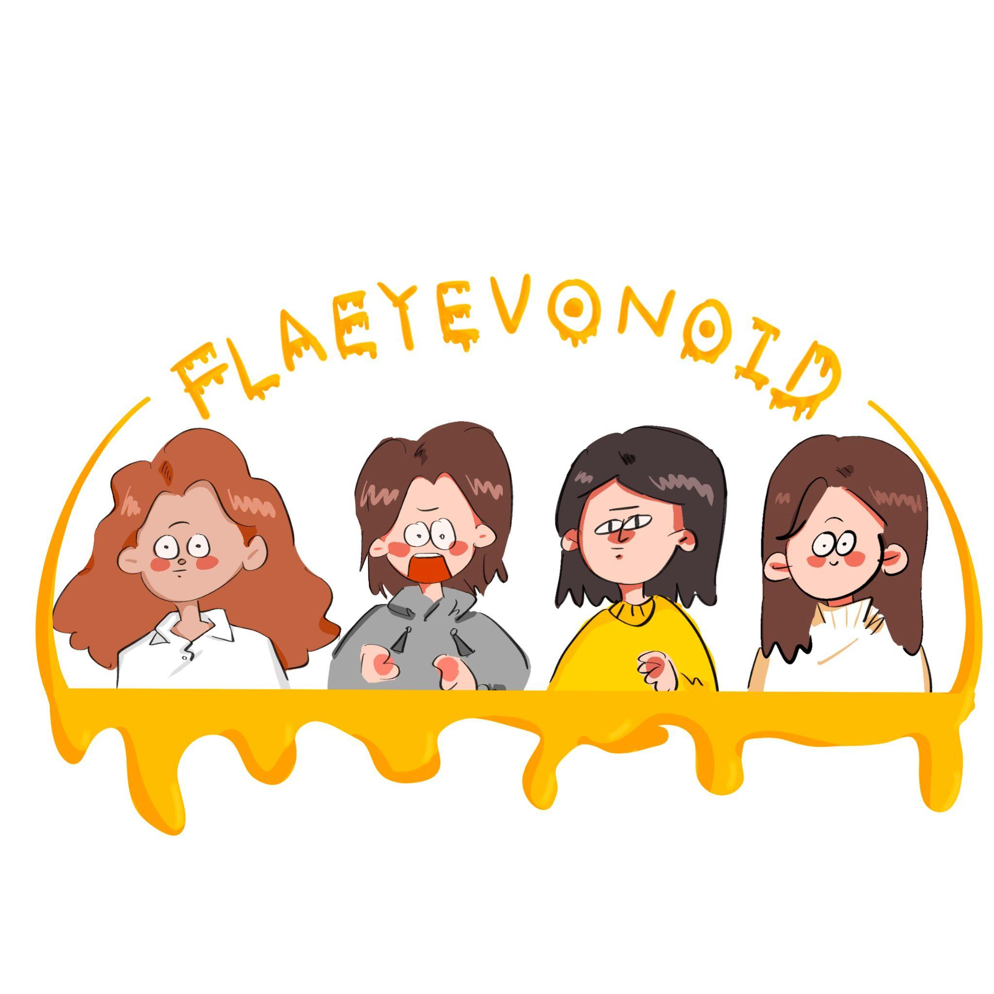


Flaveyenoids for Eye Health
Zoe Lai, Cynthia Li, Corinne Meng, Paris Weaver
Western Reserve Academy, Hudson, OH
Challenge for Next Year’s Team
About This Year’s Team
To advance our project, we have produced a list of some challenges for next year. The first challenge is to evaluate whether electroporation is the most effective bioengineering method needed for this project. In addition, we also need to assess the feasibility of engineering Bifidobacterium since it is not as well studied as E.coli in the field of synthetic biology. Another challenge is to determine the specific genes responsible for expressing the quercetin biosynthesis pathway. Finally, although studies have shown that gut microorganisms can indeed affect eye health,, the specific routes are yet to be determined. The team will need to determine if the engineered Bifidobacterium will produce a high enough concentration of flavonoid to have an effect at the eyes.
Projects proposals were voted on within the Synthetic Biology class and the most popular ones were chosen. Many of our dearest ones suffer from presbyopia and we wish to make an impact. The final team consists of four students with varying levels of experience in the field:
Zoe Lai (‘22)
Corinne Meng (‘22)
Cynthia Li (‘23)
Paris Weaver (‘23)
References & Acknowledgements
Instructor: Dr. Beth Pethel
Mentor: Dr. Kehan Zhang

