Slide 1

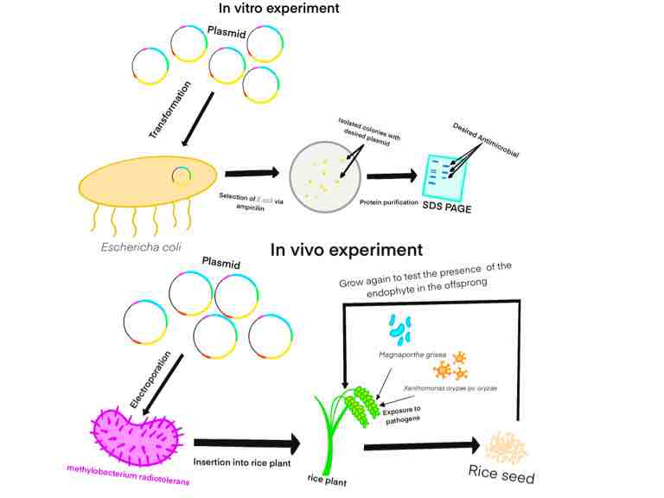
Endofight
James Gong, Maximus Keller, Hank wang
Western Reserve Academy, Hudson, Ohio
Introduction & Project Details
Experiments Planned
Our project proposes the insertion of a plasmid containing various antimicrobial genes (Xa4, chitinase, b-1 3-glucanase; chitinase and b-1 3-glucanase hydrolyze fungal cell wall while Xa4 enhances plant cell wall rigidness) into a vertically transformed endophyte (symbiotic microbes transform from parent to offspring via seeds) named Methylobacterium radiotolerans. Then, we transform this endophyte into rice to combat pathogens such as rice blight or rice blast.
Our project uses a transcription Activator like (TAL) effector based promoter to activate gene resistance in our plasmid. TAL effectors are proteins released by plant pathogen to manipulate the hosts’ transcriptome to promote disease. Plants take advantage of this mechanism to trigger defense response. TAL effector AvrXa27 activates transcription of the host resistance gene Xa27, which results in Bacterial Blight in rice.
In the in vitro experiment, we would first insert the gene into Escherichia coli, and expose the bacteria to various pathogens such as Magnaporthe Oryzae (rice blast) and Xanthomonas oryzae pv. oryzae (rice blight), to test its antimicrobial behavior through the detection of chemical released by the bacteria.
The next stage would be an in vivo experiment, where we insert the endophyte into a grown rice plant, and expose the plant into various pathogens to test the antibacterial activity after the exposure to determine the antimicrobial behavior of the endophyte.
The final stage is to cultivate the seeds produced by the first generation of rice, and repeat the experiment to test whether the endophyte successfully transmitted vertically through the seed.

Slide 2
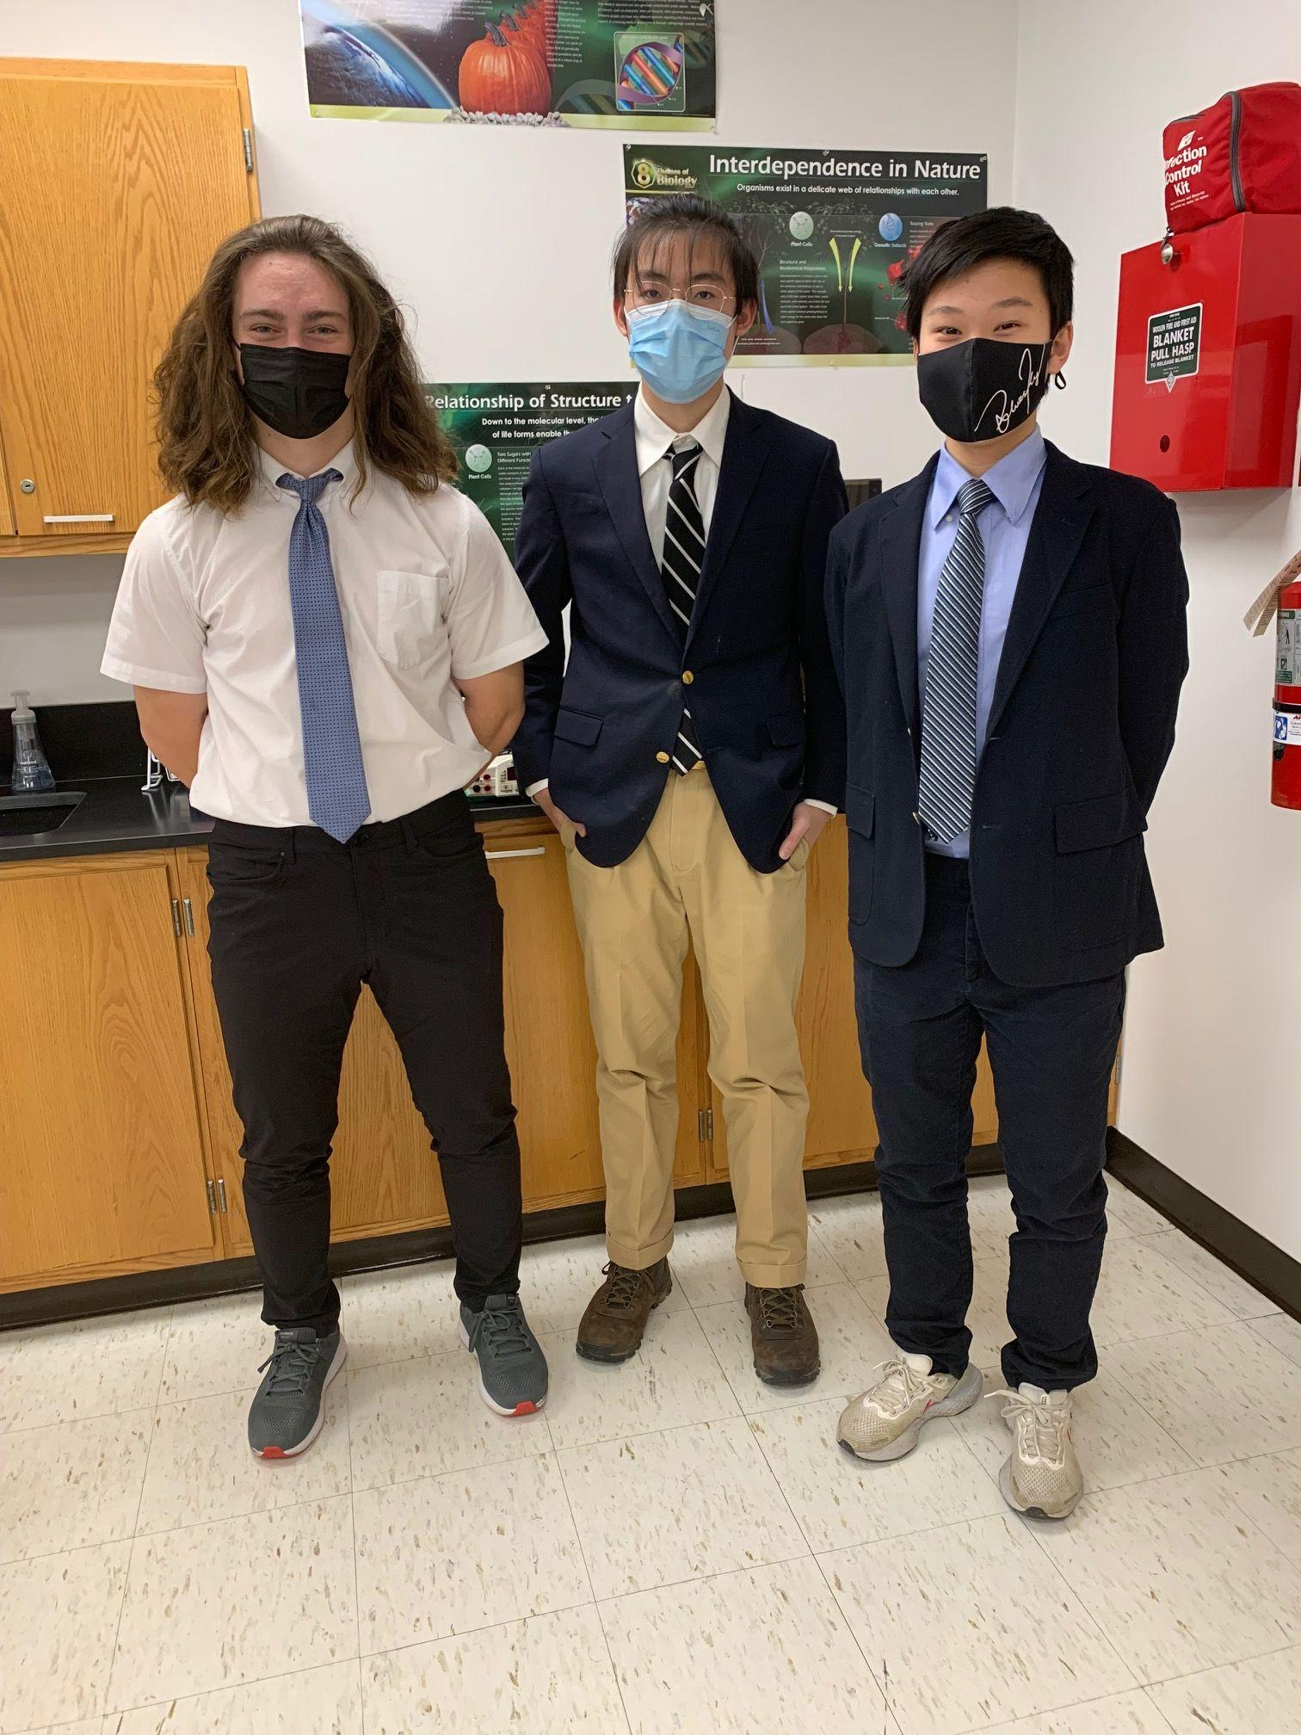
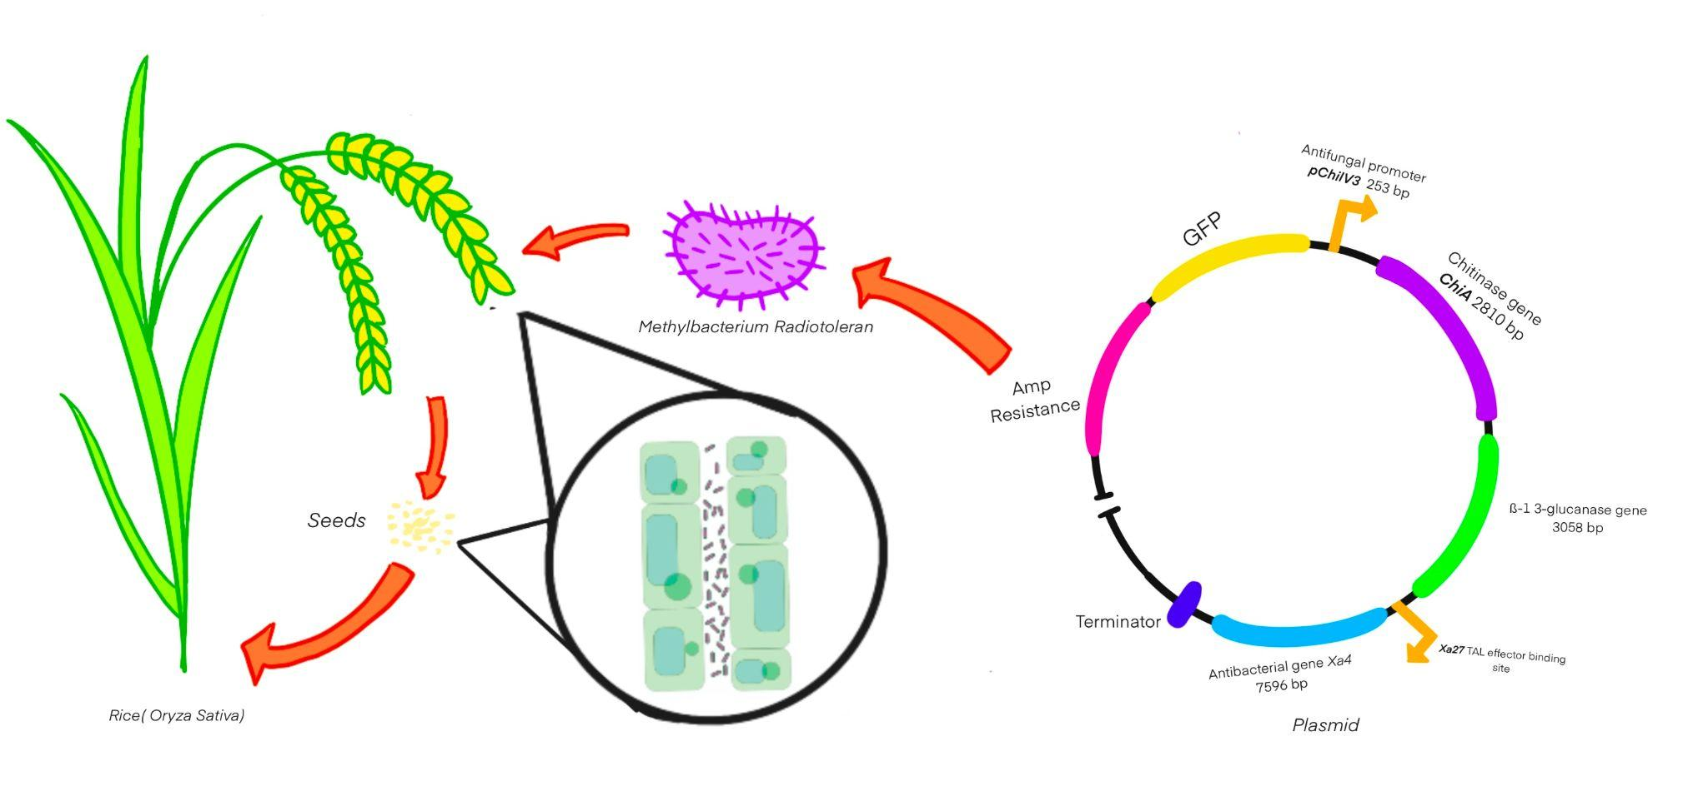


Endofight
James Gong, Maximus Keller, Hank wang
Western Reserve Academy, Hudson, Ohio
Challenge for Next Year’s Team
About This Year’s Team
The most challenging part of our project would be carrying out the experiment for the proposal. One challenge lies in creating the plasmid that provides disease resistance in rice. Another challenge lies in testing the effectiveness and finding weakness in the project’s design. The third and hardest challenge would be finding ways to improve the design if necessary.
Our team would like future teams to use the scientific method to experiment if endophyte contains the ability to express certain gene and transmit or carry the desired gene expression through generations of rice.
Maximus Keller - Idea originator, researcher, plasmid designer
James Gong - Website Designer, researcher
Hank Wang - Manager, editor, researcher
References & Acknowledgements
Special thanks to Dr. Beth Pethel as our teacher and our best source of wisdom, and Mr. Kosuke Seki as our research mentor for our team.

