Slide 1





￼
In Pursuit of Artificial Blood: Plasmid Expression System for Synthesis of Hemoglobin (Hb) and Haptoglobin (Hp) Complex in E. coli
Alexander Luck, Ian Cox, Xerxis Palsetia and Bori Kim
Andover High School; Andover, MA; March 2022
Problem
Solution
Global shortage of blood donations
Issues with donated blood:
  Short shelf-life of 42 days at 6 ºC
  Purity and safety (i.e. HIV, hepatitis, other contaminants)
Low-income countries have less access to donated blood and measures to check quality
Create affordable blood substitute: hemoglobin-based oxygen carriers (HBOCs)
Use recombinant DNA technology to create expression system to synthesize hemoglobin (Hb) and haptoglobin (Hp) complex in a bacterial host, E.coli.
Application
Artificial blood substitute
Extreme conditions with low levels of oxygen:
  Deep-water diving
  High-altitude (underground, mountains, sky, space, etc.)
  First-responder rescues (fires, earthquakes, and other natural disasters)

Slide 2

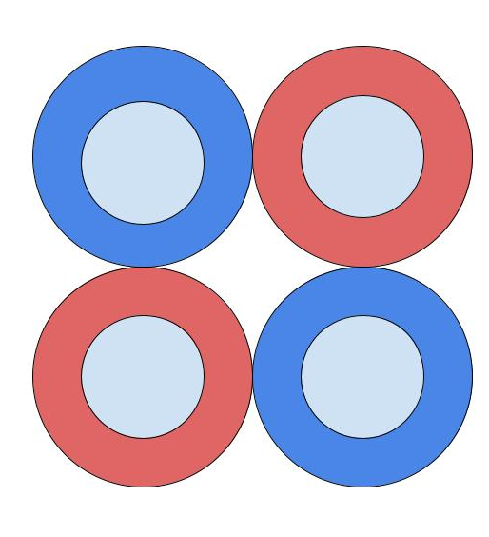
￼
In Pursuit of Artificial Blood: Plasmid Expression System for Synthesis of Hemoglobin (Hb) and Haptoglobin (Hp) Complex in E. coli
Alexander Luck, Ian Cox, Xerxis Palsetia and Bori Kim
Andover High School; Andover, MA; March 2022
Rationale
Crocodile Hb evolved to bind with byproducts of respiration, which allows the crocodile to stay underwater for over an hour in one breath. Using the crocodile Hb will result in higher oxygen capacity and more efficient release of oxygen into the tissue.
Genes for Hb: HBA (Hα) and HBB (Hβ).
Alpha subunit (α)
Beta subunit (β)
Heme + Fe (Binds O₂)
Hb protein
Cell-free Hb dissociates into dimers and causes toxicity. Hp is known to naturally bind to Hb and neutralizes the toxic effects.
Gene for Hp: Hp.
Cell-free Hb
is toxic
Hp prevents Hb toxicity
Hb-Hp complex

Slide 3
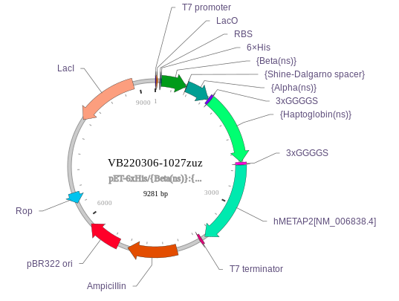
In Pursuit of Artificial Blood: Plasmid Expression System for Synthesis of Hemoglobin (Hb) and Haptoglobin (Hp) Complex in E. coli
Alexander Luck, Ian Cox, Xerxis Palsetia and Bori Kim
Andover High School; Andover, MA; March 2022
Element | Description
Selectable marker (ampicillin resistance gene) | Trait that allows cell to survive ampicillin toxicity
Ori (Origin of replication) pBR322 ori | Starts the process of replication
T7 promoter | Initiates transcription. Requires a host with T7 RNA polymerase gene under control of LacUV5. Expression of T7 is induced by lactose analog IPTG into culture.
T7 terminator | Ends transcription
Spacers: Shine-Dalgarno and 3xGGGGS | Starts protein synthesis
LacI and LacO | Produces enzymes which allow it to digest lactose
Rop | Increases affinity between 2 complementary RNAs
6xHis | Binds to the IMAC column
GOI (Genes of interest) | HBeta, HAlpha, Haptoglobin, MetAP
HαHβ-Hp-MetAp Gene Expression Plasmid
(9281 bp)

Slide 4
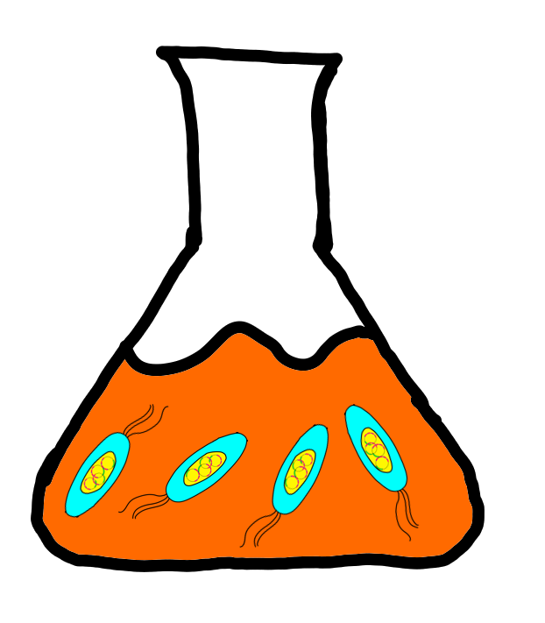
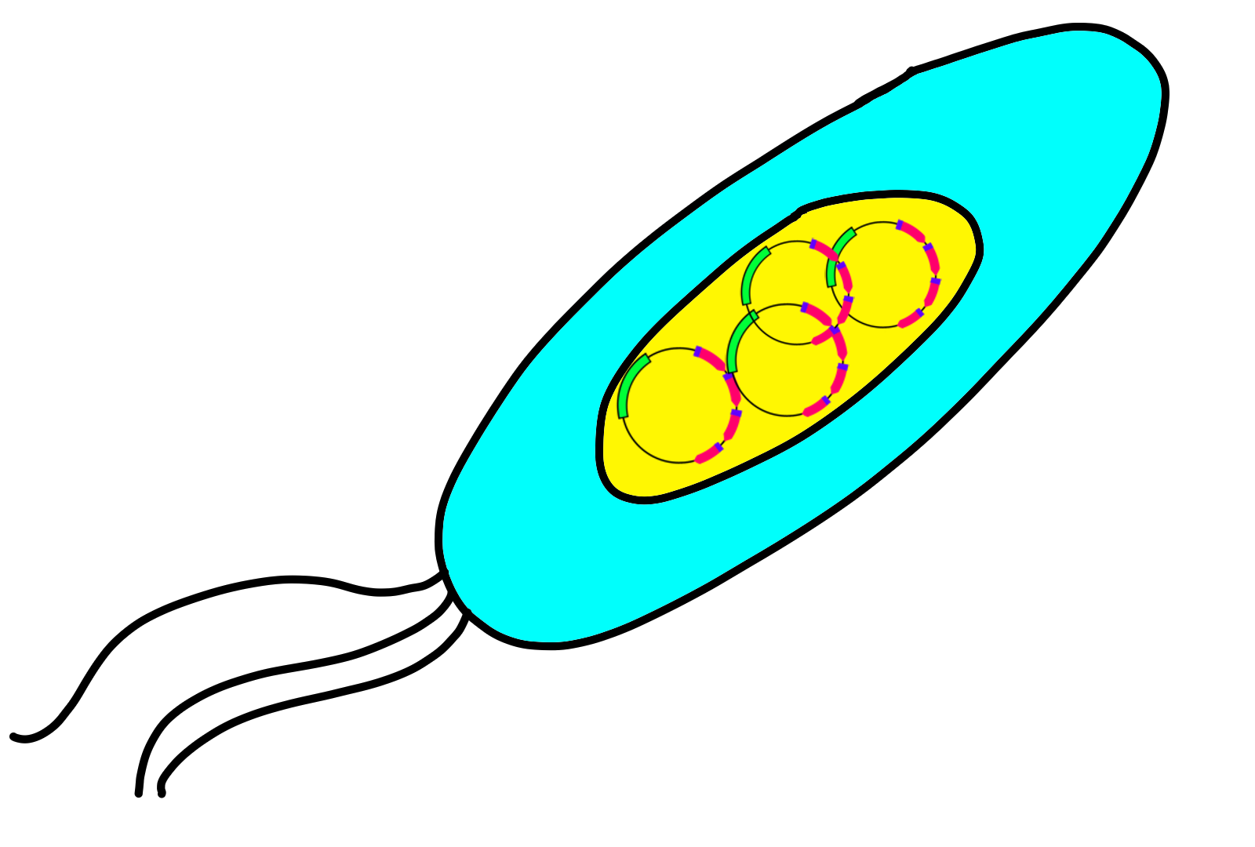
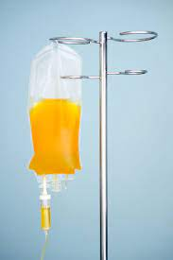
￼
In Pursuit of Artificial Blood: Plasmid Expression System for Synthesis of Hemoglobin (Hb) and Haptoglobin (Hp) Complex in E. coli
Alexander Luck, Ian Cox, Xerxis Palsetia and Bori Kim
Andover High School; Andover, MA; March 2022
Vector Design and Host System
Hb-Hp protein complex
E.coli
Cell culture
HαHβ-Hp-MetAp Gene Expression Plasmid with genes Hα and Hβ for hemoglobin; Hp for haptoglobin. Ampicillin resistance gene for selection. MetAP gene to cleave a methionine residue, an important element of post-translational modification.
Plasmid transformed into E. coli. The transformed cells are cultured in presence of ampicillin in appropriate medium to select population of cells containing the integrated plasmid. The successfully transformed hosts grown in media with glucose, IPTG and hemin produce the Hb-Hp protein complex.
The Hb-Hp protein complex purified and qualified before give to patients. The complex will be the main component in Drip IV system.

Slide 5
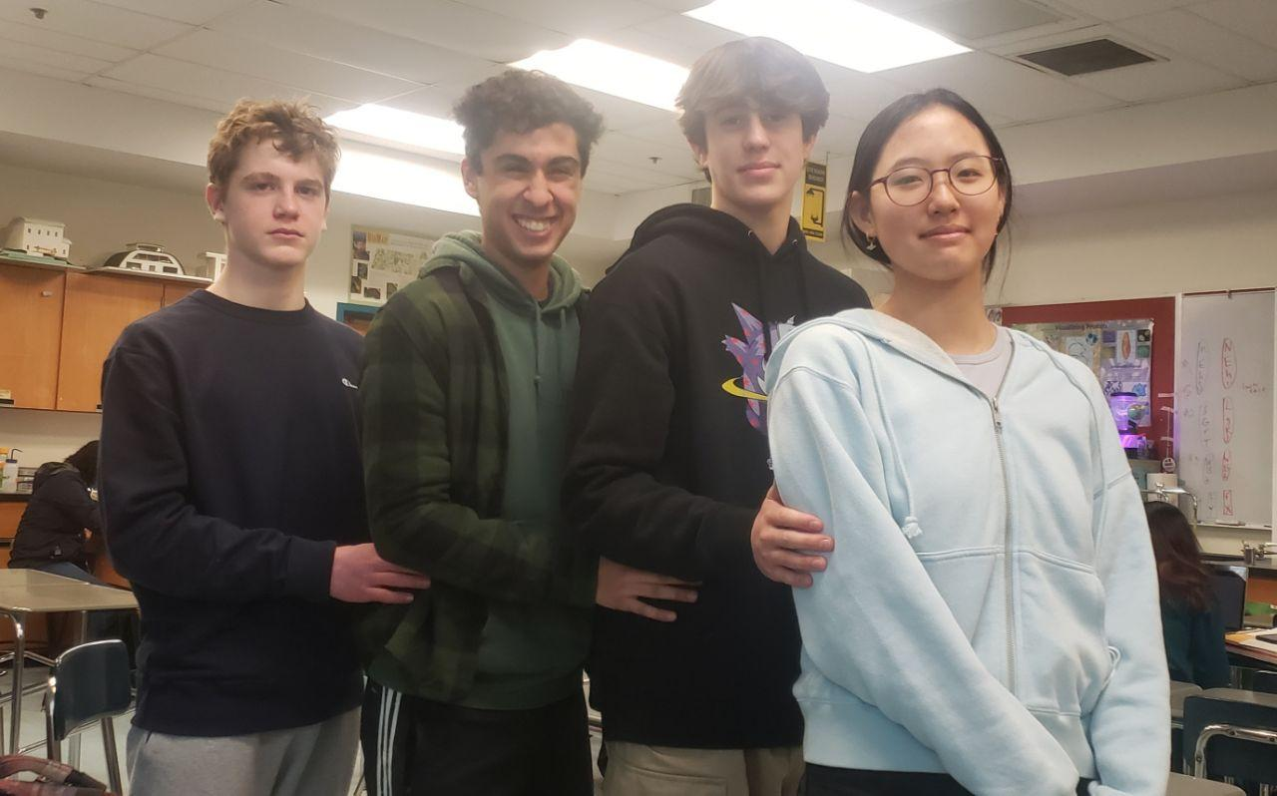


￼
In Pursuit of Artificial Blood: Plasmid Expression System for Synthesis of Hemoglobin (Hb) and Haptoglobin (Hp) Complex in E. coli
Alexander Luck, Ian Cox, Xerxis Palsetia and Bori Kim
Andover High School; Andover, MA; March 2022
Our Team and Acknowledgements
We are high school students excited about biotechnology and how it can be used in the medical field. We hope to utilize synthetic biology to bring affordable medical solutions to low-income and developing nations.
We would especially like to thank B. Tevelev for being our mentor throughout the process and our teacher Lindsey L’Ecuyer for setting us up for success in BioBuilders.
References
Evolution of Hemoglobin and Its Genes | NCBI
Crocodiles help to develop artificial blood | bmj
HEMOGLOBIN-BASED OXYGEN CARRIERS: CURRENT STATE-OF-THE-ART AND NOVEL MOLECULES | NCBI
Mechanisms of toxicity and modulation of hemoglobin-based oxygen carriers (HBOCs). | FDA
Evaluating the Safety and Efficacy of Hemoglobin-based Blood Substitutes | FDA
Expression and Purification of Recombinant Hemoglobin in Escherichia coli | plos one

