Slide 1


Green Stop Light: a Legionella detector
Aashi Agarwal, Samuel Dillon, Adonai Haile, Eli Leav, Aryan Mirajkar,
Siddharth Nirgudkar, Aprameya Tirupati, Henry Tshabalala, Madhav Kulkarni
Acton-Boxborough Regional High School
Introduction & Project Details
Experiments We Did &/or Planned
We hope to detect the pathogen Legionella pneumohila in water by genetically engineering Escherichia coli with Legionella’s quorum sensing system (LQS). LQS can detect Legionella by sensing Legionella’s signaling molecule LAI-1. We will transform our E. coli with an engineered plasmid containing GFP and LQS genes. The production of autoinducer synthase LqsA and GFP is controlled by the LqsR promoter, while the production of sensor kinase LqsS and the response regulator LqsR is controlled by the araBAD promoter. We will place engineered E. coli in water with varying concentrations of LAI-1 to simulate Legionella contaminated water, and record the expression of GFP fluorescence.
Experimental plan
Design our plasmid using Benchling, order it, and transform it into our E. coli HB101.
Prepare water with LAI-1 concentrations of
10 μM, 20μM, 40μM (Schell et al. 2015).
Test with 100μM of LAI-1 to tell us whether the genetic system works at all.
Culture the E. coli and place in each water sample. We might test with less E. coli later on.
Observe the water samples for fluorescence at 30 mins and 60 mins. Producing GFP should take a few minutes, and we will leave time for our bacteria to come into contact with LAI-1 (might also check hours later if no result).

Slide 2
Green Stop Light: a Legionella detector
Parts Overview
LAI-1
LAI-1
LqsS
LqsR
LqsA
GFP
lqsR
promoter
araBAD promoter
lqsA
gfp
lqsS
lqsR
Notes:
The figure depicts the detection and reporting pathways. E. coli HB101 will be genetically engineered to contain lqsR and lqsS, which will be constitutively expressed, and the fusion construct PlqsR-gfp-lqsA. The autoinducer synthase LqsA produces LAI-1 in Legionella. LAI-1 is released and dephosphorylates LqsS (a membrane-bound sensor kinase on E. coli HB101). The dephosphorylation of LqsS causes the dephosphorylation of LqsR, inhibiting LqsR dimerization. Due to its positive feedback loop, LqsR promotes the fusion construct PlqsR-gfp-lqsA. The expression of GFP signals the detection of LAI-1 molecules, and thus Legionella itself. The expression of lqsA in our edited E.coli produces LqsA, which then produces LAI-1. LAI-1 is released to re-stimulate the pathway and stimulate other edited E. coli HB101 to amplify the reporting signal.

Slide 3
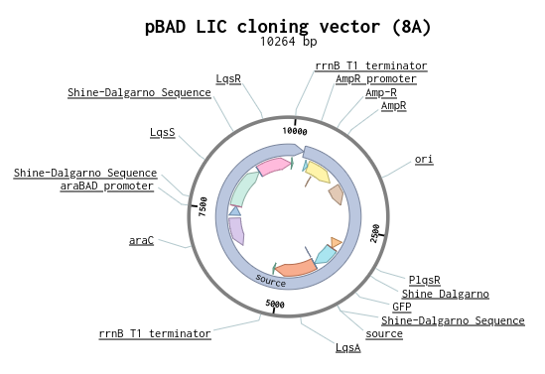


Green Stop Light: a Legionella detector
Aashi Agarwal, Samuel Dillon, Adonai Haile, Eli Leav, Aryan Mirajkar,
Siddharth Nirgudkar, Aprameya Tirupati, Henry Tshabalala, Madhav Kulkarni
Acton-Boxborough Regional High School
Challenge for Next Year’s Team
About This Year’s Team
Key Needs for Advancing the Project
Access to LAI-1 and plasmid/gene sequences
Lessons Learned
GFP reporter → simplified design compared with bioluminescence reporter
Future directions
Refine plasmid (ex. parts
and distances between them) and experiment to compare sequences
Implement as a useable product
Detect other pathogens
We have 9 total members (3 returning, 6 new). Leaders are Sam Dillon and Aashi Agarwal.
We’ve loved getting to meet in person because last year was all virtual! We also had fun brainstorming new project names and designing a plasmid!
References & Acknowledgements
Thank you to our mentor Dr. Kathryn Brink and our teacher and advisor Mr. Mathieu!
References
Hochstrasser, R., Kessler, A., Sahr, T., Simon, S., Schell, U., Gomez-Valero, L., Buchrieser, C., Hilbi, H. (2019). The pleiotropic Legionella transcription factor LvbR links the Lqs and c-di-GMP regulatory networks to control biofilm architecture and virulence. Retrieved from https://pubmed.ncbi.nlm.nih.gov/30623561/
Kessler, A., Schell, U., Sahr, T., Tiaden, A., Harrison, C., Buchrieser, C., Hilbi, H. (2013). The Legionella pneumophila orphan sensor kinase LqsT regulates competence and pathogen-host interactions as a component of the LAI-1 circuit. https://pubmed.ncbi.nlm.nih.gov/23033905/
Schell, U., Simon, S., Sahr, T., Hager, D., Albers, M. F., Kessler, A., Fahrnbauer, F., Trauner, D., Hedberg, C., Buchrieser, C., Hilbi, H. (2015). The α-hydroxyketone LAI-1 regulates motility, Lqs-dependent phosphorylation signalling and gene expression of Legionella pneumophila. https://pubmed.ncbi.nlm.nih.gov/26538361/

