Slide 1

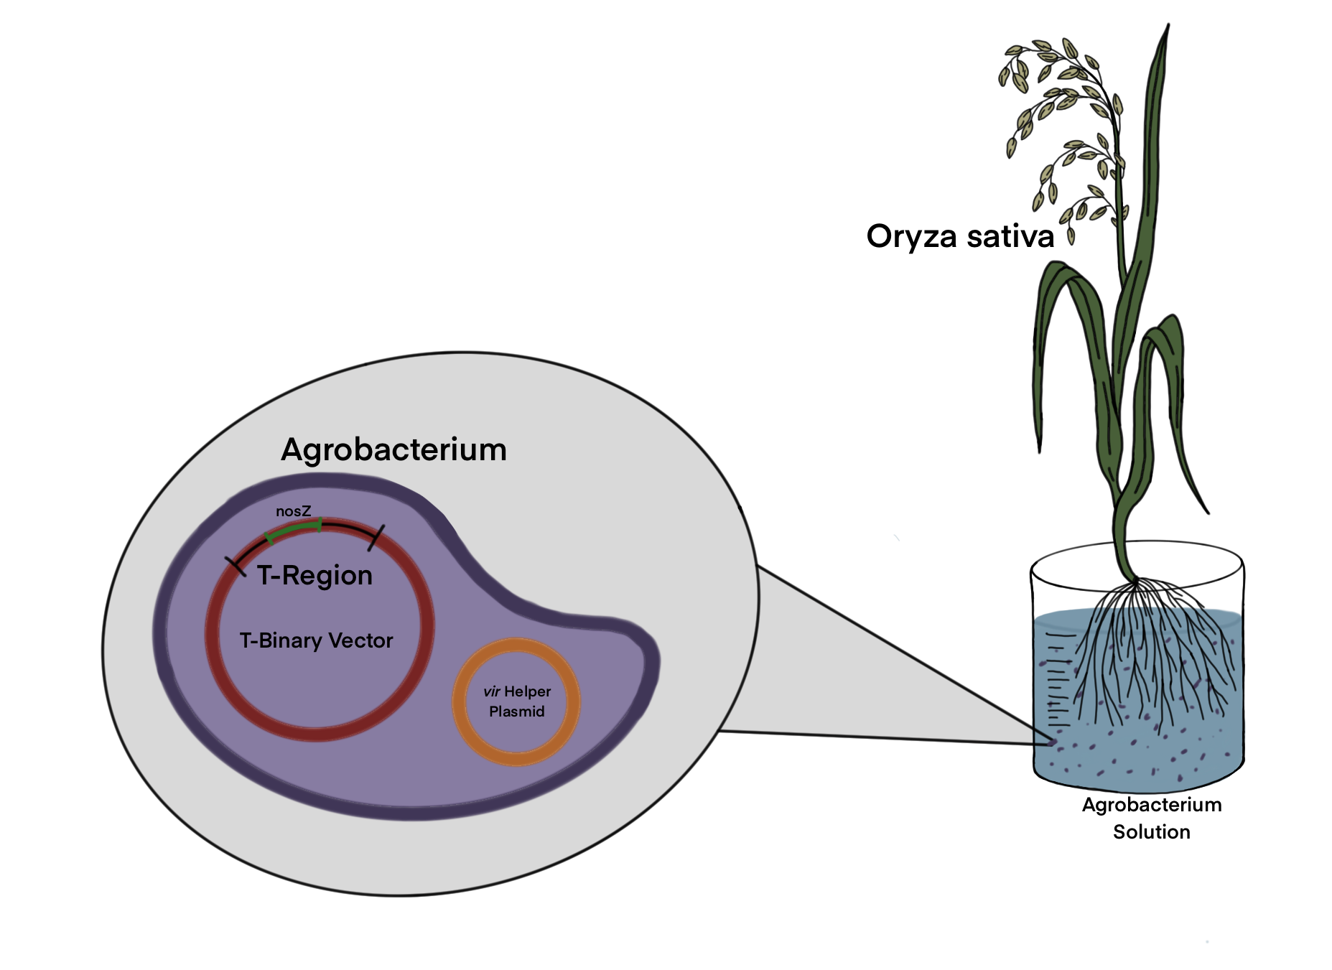
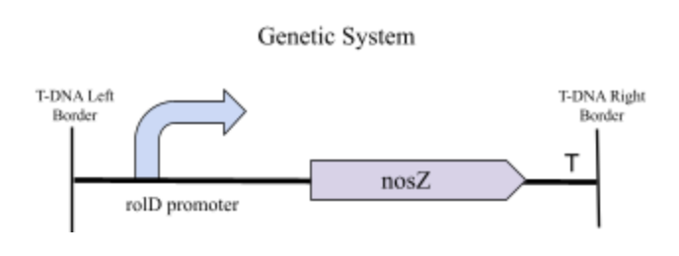

greeN2grOw
Angela Benzigar, Katya Luchette, Olivia Tagg, Audrey Weaver, Junhao Zhang
Western Reserve Academy
Nitrous oxide is a harmful greenhouse gas more potent than CO₂. It is produced by the burning of fossil fuels as well as the production and use of fertilizer. Our team aims to decrease the concentration of nitrous oxide in the atmosphere by inserting nitrous oxide reductase into plants.
We are going to use Floral-Dip Transformation to insert bacterial gene nosZ, which synthesizes the protein that breaks down N₂O into nitrogen gas, into Oryza sativa (rice)

