Slide 1

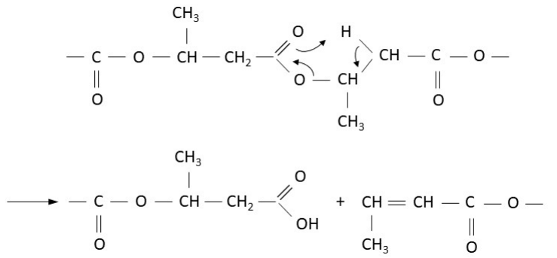
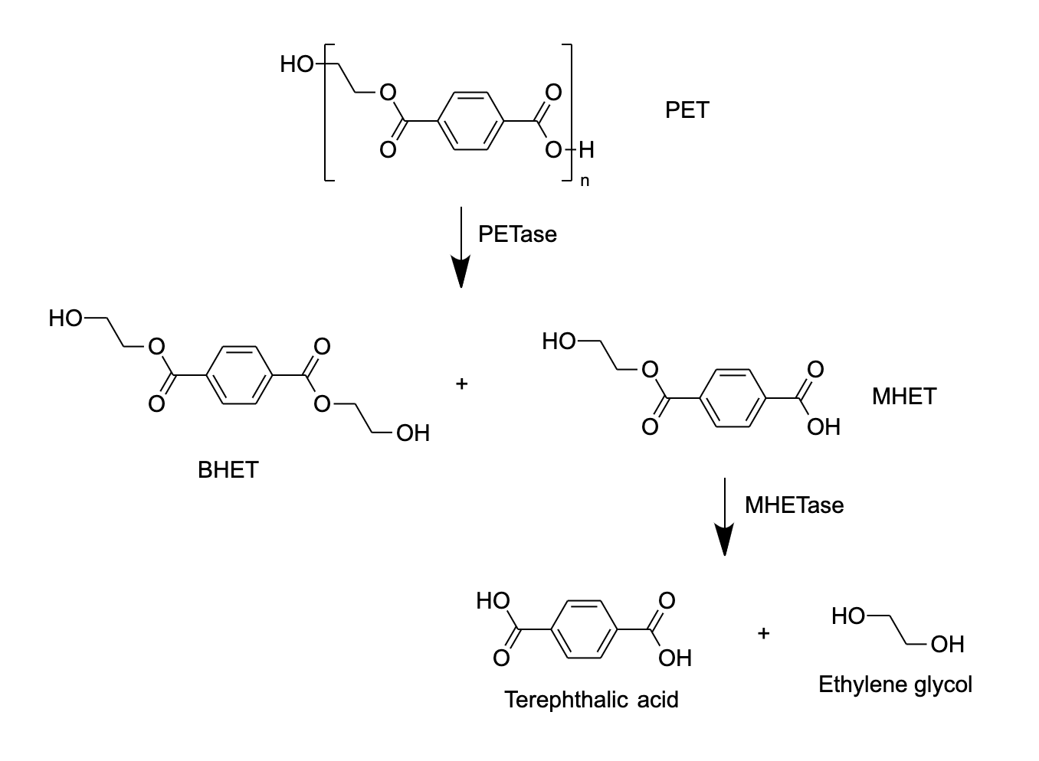

Investigations into creating more widely applicable plastic degradation tools
Anna Lian, Megan Malur, Risa Nawa, Jessy Wang, Irene Wu, Jacob Ye, Jessie Yuan, Yash Agarwal, Jonathan Lan, Dimitra Papageorgiou, Ellie Tillman-Schwartz, Chloe Zhong
Weston High School, Weston MA
What is the objective of your project?
To create a bacteria that can secrete multiple plastic degradation enzymes.
What are the limitations of your tools?
Bacteria may not be able to adapt to new conditions.
May cause change in efficacy and cost.
Figure 1: mechanism of PHB depolymerase
Genetically engineer bacteria to produce the novel combination of enzymes
  Stimulate production of all enzymes in bacteria
  Remove enzymes from bacteria through lysis
Testing enzyme combination on different types of plastic, including PET and PVC
  Find the environmental conditions that allow the enzyme to operate most efficiently by changing: temperature, humidity, pH, and concentration.
  Build in purification mechanism that isolates target enzymes to create more pure solutions.
Figure 2: mechanism of PETase + MHETase

