Slide 1



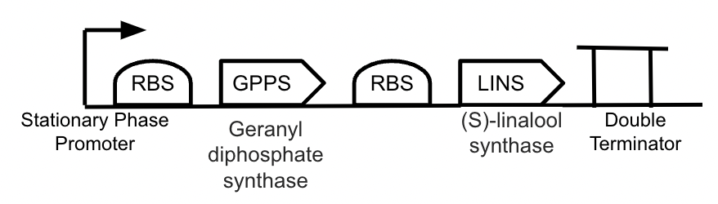
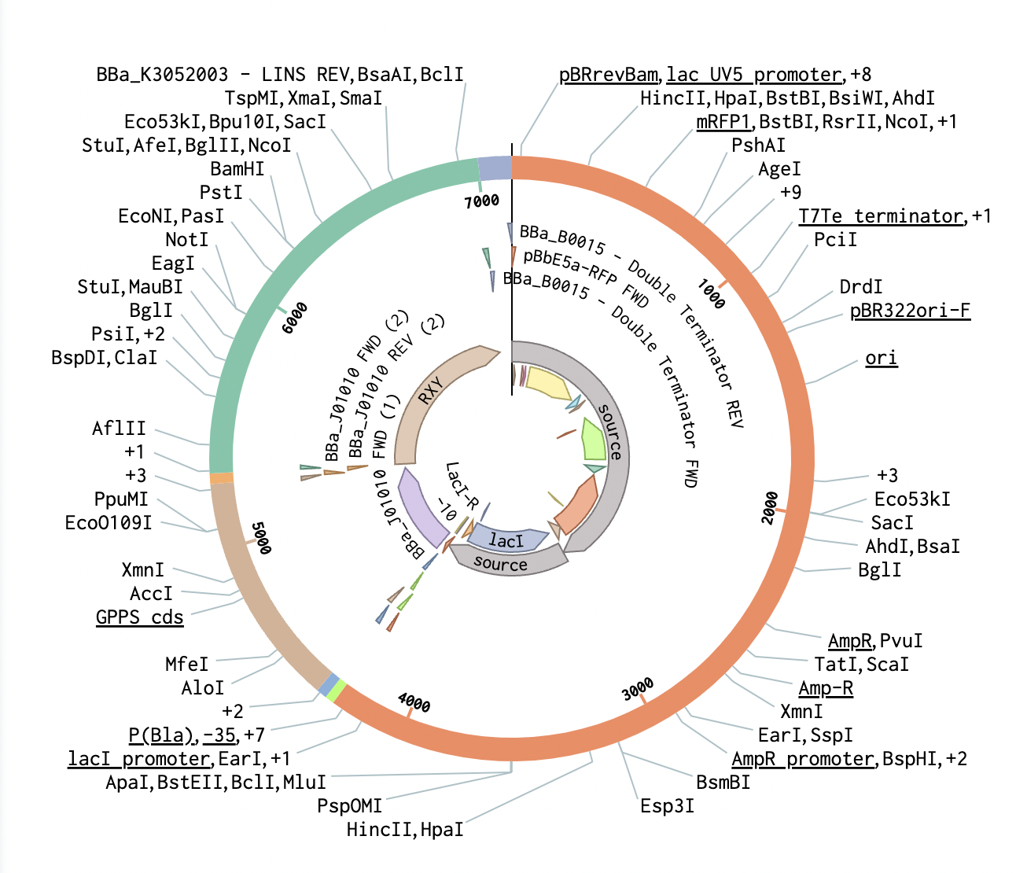
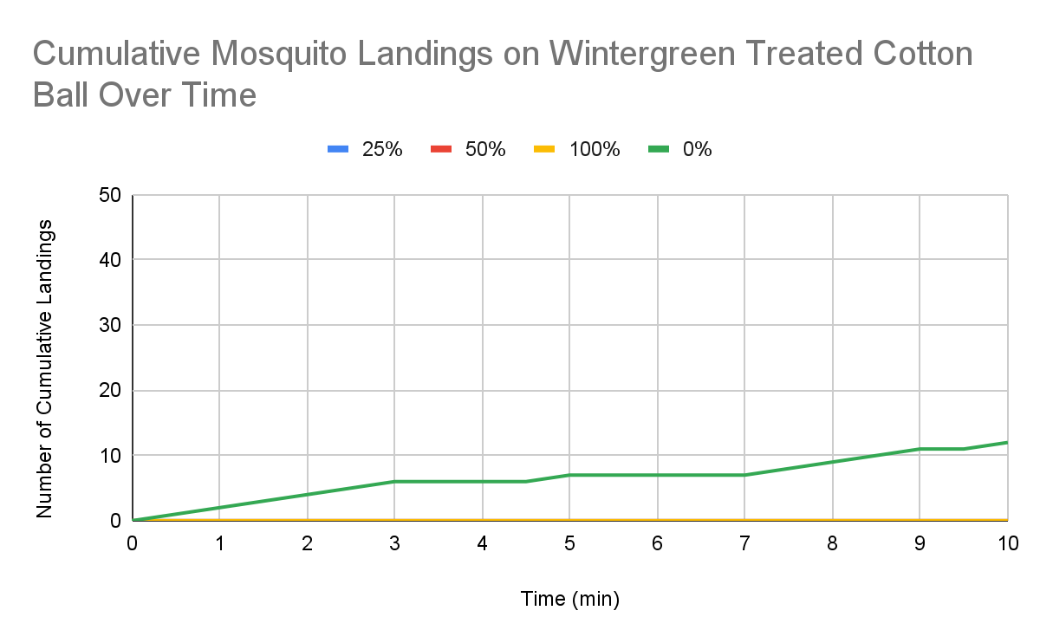
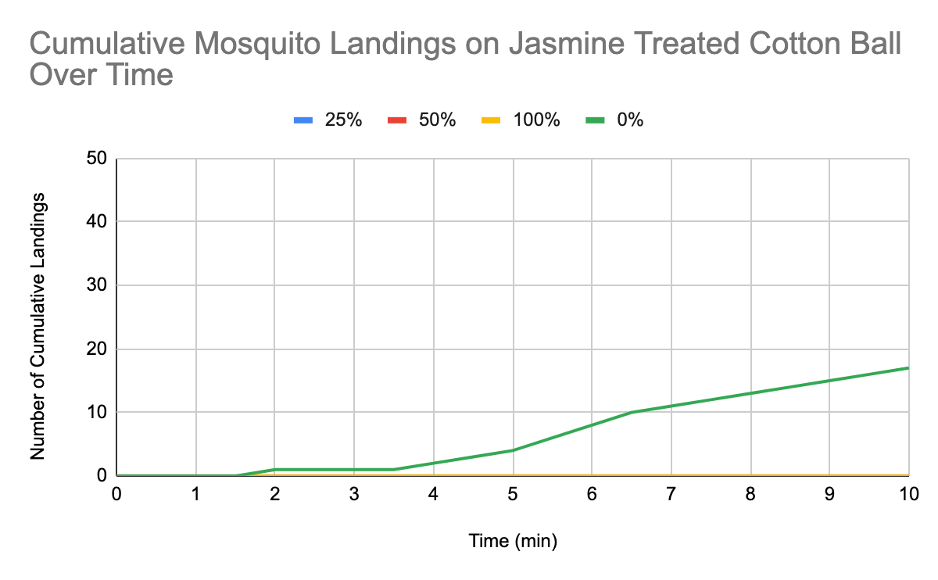
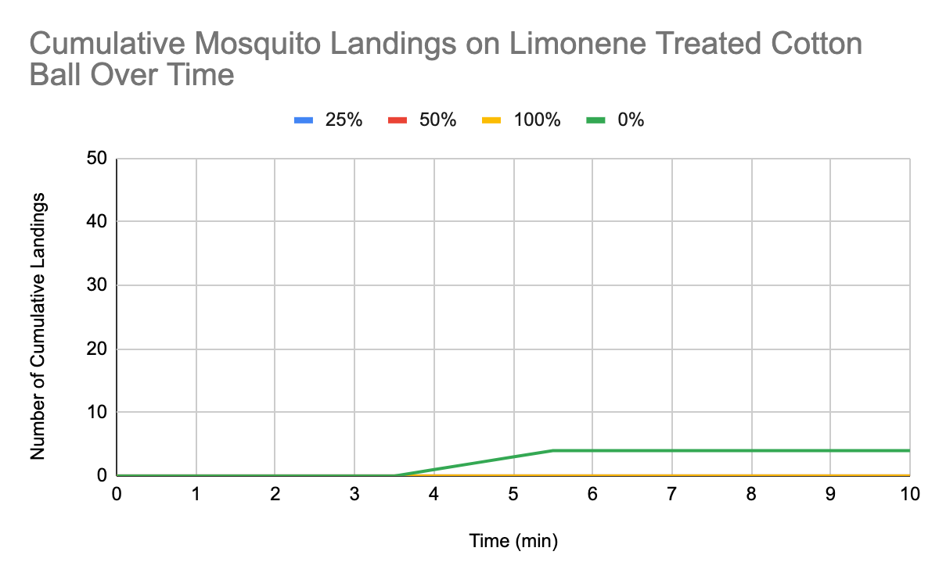
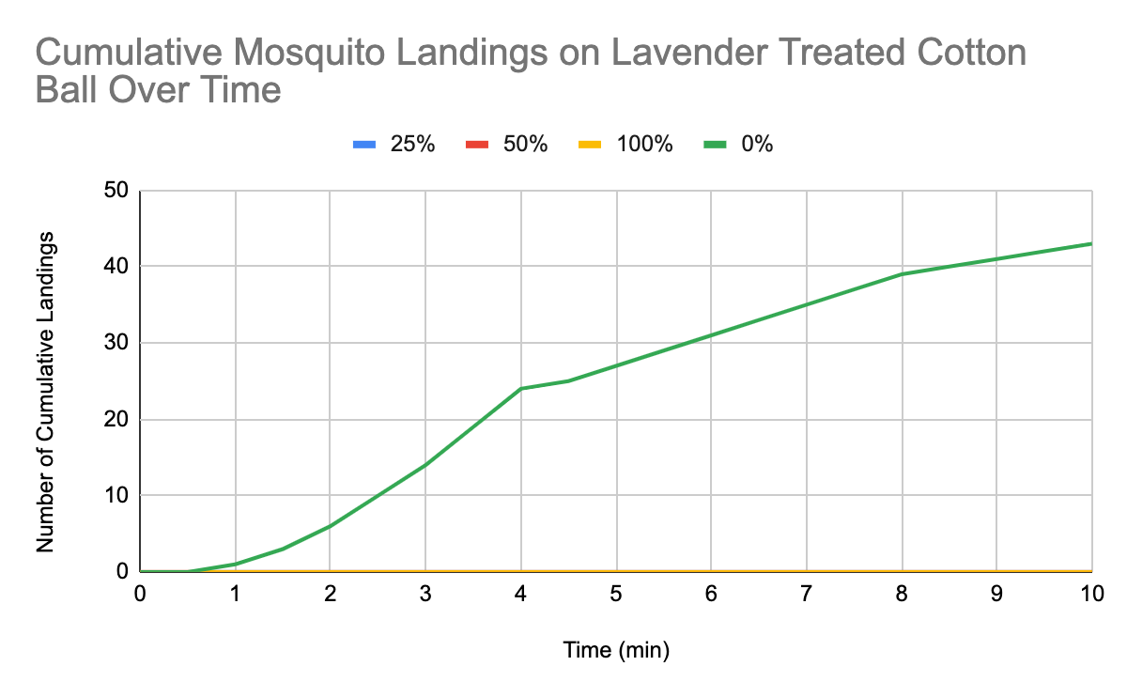

AliveSCENT
Yesenia Collins, Emily Fugazzotto, and Dillon Tirado
Tyngsborough High School , Tyngsborough, MA
Objective
To engineer E. coli to produce (S)-linalool and act as an effective mosquito repellent.
GPPS and LINS Device to be inserted into pBbE5a-RFP backbone
AliveSCENT Plasmid
Results of Essential Oils as Mosquito Repellents Tests
Notes:
What is the objective of your project?
(optional) What techniques did you use?
(optional) What technical needs do you have? What are the limitations of your tools?
Schematic/ Graphic Depiction of your project
Simple overview of the genetic system or whatever is technically relevant
1 graph showing key data if you have it. Experiment you’d like to do if you haven’t collected data yet!
Include a 1-minute audio file embedded in the slide***

