Slide 1


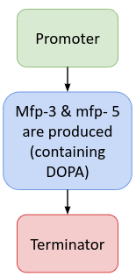

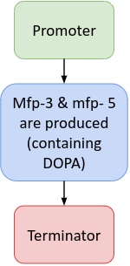
Sustainable Tape
Song Leav, Amanda Zhang, Anya Mittal, Elisa Rivero, Noah Stein, Sophia Tang, LiSun Tormey
Acton-Boxborough Regional High School
Problem: packaging tape is environmentally harmful
Solution: to create a biodegradable tape inspired by mussels’ attachment mechanisms
Future experimentation: explore with making our tape water-resistant

