Slide 1

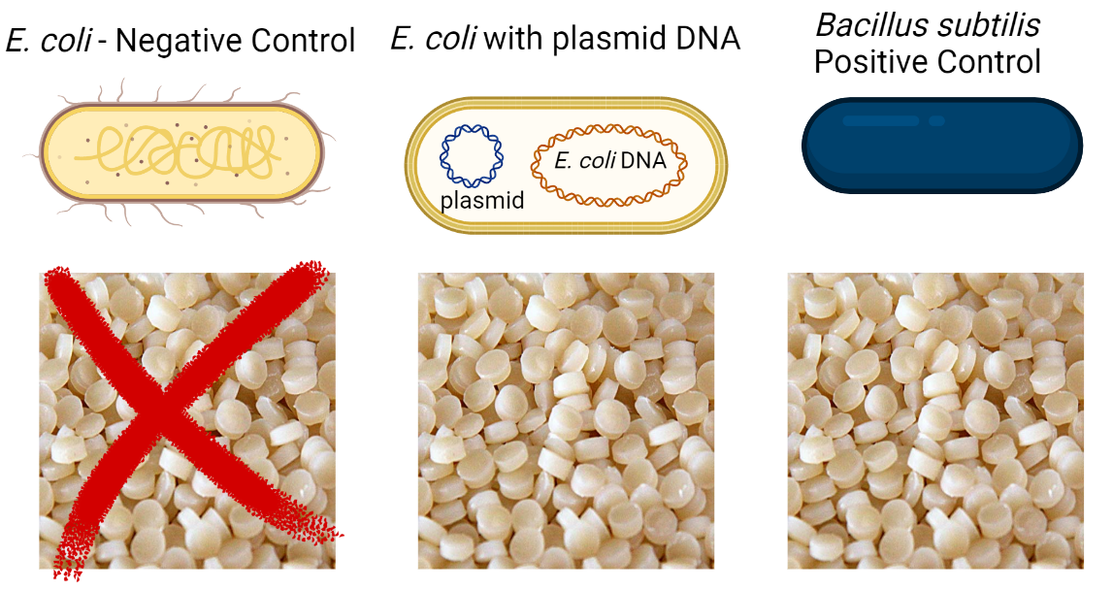
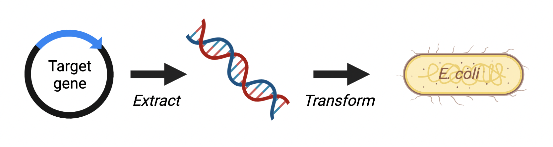
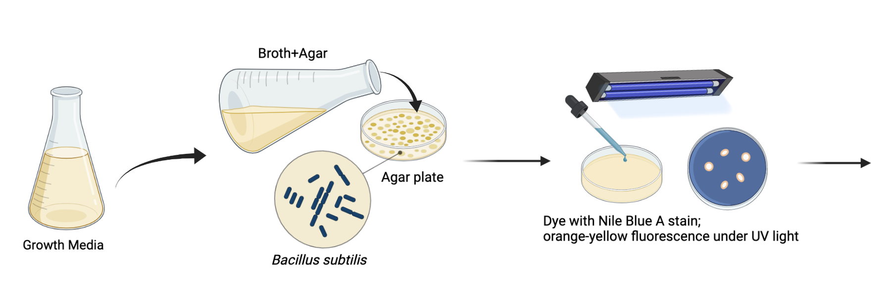
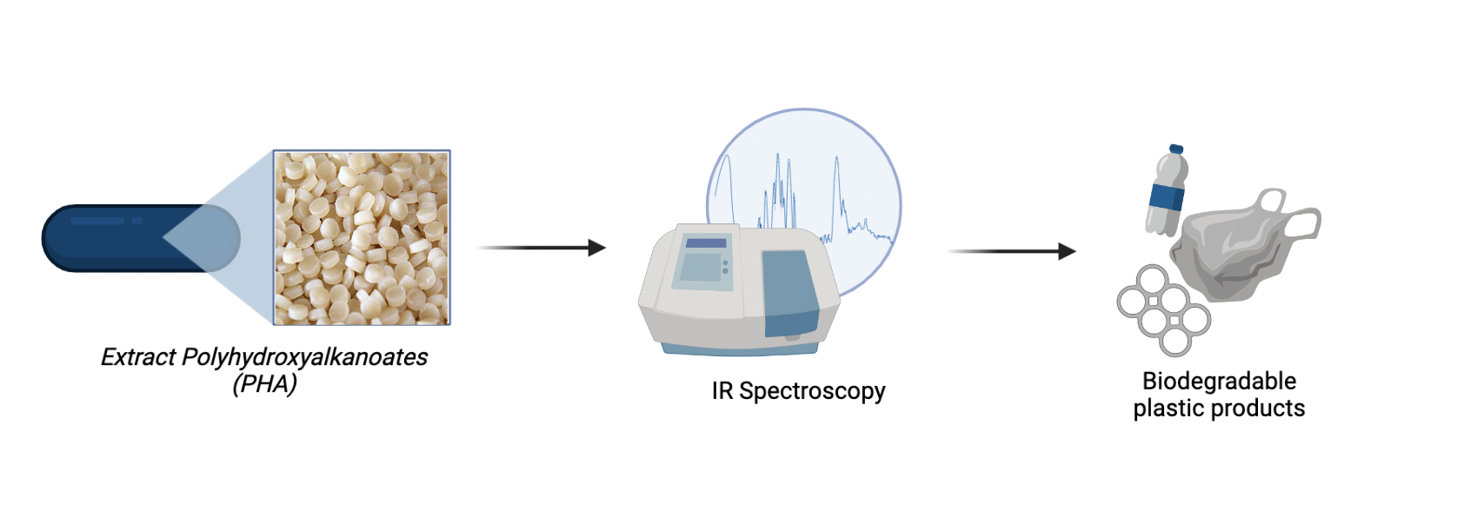

Polyhydroxyalkanoates(PHA): Biodegradable Plastic
Derek Lee, Nicolas Wu, Jeffrey Yu, Brian Liau
Taipei American School
To use E. coli to produce PHA plastic
Techniques: IR Spectroscopy, UV light
Figure #1: Experimental Goal
Figure #3: Future Planned Experiment
GROWTH
EXTRACTION
APPLICATION
Figure #2: Planned Experiment

