Slide 1

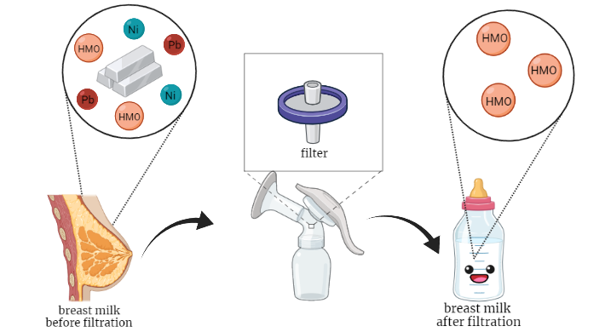
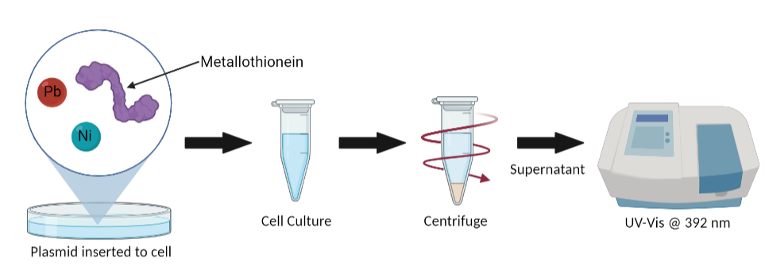
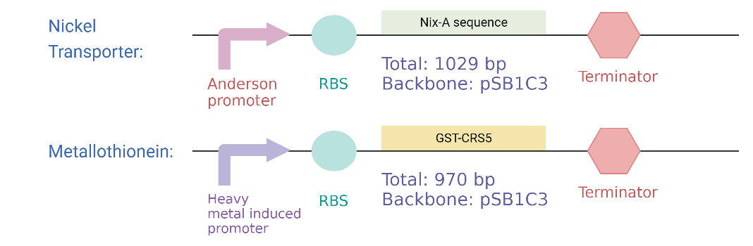

Filteristic Milk: Heavy Metal Filtration of Breast Milk
Jay Ann Kan, Katie Chu, Vienna Sun, Kristina Hong, Reese Reduta,
Justin Wang, Angeline Sun, Zoe Shong, Oscar Chen, Gabriel Lin
Taipei American School, Taipei, Taiwan
Our Project
Objective:
Create a filtration system that removes heavy metal ions from breast milk by utilizing ion transport proteins to bind and sequester heavy metals from breast milk
Techniques Used:
Expressing Nickel transporter and binding proteins
Test substrate heavy metal concentration drop with UV-Vis Spectroscopy
Figure 1. Breast milk filtration plan overview
Figure 3. Bacteria strains for Nickel transporter and Metallothionein needed for the filtration system
Figure 2. Plasmid inserted into cells, supernatant, and UV-Vis

