Slide 1

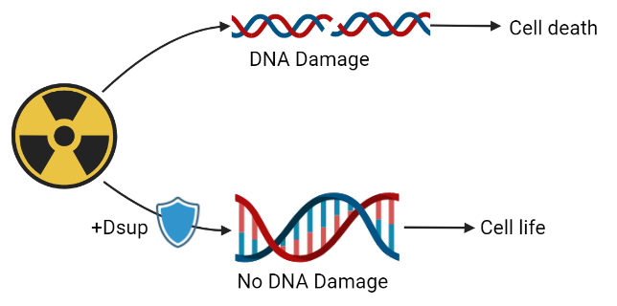
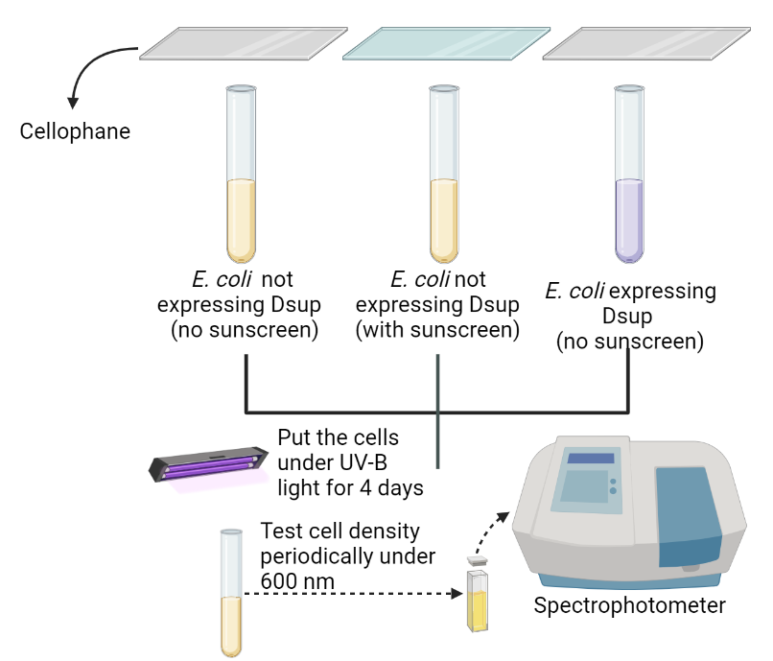
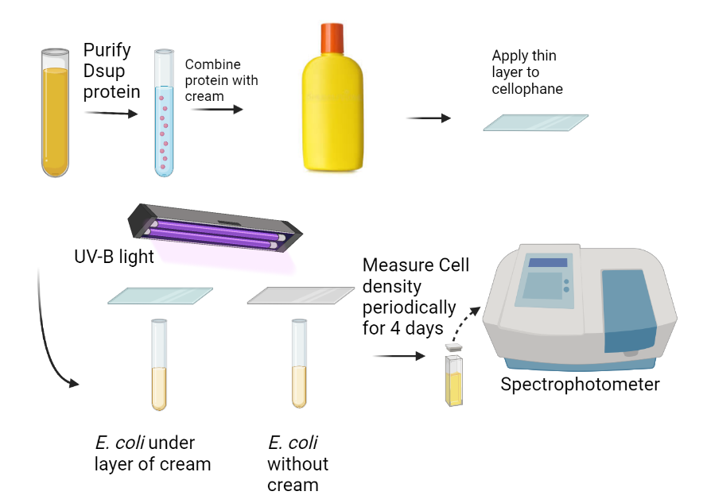

DNA Protection using Dsup
Andrew Ko, Annie Yang, Catrina Yeh, Charis Chiu, Dillon Su, Ethan Dunn
Taipei American School
Our project aims to utilize Dsup to protect eukaryotic cells from UV radiation.
Confirm Dsup expression in E. coli
Test effectiveness in 2 ways:
When bound to DNA
As an external layer

