Slide 1

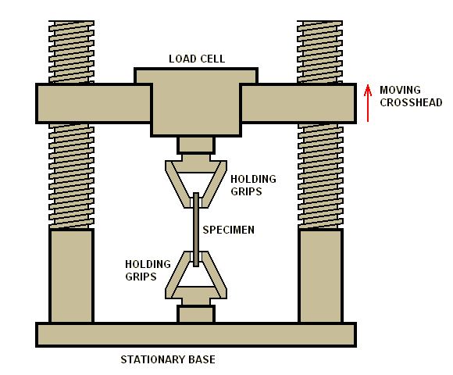
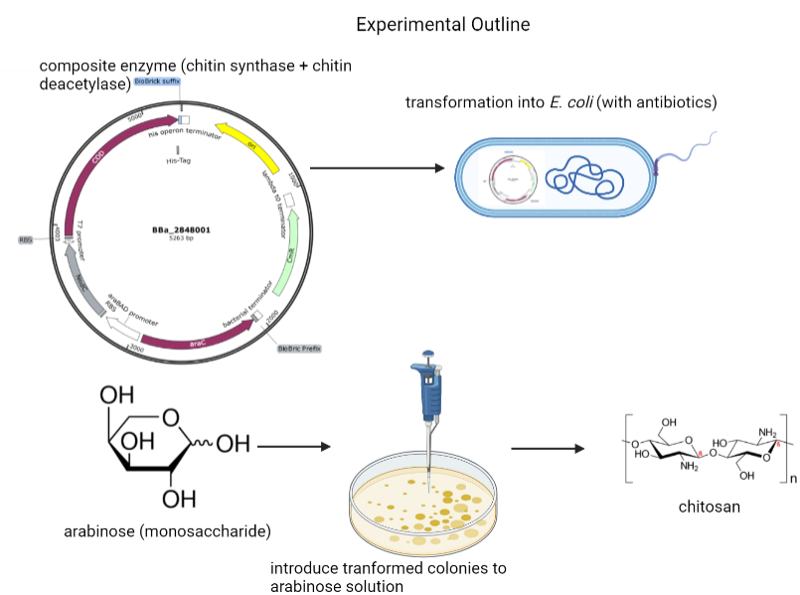
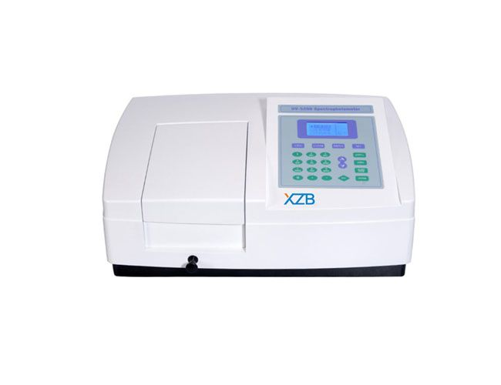

Attack on Chitin
Alex C., Amanda S., Ashley K., Dylan C., Eowyn W., Guan C., Jamie L.
Taipei American School
Objective:
  Electrospin synthetic chitosan from E. coli
  Create prototypes with varying strengths depending on application
fig. 2: tensile strength testing machine for testing strength of fibers
fig. 3: spectrophotometer is used to measure chitosan production from E. coli
fig. 1: experiment outline - negative control (no related enzymes) and positive control (dissolved chitosan in solution)

