Slide 1
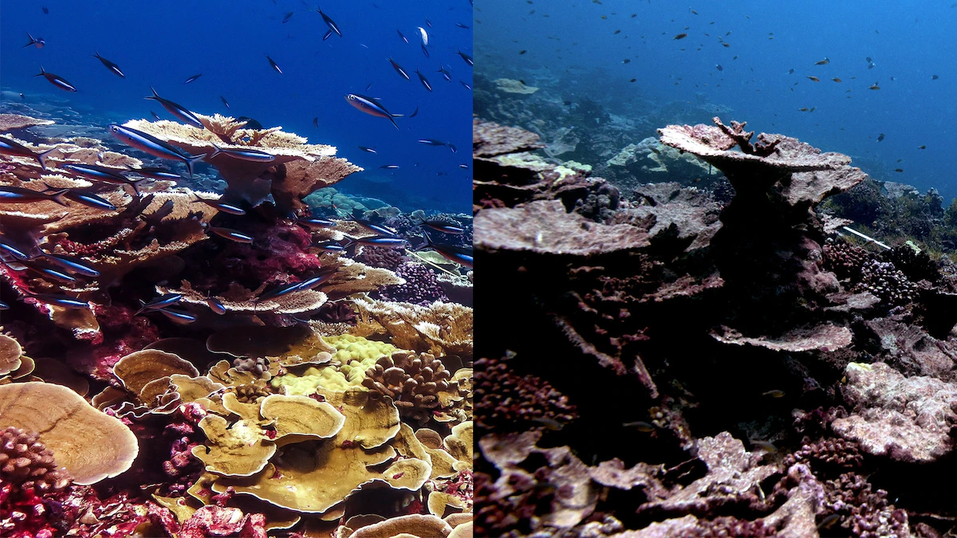


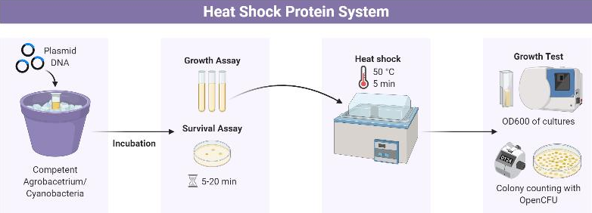
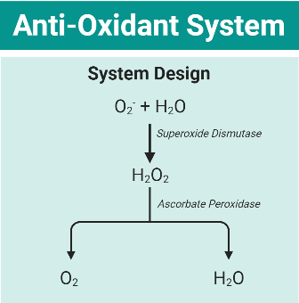
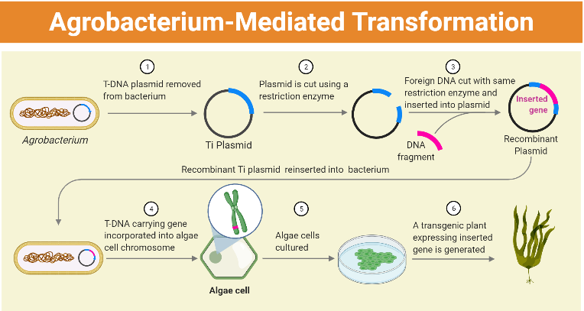
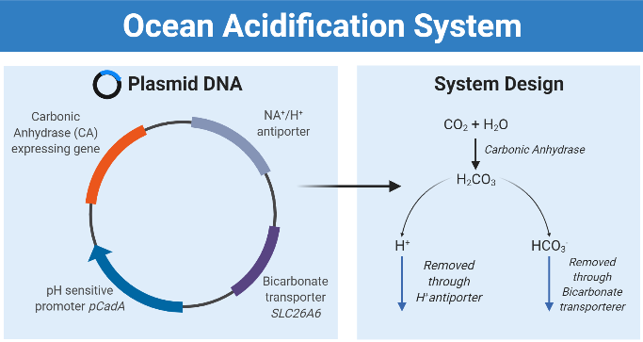
Reef-vive: A comprehensive approach
towards increased coral survivability
Andre Hsieh, Dylan Liu, Ethan Hirai, Marvin Li, Rex Liu, Sonia Fan
Taipei American School, Taipei, Taiwan
Our project aims to increase coral resistance to heat and oxidative stress factors.
Insert genes coding for antioxidants, heat shock proteins, and deacidification enzymes into cyanobacteria and agrobacterium.

