Slide 1


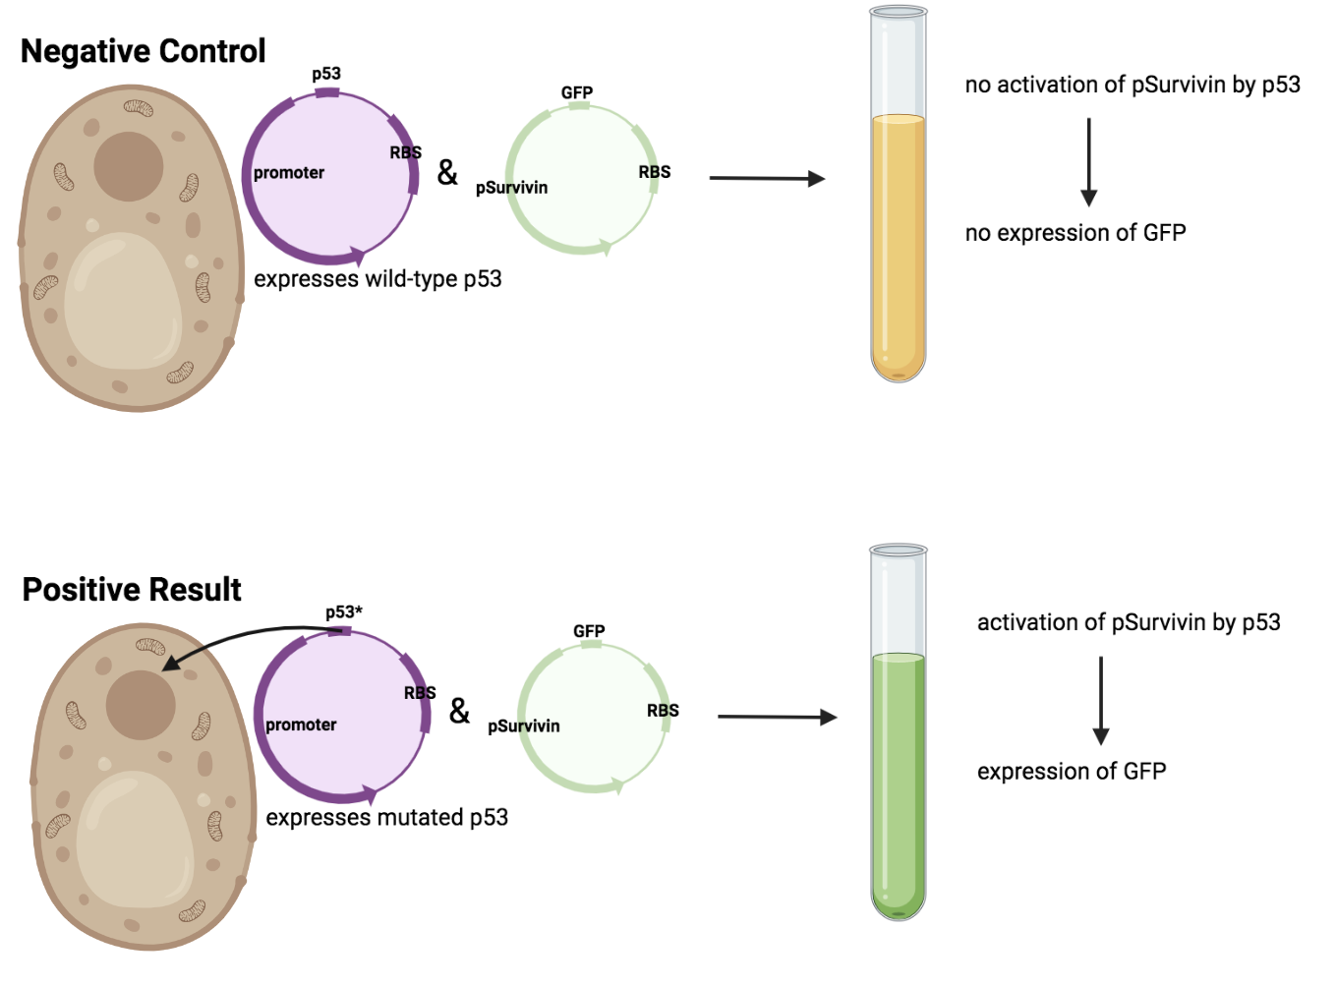
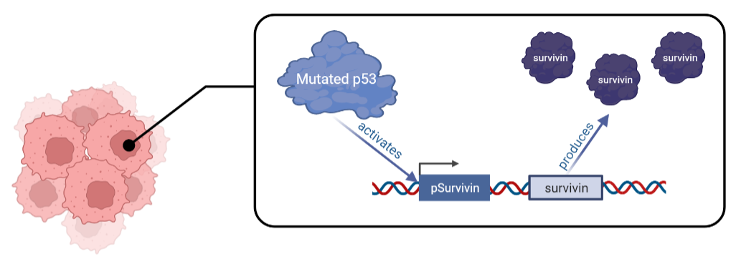

“Survivin” Cancer
Angelina Chen, Chloe Wang, Destiney Chen, Emma Chow, Veronica Kuo
Taipei American School (Team Green)
Project objective:
Create a cancer detection kit by attaching a reporter gene to pSurvivin
Figure 2. The pSurvivin + RBS + GFP sequence we plan to express.
Figure 1. Mutated p53’s effect on the expression of pSurvivin.
Figure 3. Expected results for our experiments on yeast.

