Slide 1

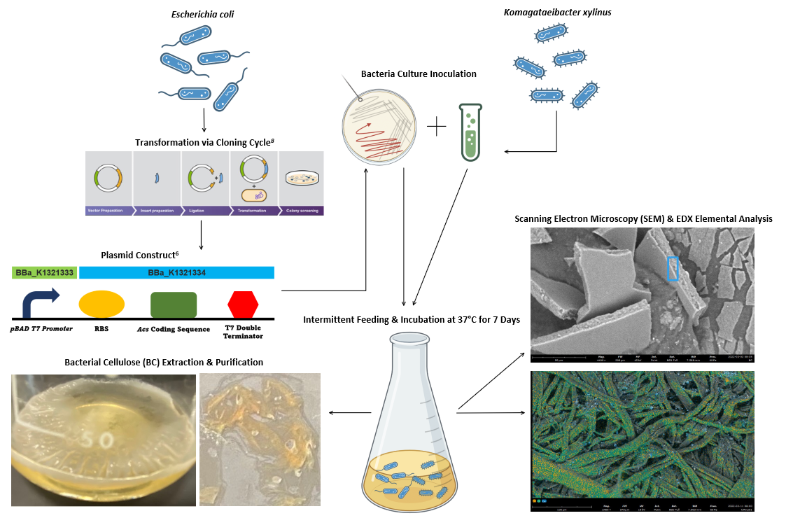
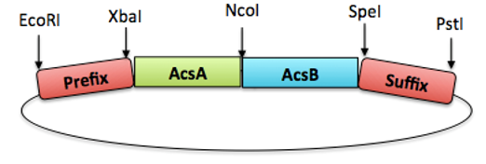

BC, A Tree-Free Guarantee: Producing Alternate Paper with Bacterial Cellulose
Austin Chang, Candice Hsu, Chia-Shuan Yeh, Evan Liu, Ruby Kuo, Stevin Yang, William Wang
TAS_Taipei_Blue, Taipei American School, Taipei
Objective: Produce Alternative Paper Source - Bacterial Cellulose (BC)
Expressed Acs operon (found in K. xylinus) in E. coli
BC formed via intermittent glucose media feeding
BC analyzed with SEM/EDX
Aim to replicate paper or cardboard products by improving BC quality
Table 1. Atomic Concentrations for BC and Paper Towel
Atomic % | BC | Paper Towel
Carbon | 48.8 | 49.6
Oxygen | 28.7 | 49.5
Figure 1. Visualization of Acs operon
Figure 2. Experimental Flowchart of the Present Study

