Slide 1

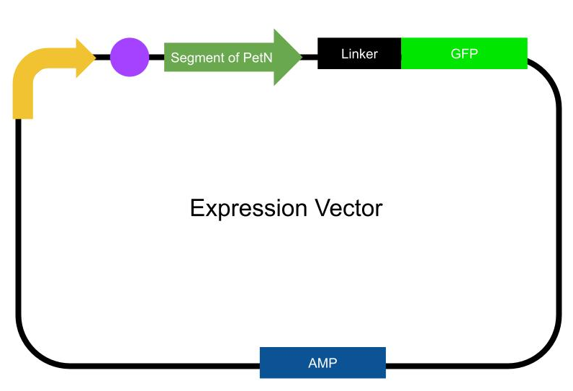
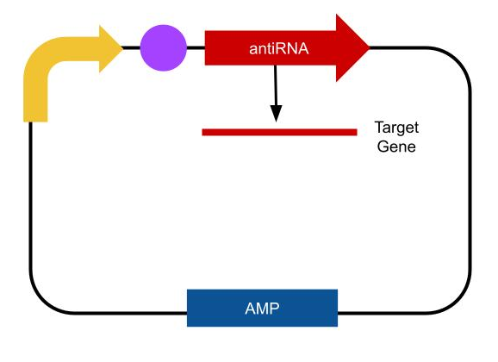
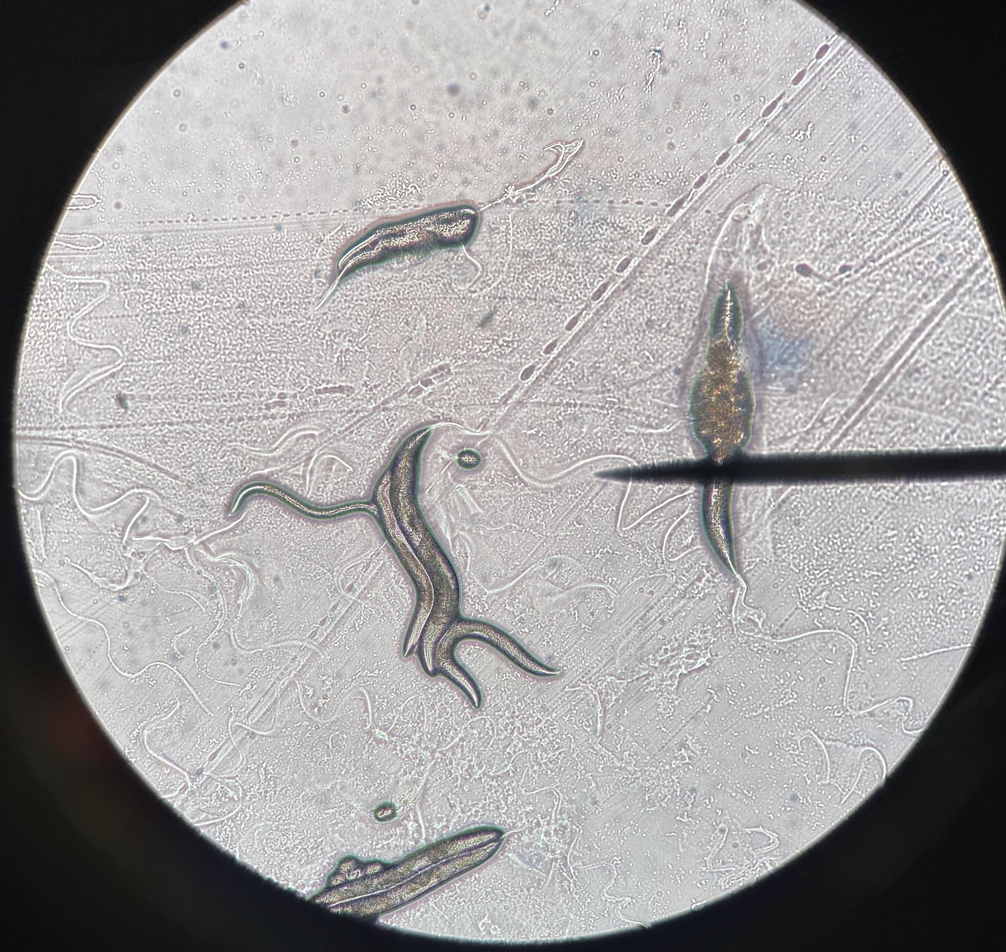

Non-Destructive Chemical Control of M. vimineum Using RNAi
Holly Gardner, Tao Groves, Sofia Lee, Kate Turman
Renaissance School
The project objective is to use RNAi technology to inhibit photosynthesis of the invasive species Japanese Stiltgrass
The target gene, petN, codes for the cytochrome b6/f complex subunit VII. This aids in electron transfer between photosystem II and photosystem I and electron flow in photosystem I.
We conducted a preliminary experiment with C. elegans, in which we introduced RNAi to the worm’s environment to stunt the growth of their offspring.
Notes:
SCRIPT HERE: https://docs.google.com/document/d/1drSAJppImg_aKctpoDS1jmenMIb2I2n0XrAugId-_3M/edit

