Slide 1

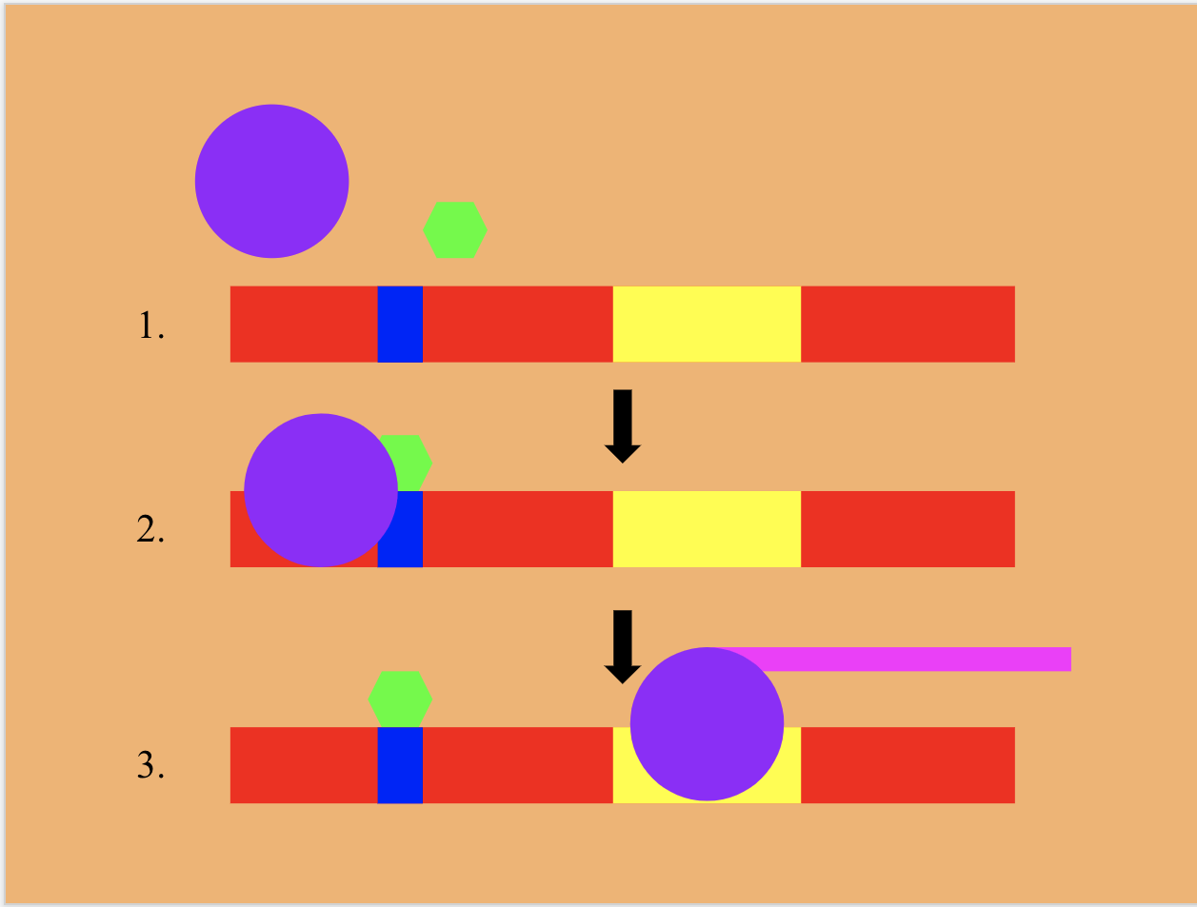
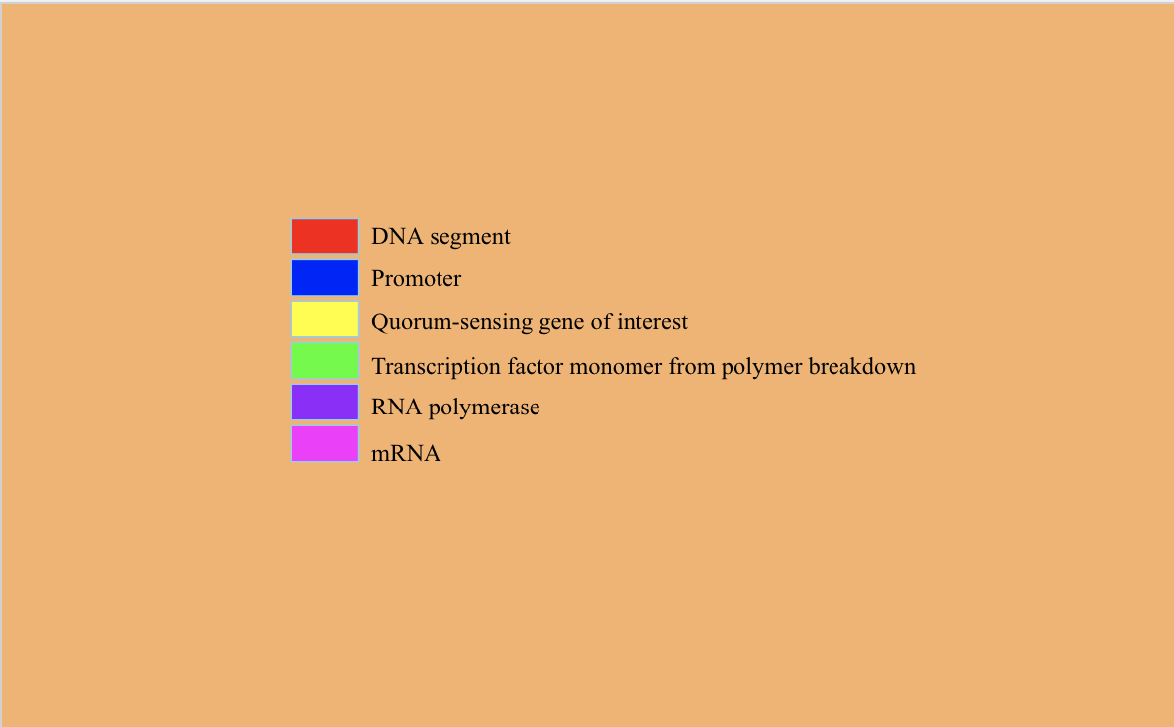

Modifying Algae to Combat Microplastic Pollution
Gabriel Crothall, Larry Huang, Aakash Jha, Chris Ji, Maria Karakousis, Tino Karakousis, Justin Liu, Yehuda Mahlab, Neel Pandula, Liam Silverberg
Julia R. Masterman, Philadelphia PA
Although there have been many solutions developed to deal with larger plastics, their counterparts microplastics, are much more difficult to address.
Our project aims to engineer ostreococcus, a a strain of filamentous algae, to absorb microplastics, efficiently retain them, and then produce luminescence to indicate that absorption of microplastics is complete. The algae would also be altered so as to prevent rapid reproduction and mitigate the formation of harmful algal blooms. Once the engineered algae has served its function and outputs its signal, the algae would be removed from the water body and the high microplastic concentration along with it.
A plasmid will be constructed using bio-blocks (pre-assembled genes/nucleotide sequences) of the following genes: BBa_E0040 (green fluorescent protein, or GFP) and BBa_J04450 (RFP). PETase and MHETase enzymes will be employed to break down polyethylene terephthalate. Said plasmid will then be inserted into the ostreococcus genome. Successful transformation and insertion of desired genes will be detected by luminescence above threshold presence of polyethylene terephthalate in the surrounding environment.

