Slide 1

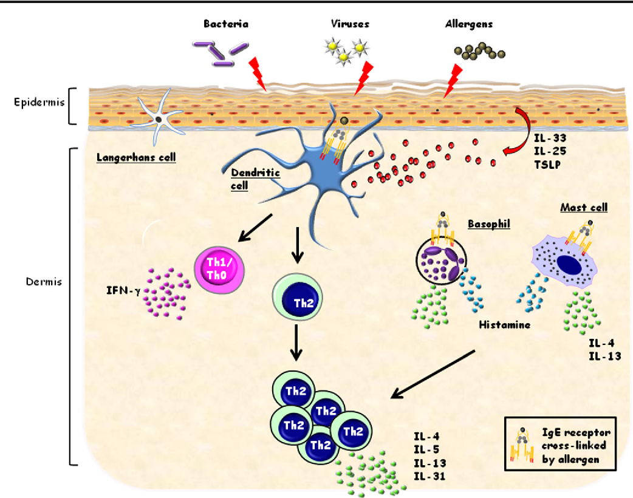
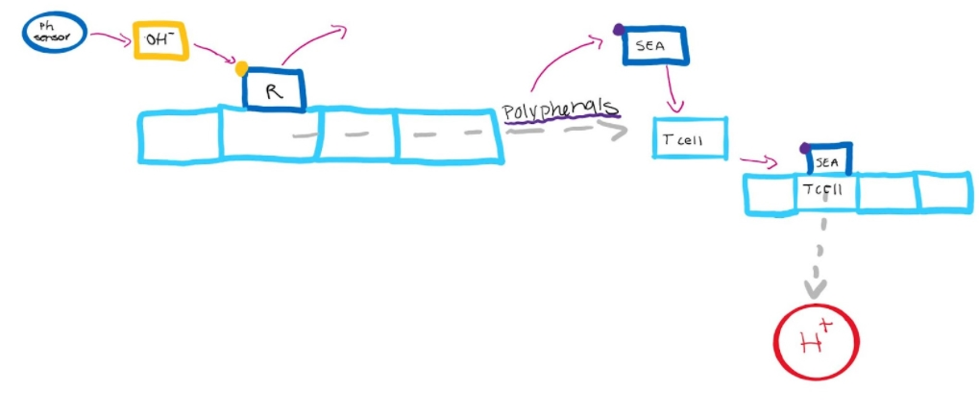

Curbing Inflammation with Phenolic Compounds
Leslie Baker, Cate Lynch, Hana Shinzawa, and Liesl-Ann Vaz
Montrose School
We created this system to reduce inflammation caused by overactivation of Th2 cells by SEAs. Reducing inflammation with phenolic compounds should also reduce its effects, namely the symptoms of eczema.
What Happens in Eczema
Our System

