Slide 1


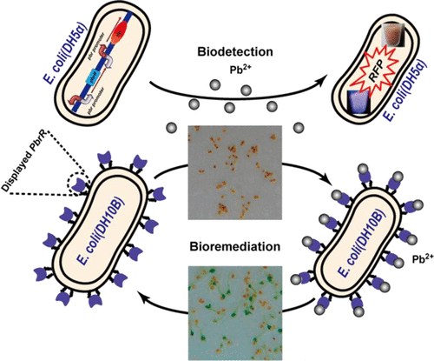
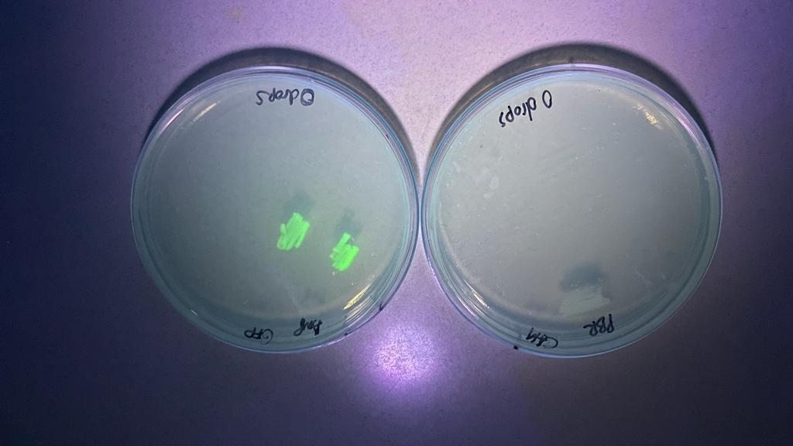
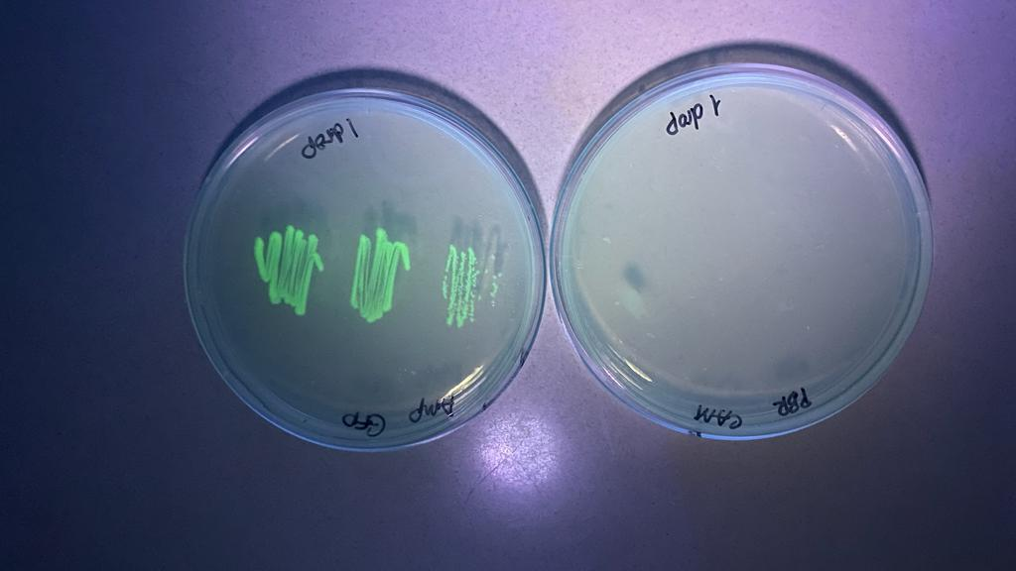
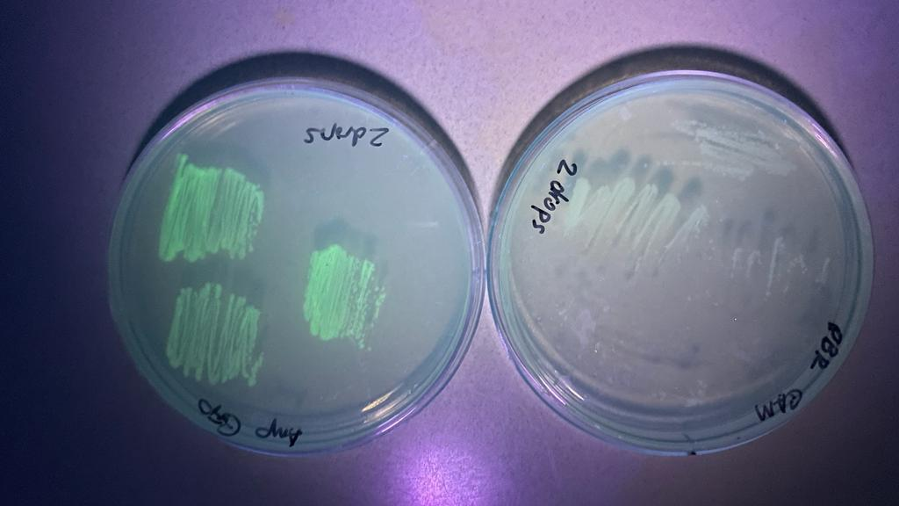
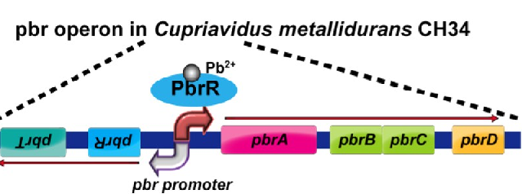
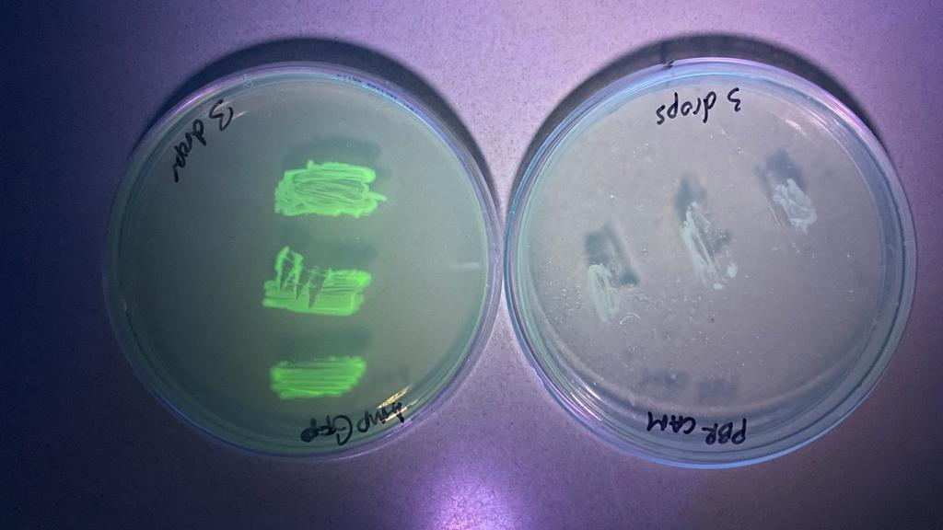
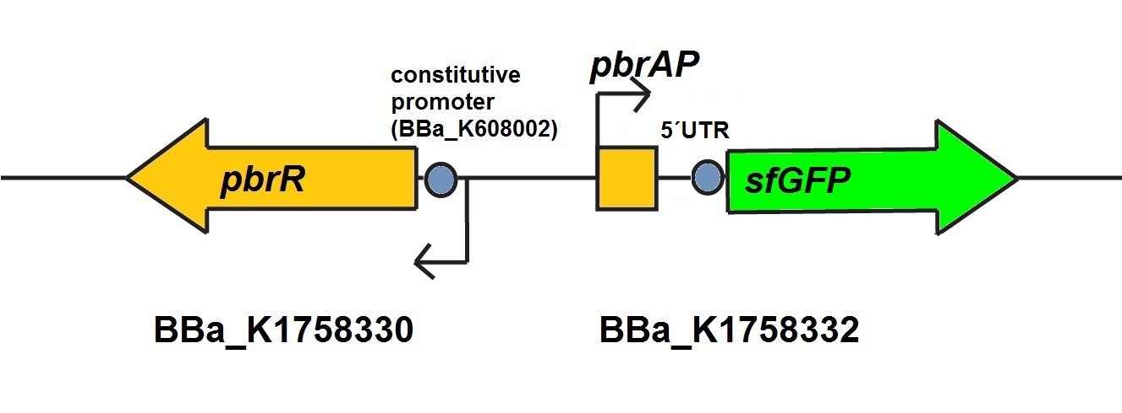

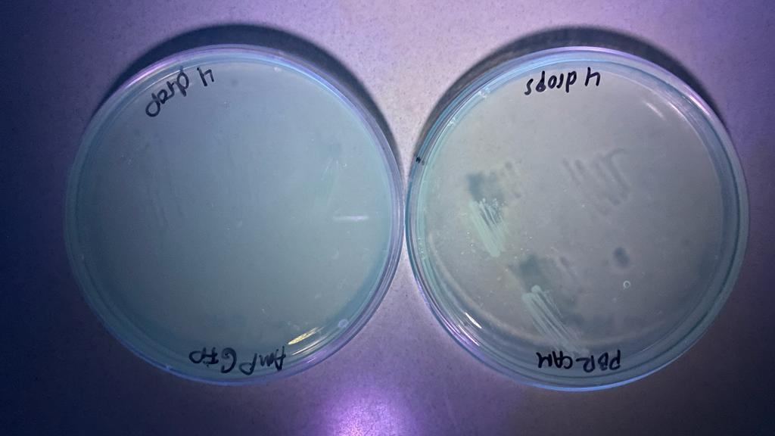
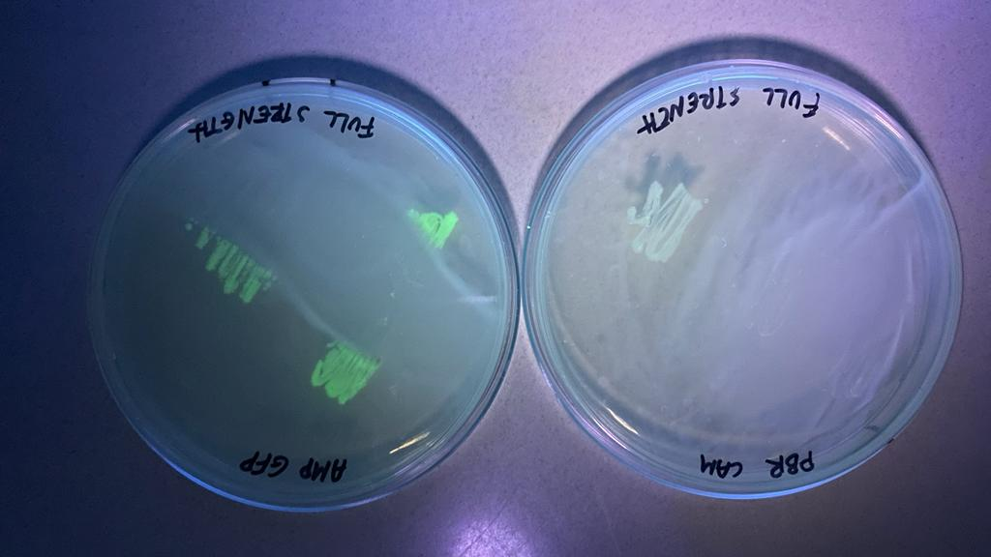
Engineering a Biological System Capable of Sensing and Removing Lead from the Environment
Students: Mamadou Barry, Keisi Goxhaj,Monica Cen, Aliou Diop, Simbala Camara.
Team leader: Alfred Lwin Mentor: Racquel Kim Sherwood PhD
School: Manhattan Comprehensive Night and Day High School, NY
Reasons for our project: Lead is one of the major contaminants in the environment and it poses major global health risks. Conventional methods to remove lead from the environment are very expensive and produce large amounts of waste. Therefore, our team is interested in a bioremediation project. We ultimately plan to engineer a biological system capable of detecting and removing lead from the environment.
Our First Objective: To design a lead responsive bioreporter capable of producing a GFP signal when it detects environmental lead.
Techniques: During the research phase of our project, we learned about the lead responsive PBR operon, encode by Cupriavidus metallidurans. Therefore, we transformed BBa-K1758333, into NEB 5⍺ competent cells. The part encodes lead specific binding protein Pbr and a GFP reporter controlled by a lead responsive promoter from C. metallidurans. Next, we incubated the transformants on LB plates supplemented with different concentration of lead nitrate.
Technical Need and Limitation: Our greatest technical limitation was the lack of BBa-K1758333 transformant colonies and an inability to adequately test if our transformants had ‘taken up’ the PBR bioreporter plasmid. Furthermore, we were unable to repeat or troubleshoot the transformation due to time constraints and lack of material.
Our Final Bioremediation Plan
Response to Lead
Bioreporter GFP Producer
Results: Unfortunately, we did not have many PBR transformants to test. Both bioreporter and Control (GFP Producer) cell patches grew in the presence of all concentrations of lead. However, the bioreporter cells did not turn green in the presence of lead. We still believe that it will be possible to fully engineer bacteria to sense and remove environmental lead and hope that future MCNDHS Biobuilders are able to overcome transformation challenges and adequately test the function of this bioreporter.

