Slide 1


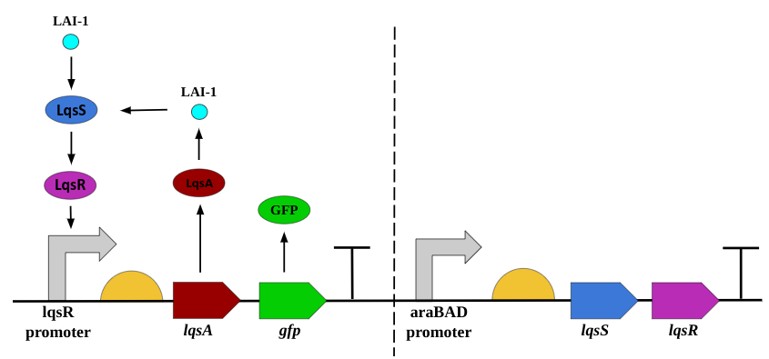
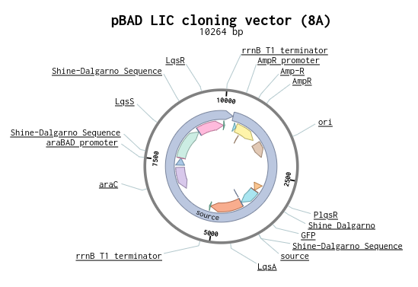
Green Stop Light
Aashi Agarwal, Sam Dillon, Aryan Mirajkar, Aprameya Tirupati, Eli Leav, Adonai Haile, Siddharth Nirgudkar, Henry Tshabalala, Madhav Kulkarni
Acton Boxborough Regional High School
  Our goal is to detect Legionella in drinking water to prevent outbreaks of Legionnaires Disease
  Genetically engineer Escherichia coli with Legionella’s quorum sensing system (LQS) to detect Legionella’s signaling molecule LAI-1 + a GFP reporting system
  Test engineered E. coli in water with varying concentrations of LAI-1 and record the expression of GFP fluorescence
Notes:
Objective: Detect and report the presence of Legionella in water using a modified E. coli
Techniques:
Used a reporter called GFP in order to visually show the presence of Legionella (green light) once detected

