Slide 1

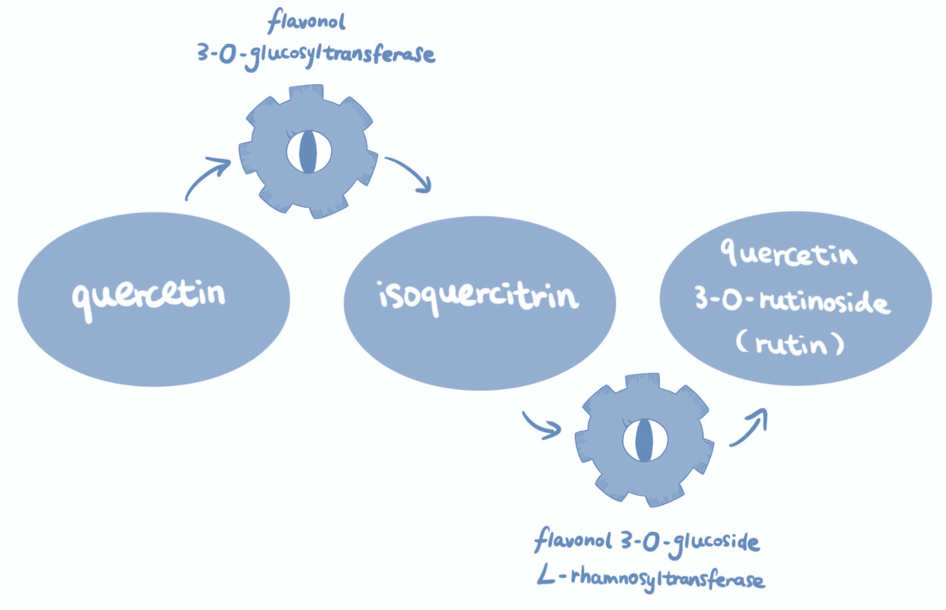
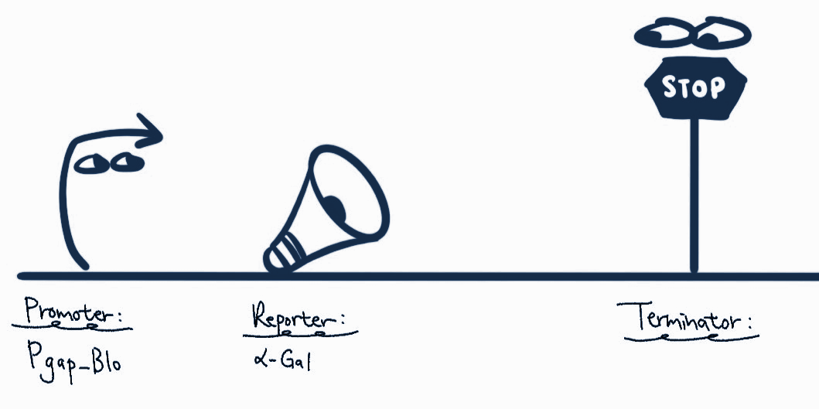
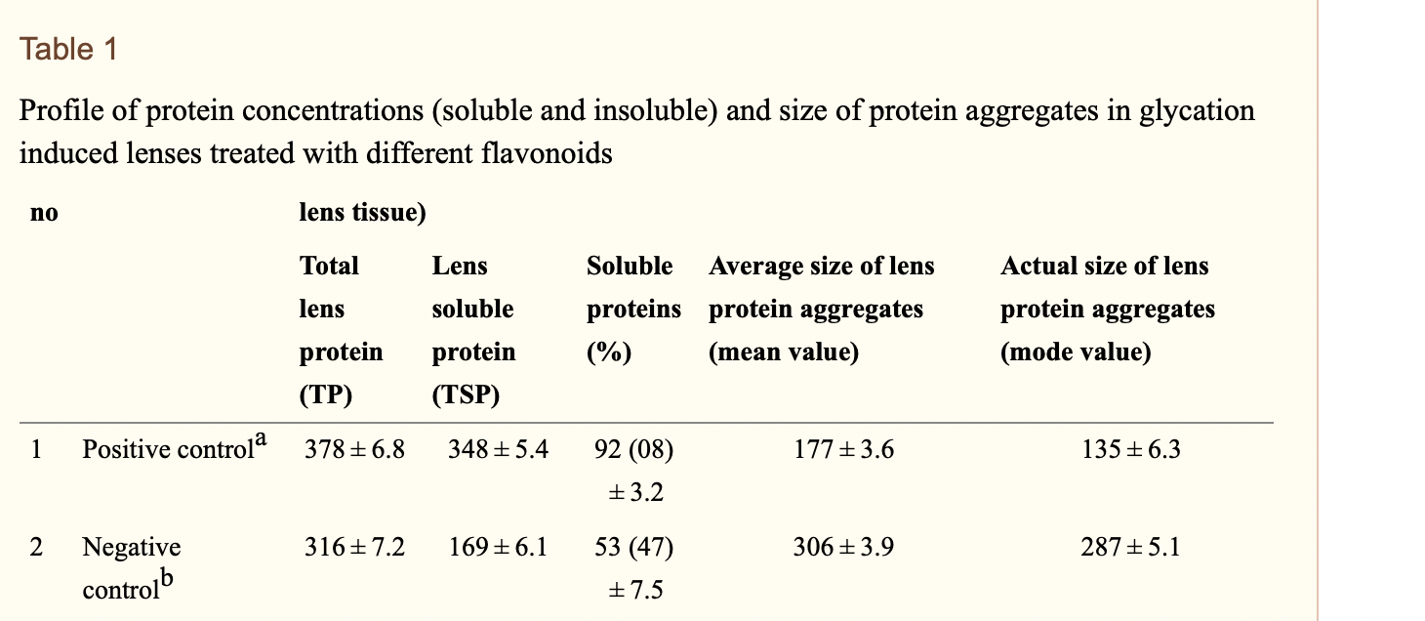

Flavenoids for Eye Health
Zoe Lai, Cynthia Li, Corinne Meng, Paris Weaver
Western Reserve Academy
Objective: Genetically engineering Bifidobacterium into a rutin factory in able to prevent oxidative stress in the eyes that leads to presbyopia.
Techniques needed: DNA extraction, Gene editing (ZFNs, TALENs, CRISPR/Cas9), PCR, lyophilization,
Fig.1. Biosynthesis pathway expressing quercetin 3-O-rutinoside (rutin) in Bifidobacterium
Fig.2. Gene expression. Promoter: Pgap_Blo; reporter: α-galactosidase (α-Gal); terminator
Fig.3. Glycation induced protein aggregation in lens treated with quercetin(74%). Glycation causes serious age-related change in lens proteins and leads to aggregation and crosslinking amongst lens crystallin molecules that leads to presbyopia (Patil et al., 2019).
Patil, K. K., Meshram, R. J., Barage, S. H., & Gacche, R. N. (2019, February). Dietary flavonoids inhibit the glycation of lens proteins: Implications in the management of Diabetic Cataract. 3 Biotech. Retrieved February 24, 2022, from https://www.ncbi.nlm.nih.gov/pmc/articles/PMC6346605/

