Slide 1

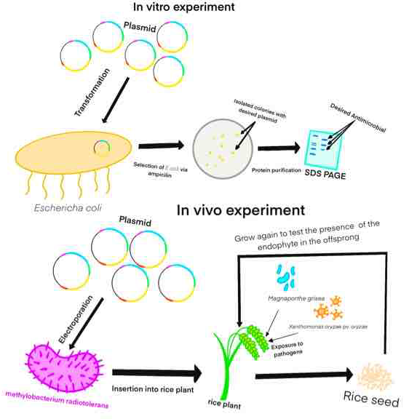
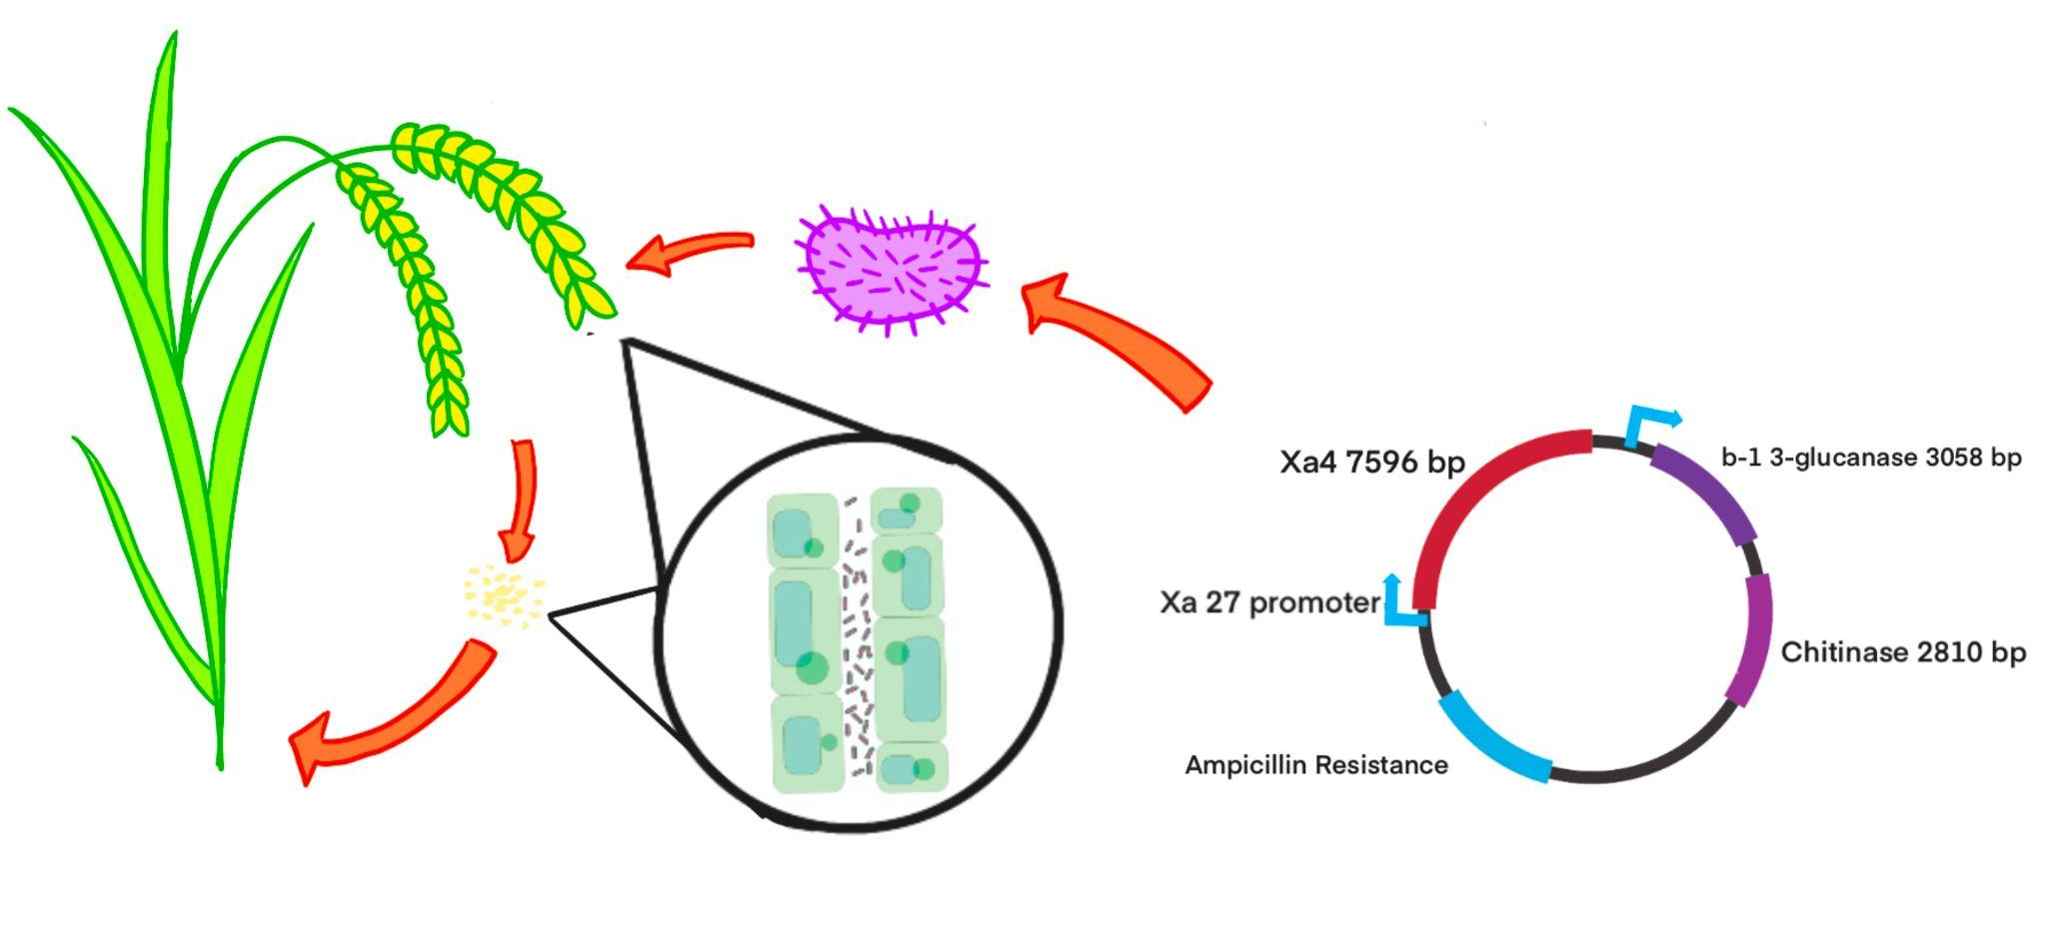

Endofight
Our project proposes the insertion of a plasmid that contains antibacterial gene XA4, as well as two genes which encode antifungal protein chitinase and b-3 1-glucanase, into an vertically transformed endophyte named Methylobacterium radiotolerans. M. radiotolerans is a symbiotic bacteria that dwells in all parts of rice plant and transfers from parents to offspring via seed. XA4 enhances rigidness of plant cell walls, enabling the resistance towards rice blight bacteria Xanthomonas oryzae pv. oryzae, whereas chitinase and b-3 1-glucanase hydrolyzes cell walls of pathogenic fungi such as rice blast fungus Magnaporthe grisea. Through inserting M. radiotolerans after transforming the plasmid into it, the endophyte would provide immunity for a strain of rice towards the specific pathogen.
Our project will use transformation of plasmid into methylobacterium via electroporation, and SDS PAGE which is electrophoresis for protein, and protein purification to separate the desired protein that is transcripted from inserted gene into RNA and translated into antibacterials.
James Gong, Maximus Keller, Hank Wang
Western Reserve Academy

