Slide 1
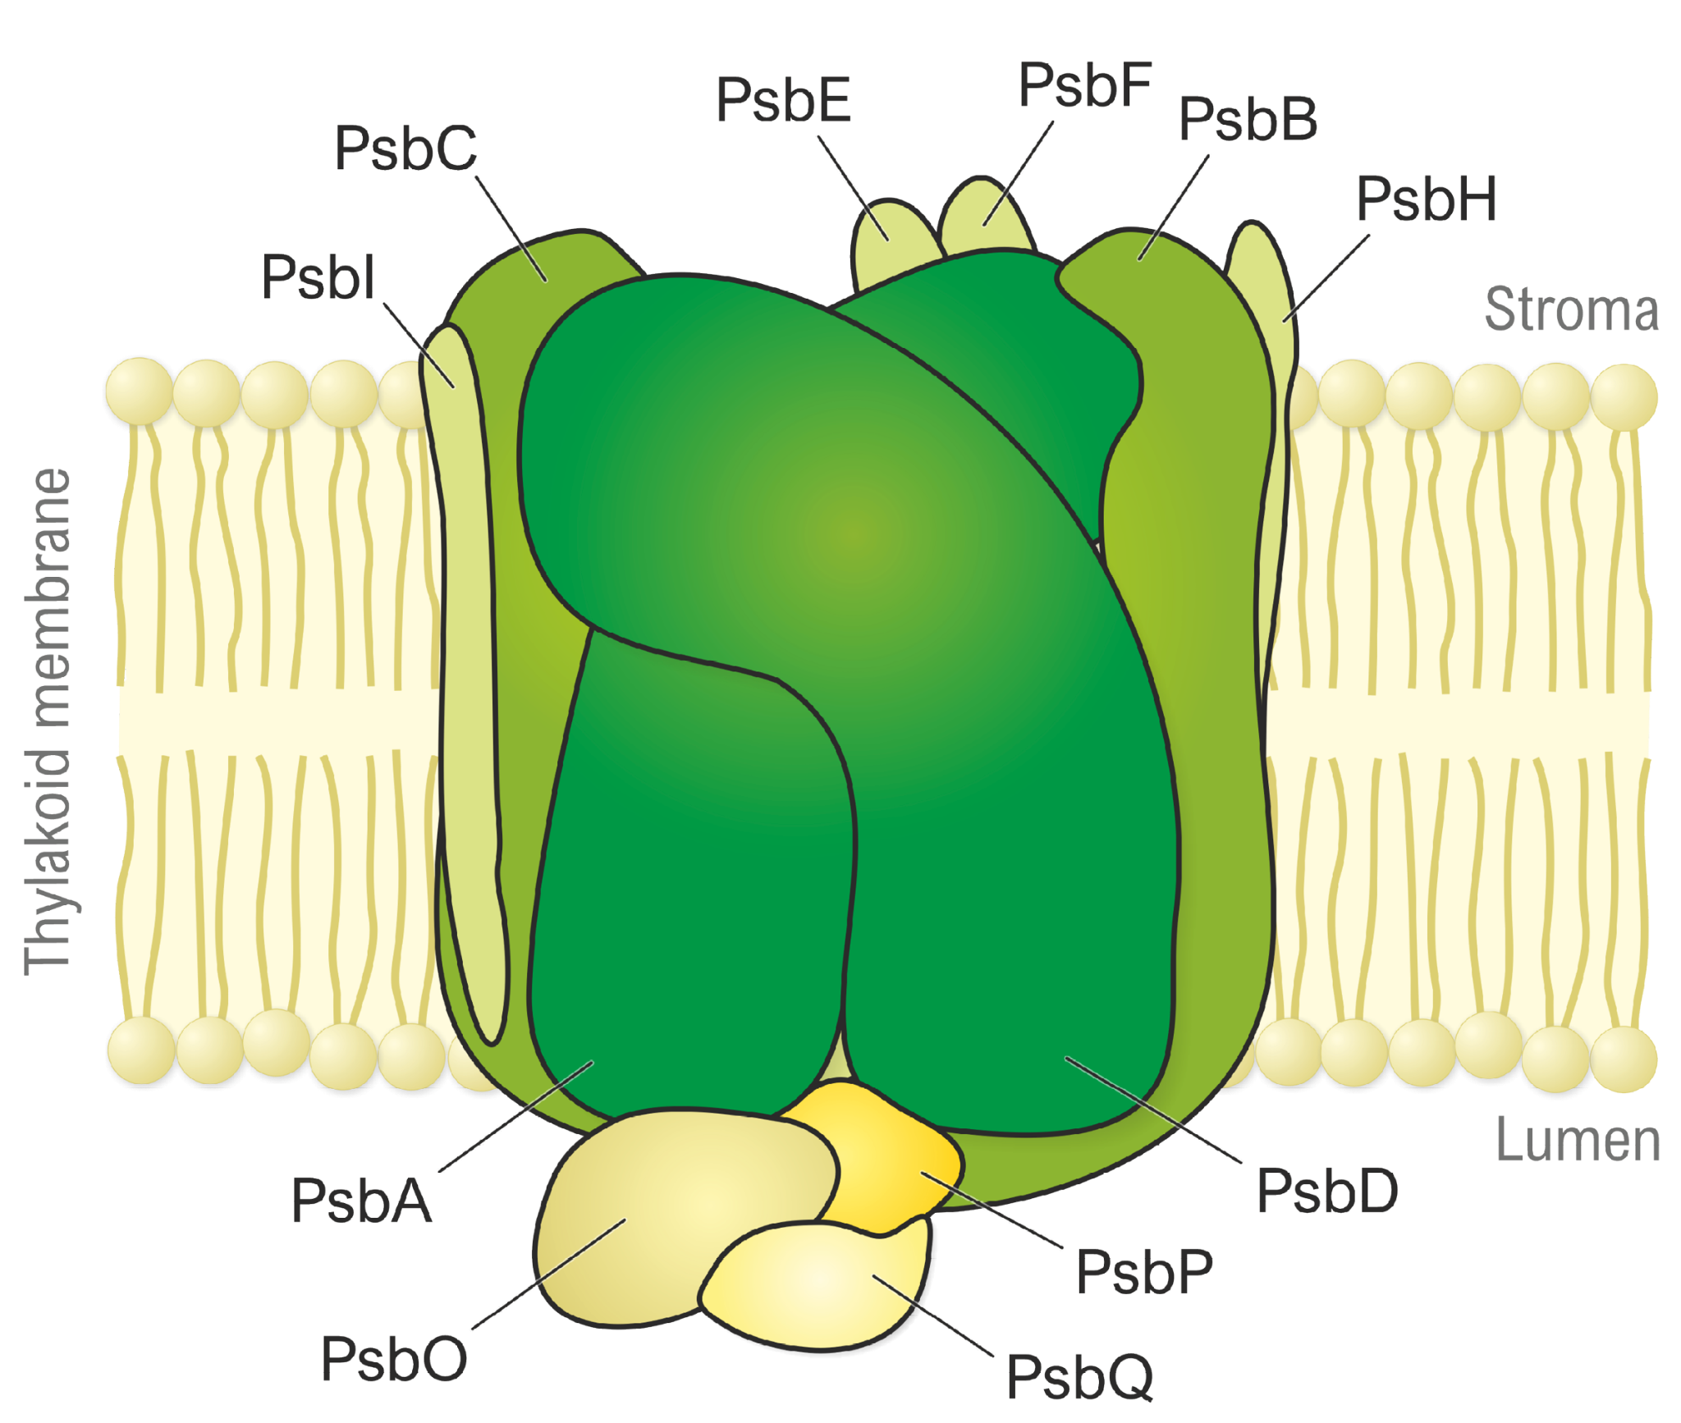

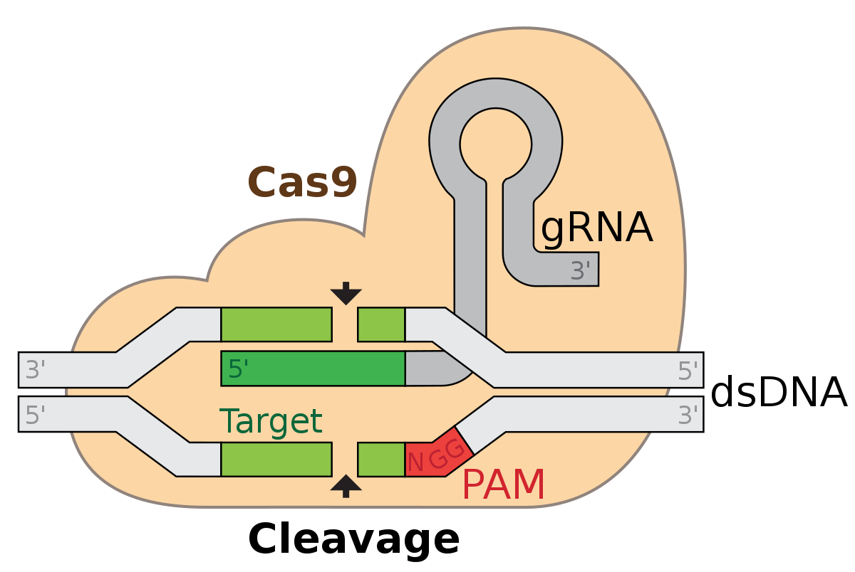
Never Soy Never: Reducing Water Usage in Farmed Glycine Max
Seowon Park, Ellie Wu, Alex Vertikov, Ethan Lee, Nina Pappas, Sanaa Devgan, Nicole Lu, Divya Siddi, Jeffrey Pan, Dr. Emily Miller, Mr. Shawn Mullins, Hyejin Oh (UCB)
Westwood High School, Westwood, MA, USA
Figure 1
Figure 1
We plan to alter regulatory genes via CRISPR/Cas9 to increase expression of the Photosystem II Subunit S (PsbS)
Will lead to increased signals for closed stomata, decreasing water lost to transpiration
Tentative Experiment Plan:
Collect data on water intake of the edited plant under normal light/Co₂ conditions
Test Viability: Ensure reasonable level of productivity. Plant plant should also be intaking enough Co₂ to ensure adequate photosynthetic activity.
Figure 2
Figure 1: “PSII-Proteins.” Antibodies to Photosystem II Proteins, https://www.agrisera.com/dokument/bibliotek/Image/PSII-proteins.png.
Figure 2: “CRISPR-Cas9.” Wikimedia Commons, https://en.wikipedia.org/wiki/CRISPR_gene_editing#/media/File:GRNA-Cas9.svg

Slide 2
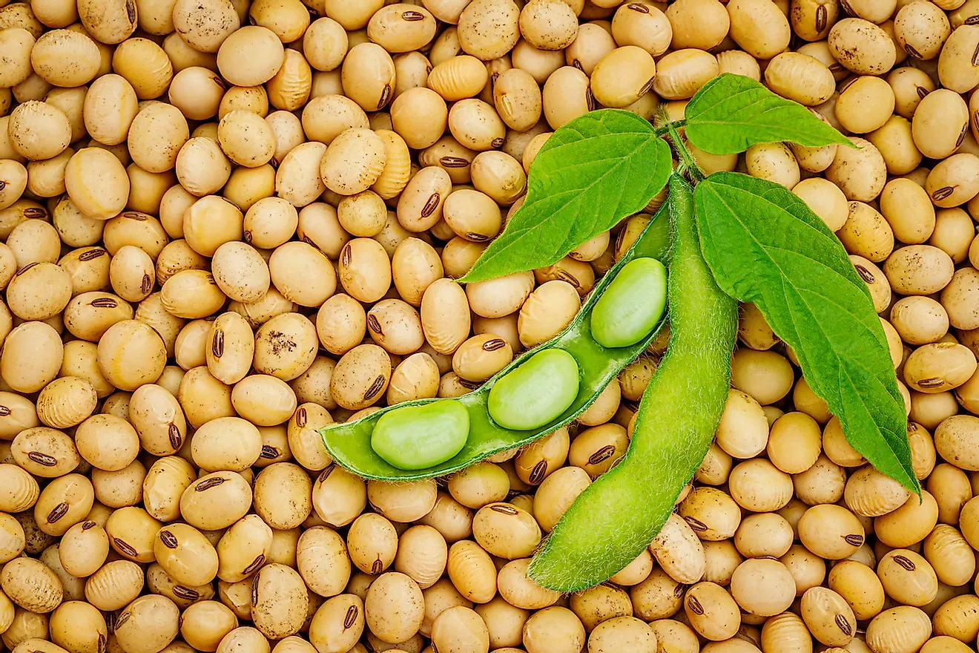
Background & Objectives
Background:
Soybeans require a substantial amount of water
Around 256 tons of water are needed for 1 pound of soybean plants
The U.S. produces around 73 million tons of soybean in a year
Drains critical water supplies as climate change accelerates watershed variability
Project Objective:
Decrease the amount of water consumption in the growing process soybean plant by decreasing the period of stomatal opening (increase frequency of closed stomata)
Futterman, Allison. “5 Interesting Things about Soy.” Discover Magazine, Discover Magazine, 4 Apr. 2022, https://www.discovermagazine.com/planet-earth/5-interesting-things-about-soy.
Notes:
Image taken from: https://www.worldatlas.com/articles/largest-soybean-producing-countries.html

Slide 3
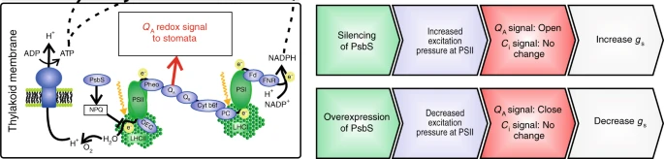
Approach
Overexpression of PsbS lead to a change in Q_{a} (light signal) that leads to closed stomata.
C_{i}=open/close signal in response to CO₂ levels
Q_{a} = open/close signal in response to light levels
g_{s}=stomatal conductance
Figure 3
Use CRISPR/Cas9 to demethylate PsbS promoters or introduce CRISPR-based Artificial Transcription factors
Both could increase transcription of PsbS gene and thus expression of Photosystem II subunit S protein
Increased expression of PsbS →less stomatal opening in response to light due to changed Quinone A (Q_{a} ) signal
References:
https://www.nature.com/articles/s41467-018-03231-x
https://www.ncbi.nlm.nih.gov/gene/100305885
https://www.ncbi.nlm.nih.gov/pmc/articles/PMC4714440/
https://www.ncbi.nlm.nih.gov/pmc/articles/PMC4528160/
https://pubmed.ncbi.nlm.nih.gov/29133124/
https://www.nature.com/articles/s41598-019-48130-3
https://www.ncbi.nlm.nih.gov/pmc/articles/PMC7580621/
Figure 3: Głowacka, K., Kromdijk, J., Kucera, K. et al. Photosystem II Subunit S overexpression increases the efficiency of water use in a field-grown crop. Nat Commun 9, 868 (2018). https://doi.org/10.1038/s41467-018-03231-x.
Notes:
Voice Recording:
decrease water consumption but also co2 which is essential for the photosynthesis process
http://biobuilderclub-library.org/
https://www.youtube.com/watch?v=iI5Iw2x4JYQ
https://www.agrisera.com/dokument/bibliotek/Image/PSII-proteins.png
https://www.nature.com/articles/s41467-018-03231-x

Slide 4
Drawbacks and Future Plans
Current Limitations:
This process should result in lower time for transfer of molecules in/out of the plant, potentially impacting ability to take in vital CO₂ for use in Photosynthesis
Could plausibly impact the transcription of other genes or have unintended effects of overproduction of PsbS protein
Unsure of the best method to increase expression of the protein (how exactly to use CRISPR for higher gene expression)
Next Steps:
Determine the most effective method of altering soybean genome to permanently increase PsbS expression
Conduct the actual gene editing to ensure that water intake is actually reduced under normal conditions and that the soybean’s productivity is not impacted
Study the effect of changing photosystem subunit expression on other plants, especially key agricultural crops

